Slide 1
Where Do I Begin? How Cities Can Address Cybersecurity Risks Starting Today!
Dave Mims | VC3 | IT in a Box
HANDOUTS & PRESENTATONS ARE AVAILABLE THROUGH THE EVENT APP
AND AT WWW.IOWALEAGUE.ORG

Slide 2
Anatomy of a Cyberattack
Notes:
https://www.youtube.com/watch?v=668mc-_kJBM

Slide 3
Cities That Didn’t Stay Out of the Headlines
Leonardtown, Maryland (July 8, 2021): “‘Shut down everything’: Global ransomware attack takes a small Maryland town offline” (Source: The Washington Post)
Texarkana, Texas (June 24, 2021): “Texarkana rebounding from ransomware attack that crippled municipal computers” (Source: KLSA News)
Whistler, British Columbia (April 29, 2021): “Whistler resort municipality hit by new ransomware operation” (Source: Bleeping Computer)
Covington, Louisiana (March 17, 2021): “Cyberattack on Covington's municipal computer system raises questions, concerns” (Source: NOLA.com)
Oldsmar, Florida (February 8, 2021): “‘Dangerous Stuff’: Hackers Tried to Poison Water Supply of Florida Town” (Source: New York Times)
Jersey City, New Jersey (January 14, 2021): “New Jersey City Utility Struggling With Costly Cyberattack” (Source: Government Technology)

Slide 4
It Could Happen to You
95% of all successful attacks over the past two years started in email.

Slide 5
Evolving Threats
Access to user credentials continues to increase. With so many ways to steal user credentials, the risk of a breach continues to increase.
Hackers continue to exploit software vulnerabilities and outdated operating systems through zero day vulnerabilities, support of sophisticated nation states, and going after soft targets.
Cyber threat detection has become a bigger issue. Once inside your systems, hackers often remain undetected for many, many months.

Slide 6
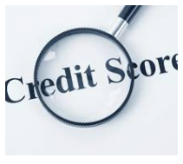
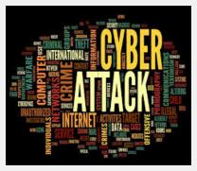
Cybersecurity Risk Impacts Municipal Finances
The Big 3 credit rating agencies (S&P, Moody’s, Fitch) consider cybersecurity when determining your bond rate. In other words, cybersecurity impacts your borrowing and financing.
Insurance institutions consider cybersecurity when determining your premiums.
State and federal agencies consider cybersecurity when giving you access to criminal information systems.

Slide 7
Who remembers the story of Achilles?

Slide 8
It just takes ONE…
ONE unprotected / unmanaged computer to let in a cybercriminal.
ONE unsuspecting employee to let the cybercriminal in past your best cyber defenses.
ONE critical best practice overlooked (such as regularly testing your data backups) to lose your data to ransomware.

Slide 9
For those hit with ransomware…
“Paying ransom will not ensure your data is decrypted or that your systems or data will no longer be compromised. CISA, MS-ISAC, and federal law enforcement do not recommend paying ransom.” (Cybersecurity and Infrastructure Security Agency)
92% of impacted organizations don’t get all their data back.
29% of impacted organizations cannot get more than half their data back.
Of those organizations that pay a ransom, 80% get hit again.
Notes:
https://www.forbes.com/sites/daveywinder/2021/05/02/ransomware-reality-shock-92-who-pay-dont-get-their-data-back/?sh=195f1878e0c7
https://www.cybereason.com/hubfs/dam/collateral/ebooks/Cybereason_Ransomware_Research_2021.pdf

Slide 10
Your biggest risks! – The 3Ps
Passwords
Patching
People

Slide 11
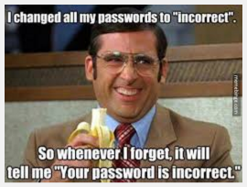
Big Risk: Poor Passwords
A study from a research company in California found:
1 out of 3 people had their passwords written down somewhere around their desk.
Many used obvious passwords (child’s name, pet name, college mascot, birthdate, etc.).
Overall, researchers figured out the passwords of half the people in the study!
Half of all security breaches involve stolen or easily guessable passwords!

Slide 12
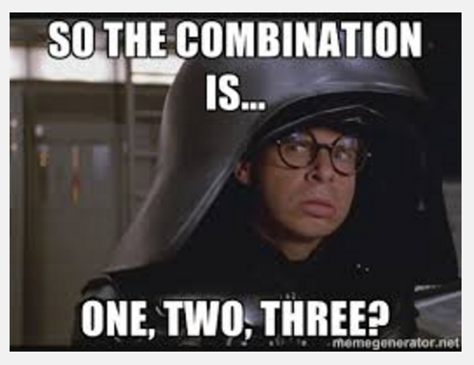
Big Risk: Poor Passwords
NordPass’s annual worst passwords list, compiled from millions of leaked passwords during the year, shows people continue to put themselves at risk. The top 25 worst passwords are:
Remember, hackers are using automated software to look for security holes. That automated software attempts to use common and weak passwords that are easy to crack.
1. 123456 | 2. 123456789 | 3. picture1 | 4. password | 5. 12345678
6. 111111 | 7. 123123 | 8. 12345 | 9. 1234567890 | 10. senha
11. 1234567 | 12. qwerty | 13. abc123 | 14. Million2 | 15. 000000
16. 1234 | 17. iloveyou | 18. aaron431 | 19. password1 | 20. qqww1122
21. 123 | 22. omgpop | 23. 123321 | 24. 654321 | 25. qwertyuiop

Slide 13
Your biggest risks! – The 3Ps
Passwords
Patching
People

Slide 14
Big Risk: Failing to Patch
Government particularly lags on replacing outdated software and patching current software. It’s not unusual to see cities using software that is 10 (or more) years old and hasn’t been supported by the software vendor for a long time.
Local government often avoids patching because:
Fear of breaking old, obsolete hardware and software.
Interruptions to employee work.
Applying patches manually takes up time.
There are too many patches.
City leadership does not understand and/or prioritize patching.

Slide 15
Big Risk: Failing to Patch
By not regularly applying patches, you are choosing to leave security holes open for hackers to exploit.
While patching can challenge cities, they can more aggressively stay on top of this important activity by:
Working with experienced IT engineers who understand the patch management process.
Building a proactive patching plan that alleviates operational hassles such as employee interruptions and manual staff time.
Modernizing technology so that patching is easier and reduces the risk of “breaking” any applications.

Slide 16
Your biggest risks! – The 3Ps
Passwords
Patching
People

Slide 17
Big Risk: Untrained People
Who receives an email with ransomware?
Who clicks on a malicious website link?
Who opens a malicious file attachment?
How does ransomware get into your city network?
People You, your staff, or some other user on your network.

Slide 18
Can you spot phishing?
Notes:
https://phishingquiz.withgoogle.com/

Slide 19
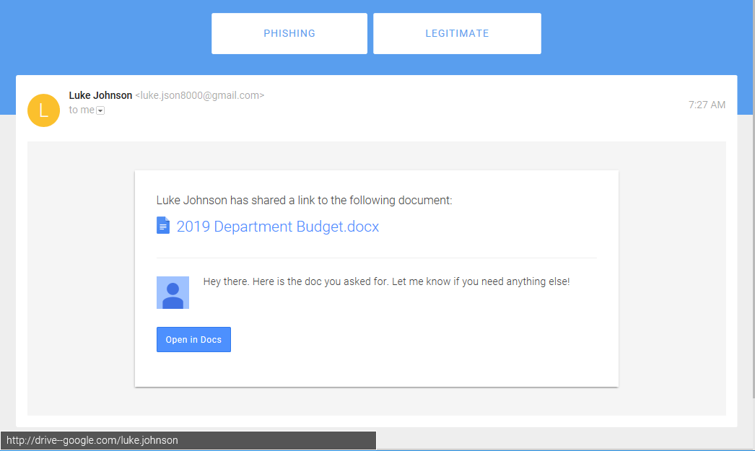
Can you spot phishing?

Slide 20
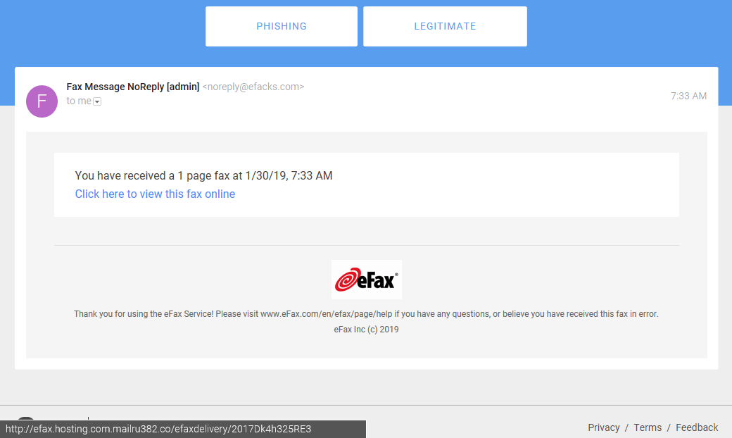
Can you spot phishing?

Slide 21
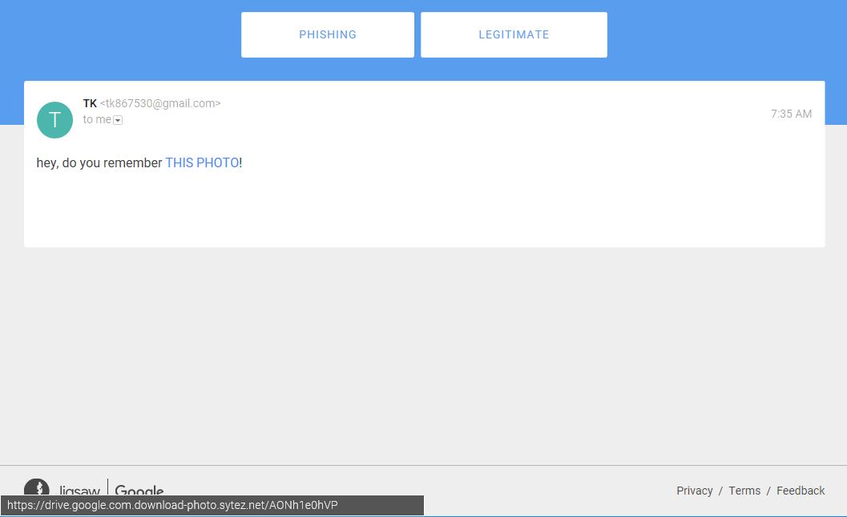
Can you spot phishing?

Slide 22
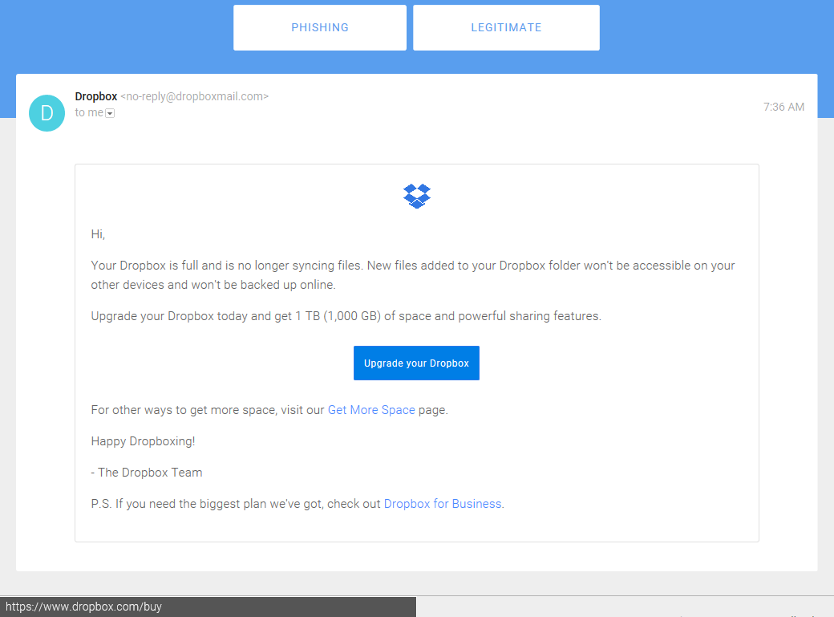
Can you spot phishing?

Slide 23
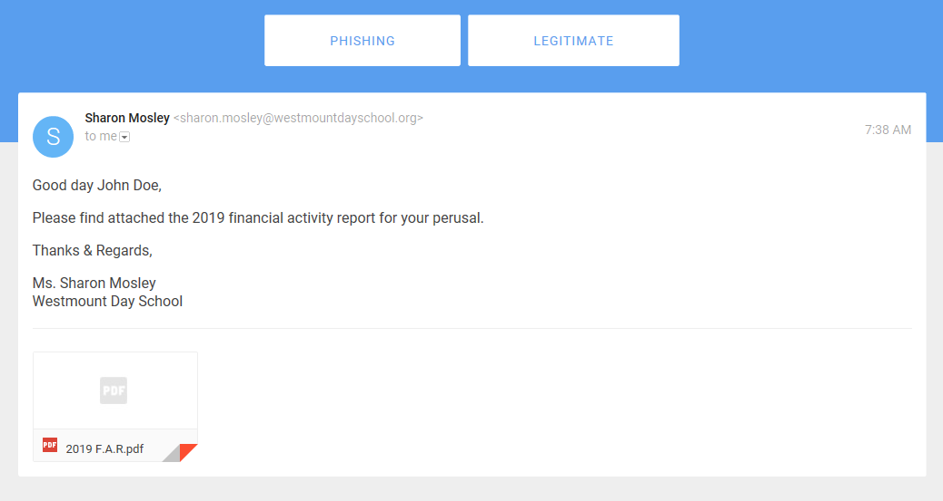
Can you spot phishing?

Slide 24
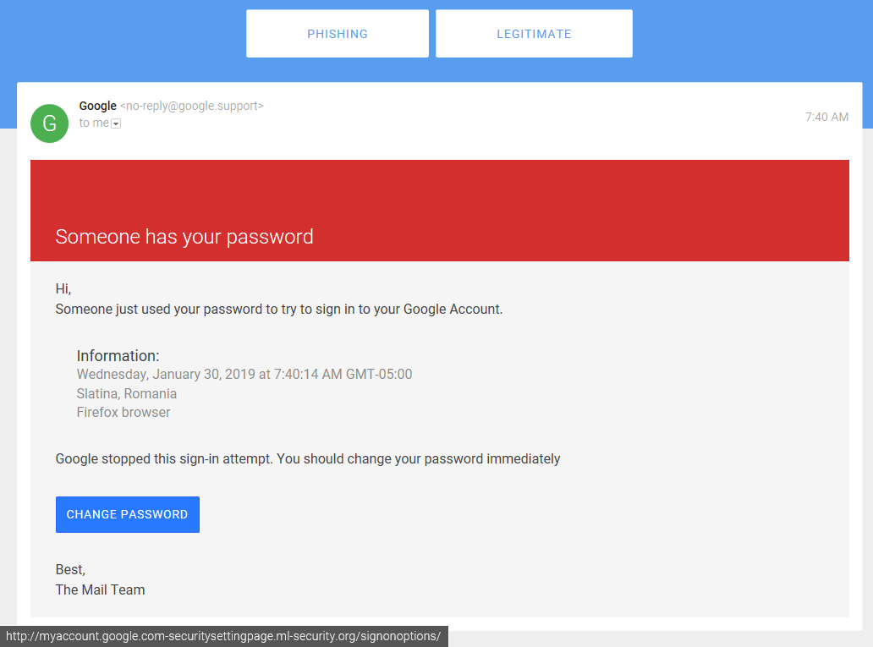
Can you spot phishing?

Slide 25
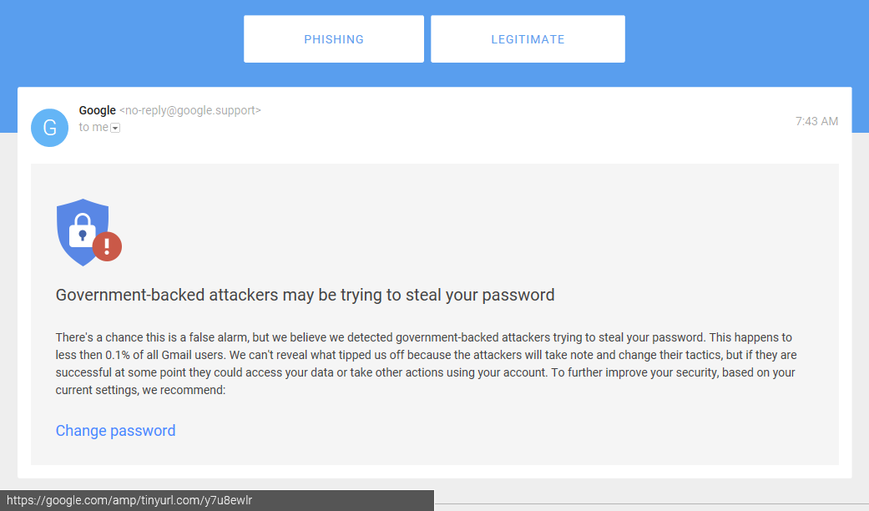
Can you spot phishing?

Slide 26
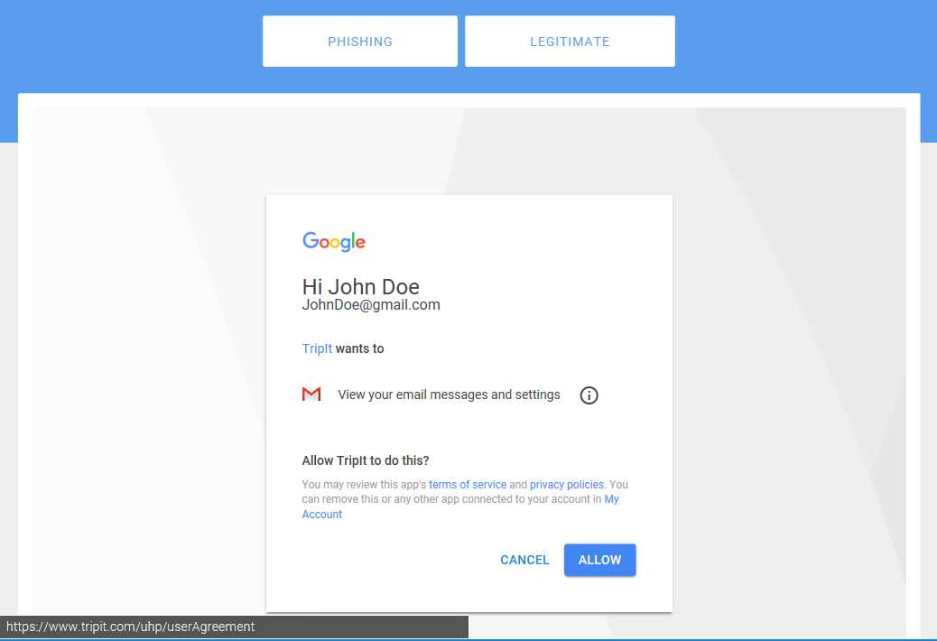
Can you spot phishing?

Slide 27
Phishing takes its gloves off…
Bad actors aren’t only sending out automated phishing emails like we just worked through. More sophisticated techniques include:
Spear phishing and whaling: These two terms pretty much mean the same thing—a hacker goes after a specific city employee with a great deal of thought and effort. The stakes are usually higher here. For example, the hacker may try getting you to transfer a lot of money.
Vishing: Refers to phishing over the phone. Hackers may do something like pretend they’re a legitimate caller who needs a username and password over the phone. If you hand that information over, the hacker may then use that information to hack you online.
“Personalized” blackmail: In-your-face, threatening blackmailing emails play upon fear and a person’s lack of technical knowledge. A real example: “While you were viewing video clips, your internet browser started out functioning as a Remote Desktop that has a keylogger which provided me accessibility to your display screen as well as web cam.” These emails are not personalized blackmail threats toward you. They are automated messages sent by machines, with hackers hoping that the general messaging hits a nerve with a small segment of the users it targets.

Slide 28
3Ps: Who is the biggest risk?

Slide 29
What do we do?

Slide 30
Fundamentals
Three fundamental areas to absolutely get right!
The Wall
The People
The Escape

Slide 31
Fundamental: The Wall
Policies, Technology, and Professionals

Slide 32
Fundamental: The Wall
Policies, Technology, and Professionals
Policies: Set policies around passwords, computer usage, internet usage, access, and other important areas.

Slide 33
Passwords
Use a password on all devices – including tablets and phones.
Use passphrases (preferred) or complex passwords.
Use two-factor authentication (2FA or MFA).
Do not write passwords down and leave them visible.
Do not use obvious passwords. Change your password today if it’s in the top 25!!!
Do not use the same password for all systems you access.
Consider using a reputable password manager.

Slide 34
Fundamental: The Wall
Policies, Technology, and Professionals
Policies: Set policies around passwords, computer usage, internet usage, access, and other important areas.
Technology: Monitoring and alerting, patch management, modern/supported hardware, modern/supported operating system, modern/supported applications, endpoint detection and response (EDR), antivirus, antispam, email, etc.

Slide 35
Fundamental: The Wall
Policies, Technology, and Professionals
Policies: Set policies around passwords, computer usage, internet usage, access, and other important areas.
Technology: Monitoring and alerting, patch management, modern/supported hardware, modern/supported operating system, modern/supported applications, endpoint detection and response (EDR), antivirus, antispam, email, etc.
Professionals: Work with people who know what they are doing when setting up, configuring, upgrading, monitoring, managing, and supporting technology.

Slide 36
Fundamentals
Three fundamental areas to absolutely get right!
The Wall
The People
The Escape

Slide 37
Fundamental: The People
Training, Training, and Training
Remember:
Who gets the email?
Who clicks the link?
Who opens the attachment?
Who has access to your systems?
In hindsight, you might say, “How could they let that happen? How could they not see the danger or know better?”
Have you trained them?

Slide 38
Fundamental: The People
Today, training employees about cybersecurity is more important than ever.
Cities are targets for hackers and criminals who use ransomware, malware, viruses, and other cyberattack tools to harm city operations, networks, and data.
Hackers use techniques that trick employees into handing over access to your systems—and criminals know that people can be the weakest link in your security.

Slide 39
Fundamental: The People
Today, training employees about cybersecurity is more important than ever.
Cities are targets for hackers and criminals who use ransomware, malware, viruses, and other cyberattack tools to harm city operations, networks, and data.
Hackers use techniques that trick employees into handing over access to your systems—and criminals know that people can be the weakest link in your security.
Train them about…
Spotting email scams (phishing, spear phishing, whaling)
Spotting phone scams (vishing, smishing)
Spotting in-person scams (people following employees inside)
Simulated phishing attacks work really well!

Slide 40
Fundamentals
Three fundamental areas to absolutely get right!
The Wall
The People
The Escape

Slide 41
Fundamental: The Escape
Data Backup and Disaster Recovery
When the Wall is breached and people let the bad guys right in, know you can recover!

Slide 42
Fundamental: The Escape
Data Backup and Disaster Recovery
Address time to recovery after smaller incidents through onsite data backup.
Plan for worst-case scenarios through offsite data backup.
Monitor your data backup in real-time.
Test your data backups regularly.
Your data backup is ultimately your escape plan (think of it like additional low-cost insurance) if the worst happens.
Have it. Manage it. Test it. -- Know it will work!

Slide 43
REMEMBER: It just takes ONE…
ONE unprotected / unmanaged computer to let in a cybercriminal.
ONE unsuspecting employee to let the cybercriminal in past your best cyber defenses.
ONE critical best practice overlooked (such as regularly testing your data backups) to lose your data to ransomware.
Don’t join that list of cities on the front-page news!

Slide 44
Iowa League’s IT in a Box

Slide 45
Questions?
Dave Mims | VC3 | IT in a Box dave.mims@vc3.com 800-787-1160
Visit us on the web at VC3.com

