Slide 1
The Ten Habits of Highly Effective City Councils
Iowa League of Cities Annual Conference
Coralville, IA September 17, 2021
Patrick Callahan, Municipal Consultant
Callahan Municipal Consultants, LLC

Slide 2
Reason for this topic
After 47 years in City Government – 23 years as city manager and 24 years as a municipal consultant…
Why are some cities so successful?
Why do some cities struggle and fight?
Observation of “cycles of success and failure” in cities

Slide 3
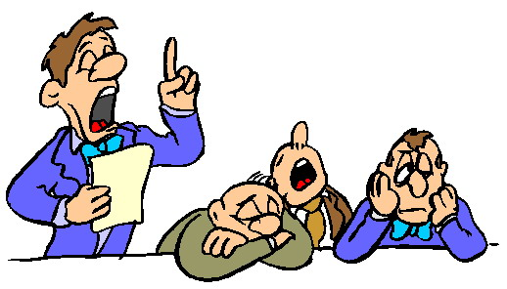
Disclaimer and Comments
Not every successful city adopts all ten habits
Cities that struggle may follow some of these habits
General rule….Adopt these habits and the probability of success will increase
Added bonus – Your job may be more enjoyable

Slide 4
General Overview of Session
Review Ten Habits – 5 minutes each
Offer your suggestions – Name your city
Ask your questions
Send us your examples or model documents

Slide 5
1. Start with the Basics
Brief and concise mission statement
Develop a vision statement for the City’s future
Develop long range goals and objectives
New Council Member’s Orientation
Mission Statement
Vision Statement
Goals and objectives

Slide 6
2. Understand the Elements of Teamwork
Council – Collection of diverse people
Only Power – Act as one entity
Working together to accomplish a specific purpose
Key – trust, openness and mutual respect

Slide 7
3. Master small group decision making
Ability to work with others
Knowledge to do the job
Ability to deal with issues rationally
Remember the “dignity of the office.”

Slide 8
4. Clearly define roles and relationships
Mayor, Council, and Staff roles
Know the functions – specific responsibilities
Expected performance – behavior of the person in the role
City Council Code of Conduct

Slide 9
5. Establish and Abide by a Good Council – Staff Partnership
Council – establish the vision, goals, policies and empowerment
Council – define the needs to be met and outcomes to be achieved
Staff – carryout directives, complete the tasks, and provide feedback
Key – trust, communication, and evaluation

Slide 10
6. Systematic Evaluation of Policy Implementation
Periodic feedback on policy results
Reports, staff memos, and newsletters
Policy amendments as needed
Work sessions to review results

Slide 11
7. Allocate Council time and energy appropriately
Goal setting – annual retreats
Study or work sessions – analysis of issues
Community relations – interaction with citizens and agencies
Prepare a capital improvements plan (CIP)

Slide 12
8. Set clear rules and procedure of council meetings
Conduct effective and productive meetings
Adopt rules and procedure
Conduct business – orderly, discipline and productive manner
Avoid political partisanship
Meetings are the city council’s “image to the world”

Slide 13
9. Seek assessment of public concerns and evaluations of performance
Seed feedback – surveys, questionnaires, public hearings, etc.
Information on City website
Use of social media
Make adjustments, as needed

Slide 14
10. Practice continuous learning and development
Read the Mayor and Council – Policy Leaders’ Handbook
Attend League conference and workshops
Read Cityscape magazine and League reports
Networking with other cities
Staff training and education too!

Slide 15
For copies of publications of the Iowa League of Cities that were references, Go to www.iowaleague.org (You will need your city’s password)
Go to Page marked – Resources
Go to the category - Administration

Slide 16
For copies of other publications or models referenced during this presentation – contact:
Patrick Callahan, Municipal Consultant
Callahan Municipal Consultants, LLC
callahan.cmc@gmail.com
563-599-3708
Note: Send your city’s “model documents” to the speaker to distribute

