Slide 1
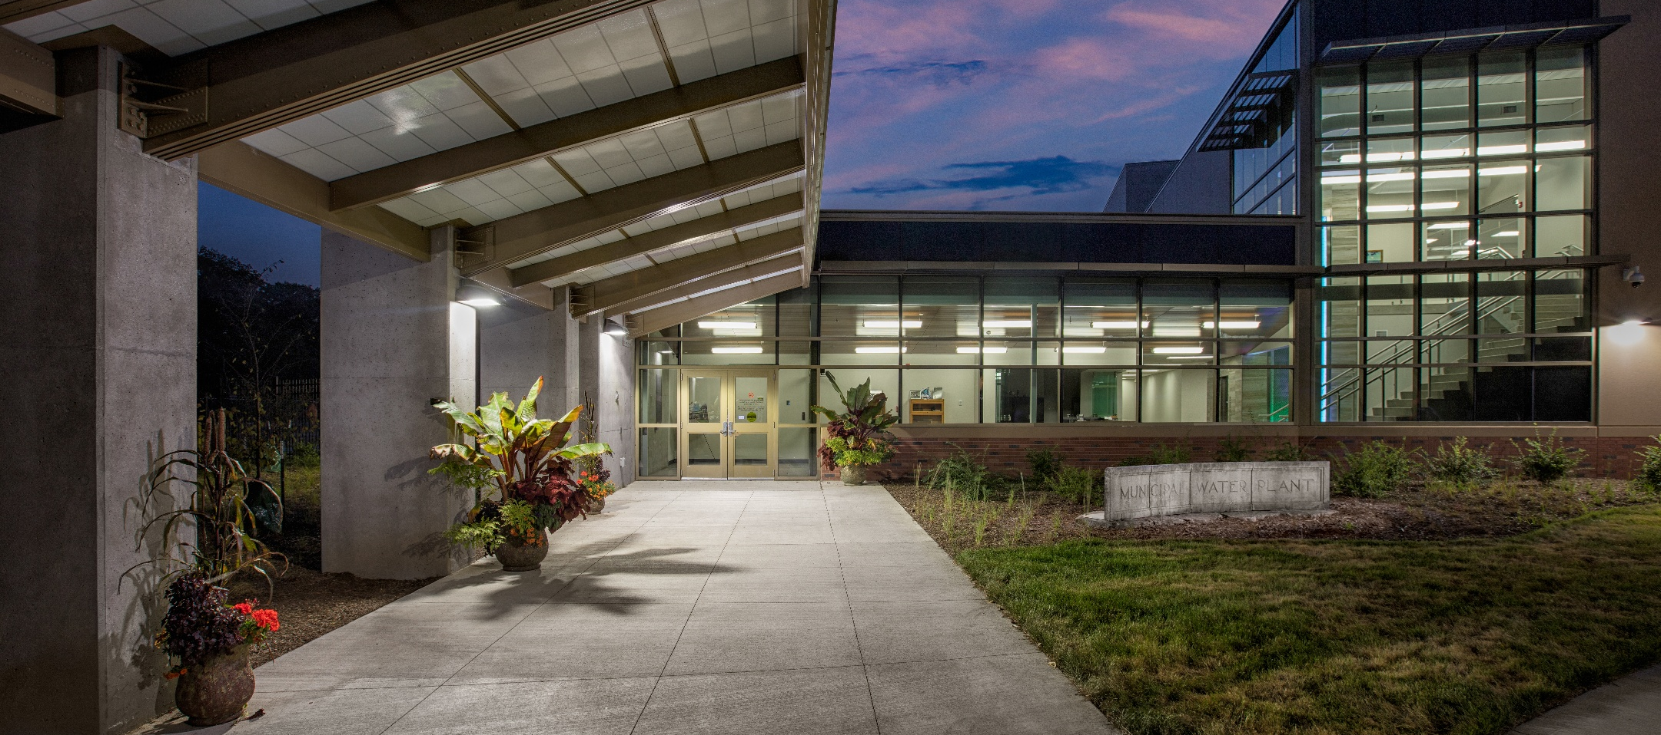

t
Ensuring Resilient Energy-Related Infrastructure for City Facilities
Adib Amini, Ph.D., PE, ENV SP, BCEE
FOX Strand
The content of this presentation is not to be downloaded, copied, used, or otherwise transmitted without the prior consent of Adib Amini ®

Slide 2
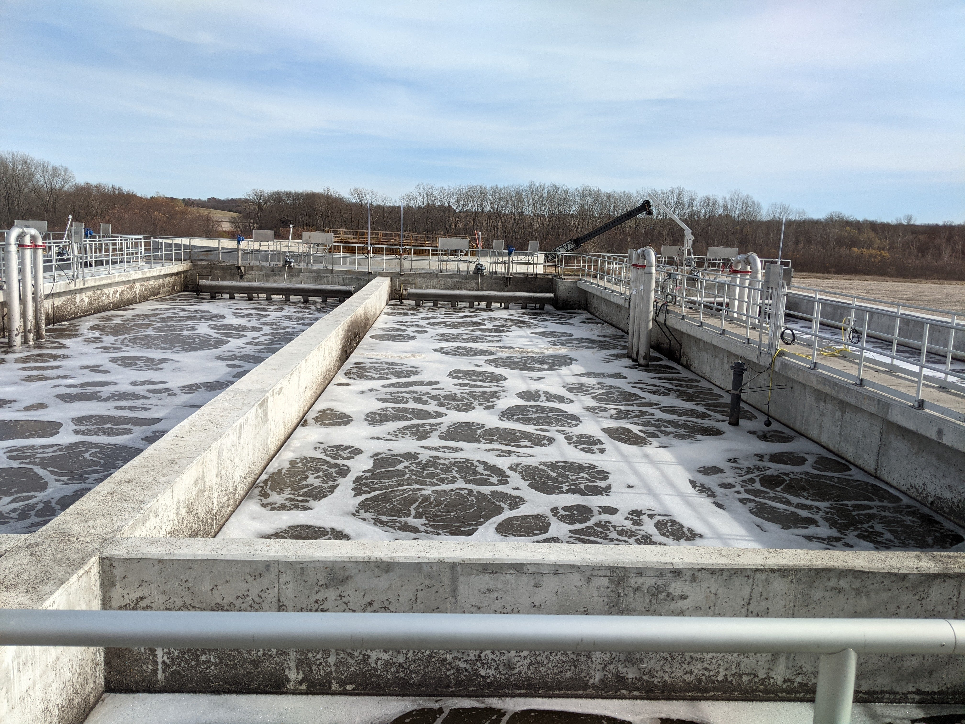
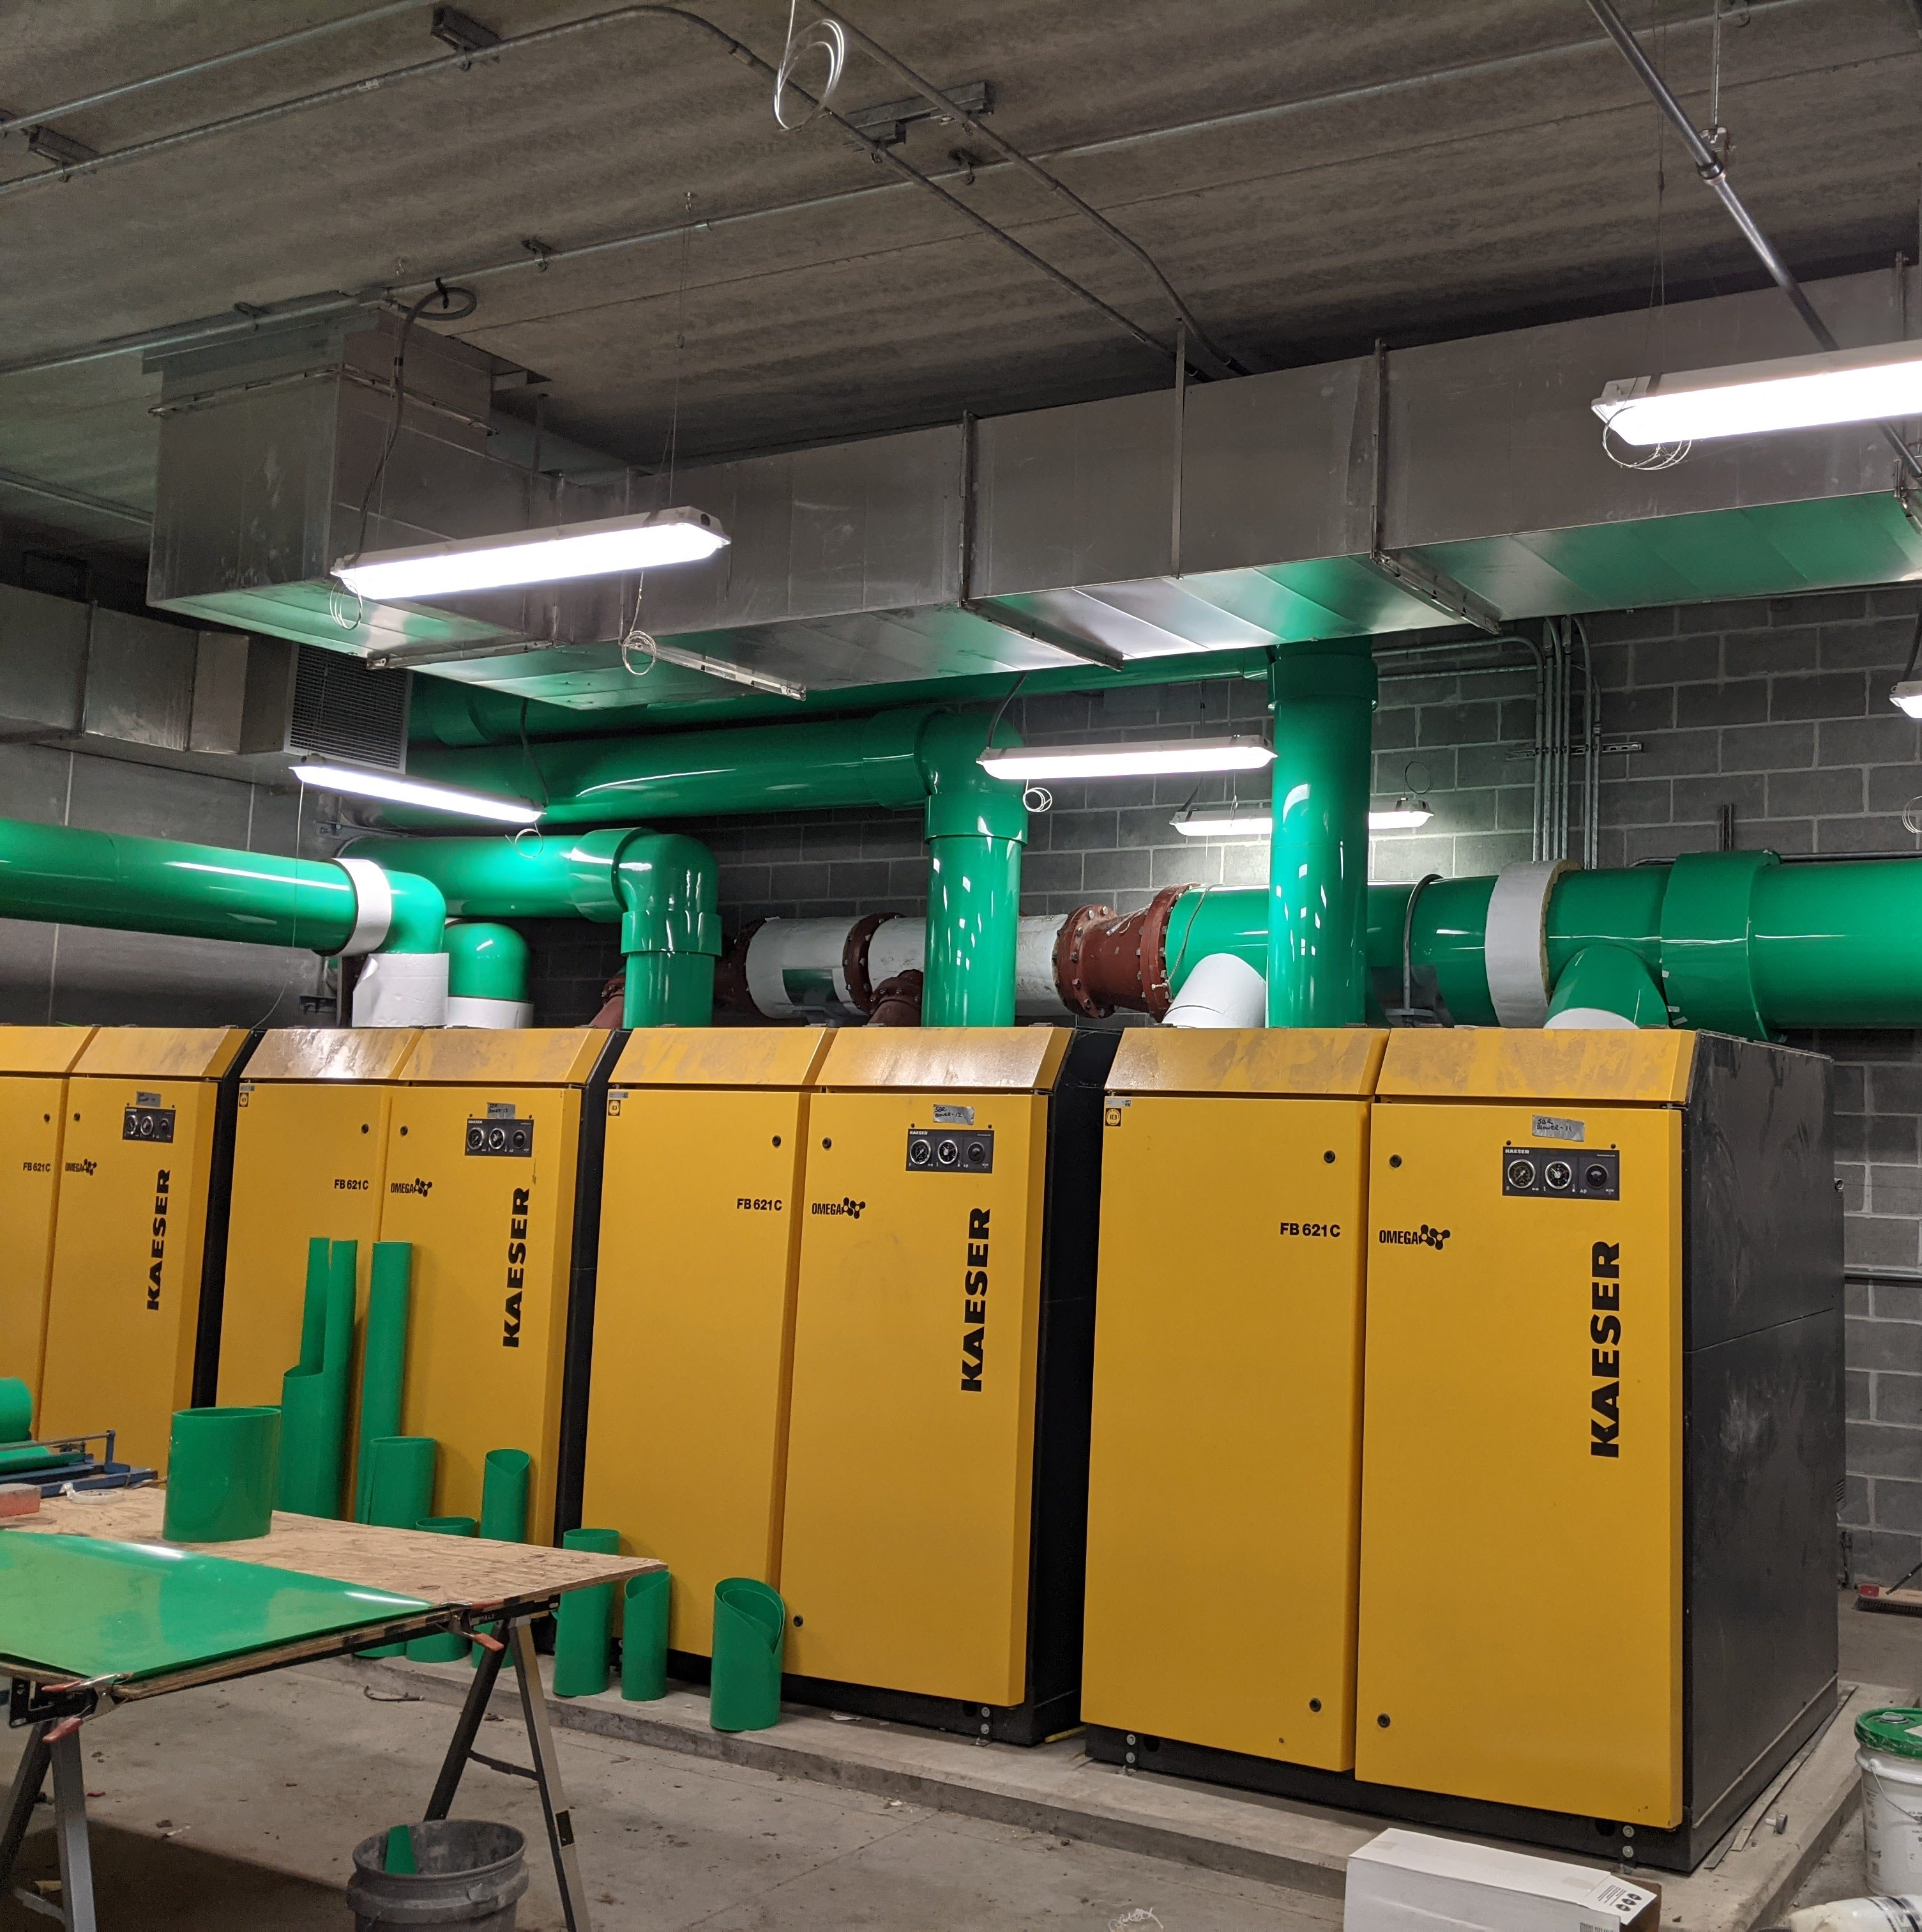
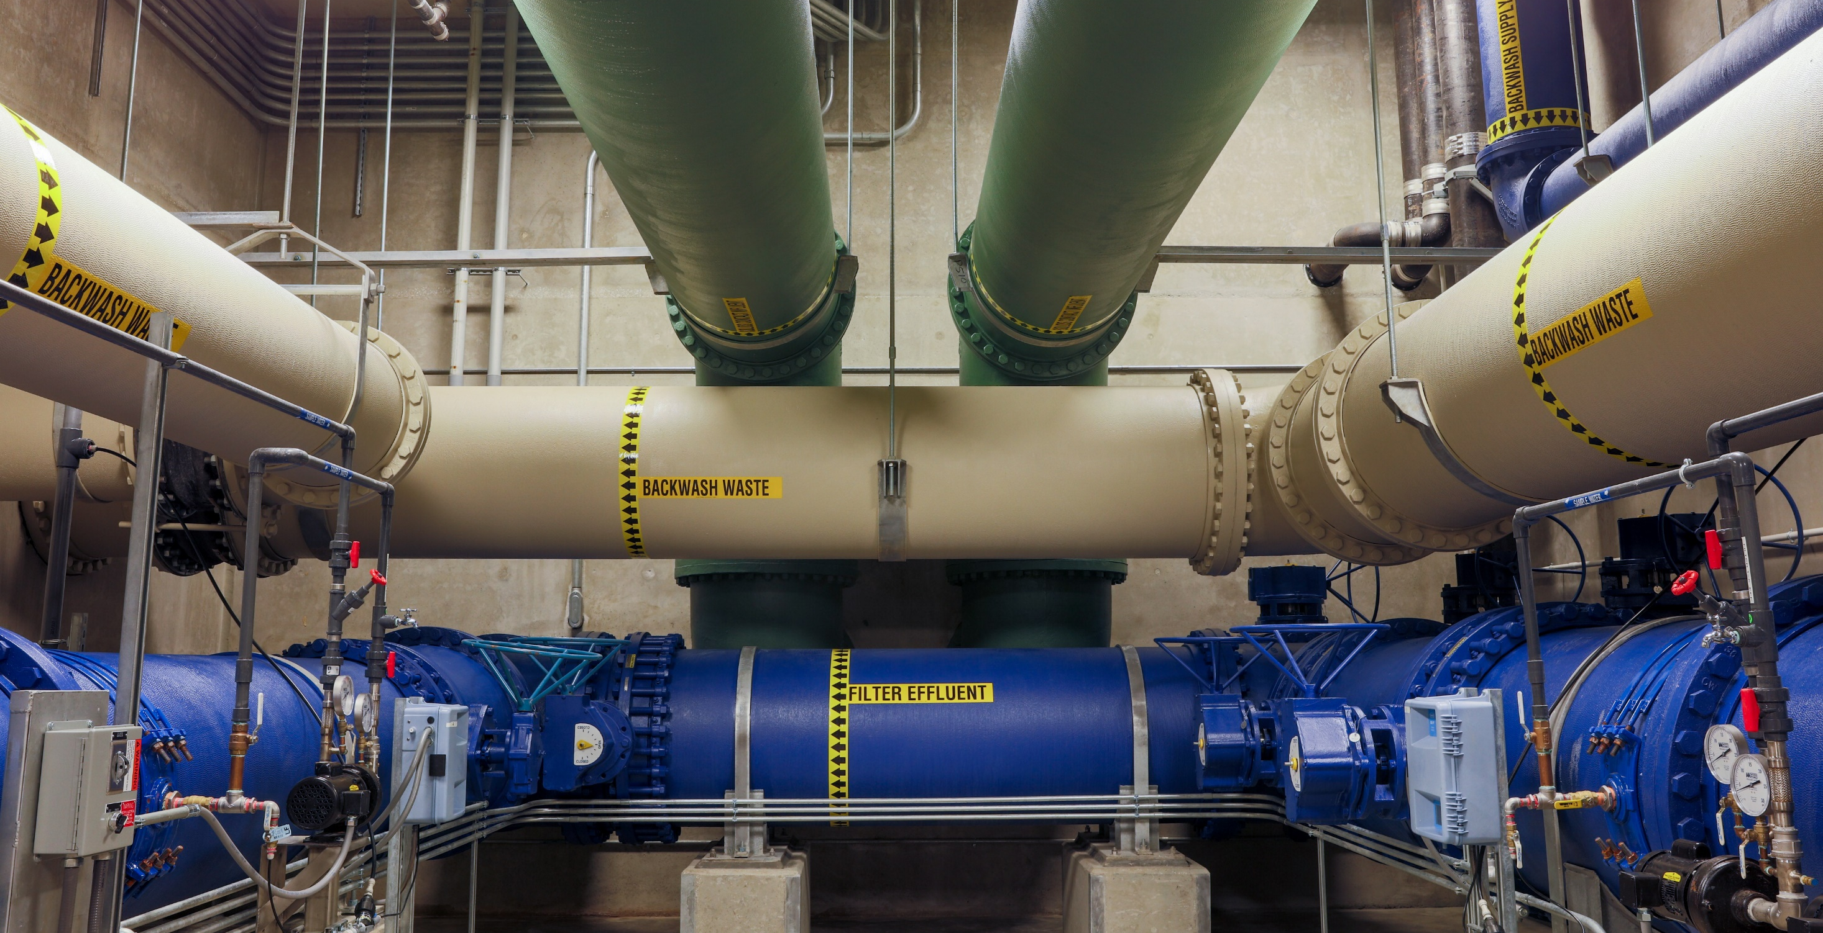
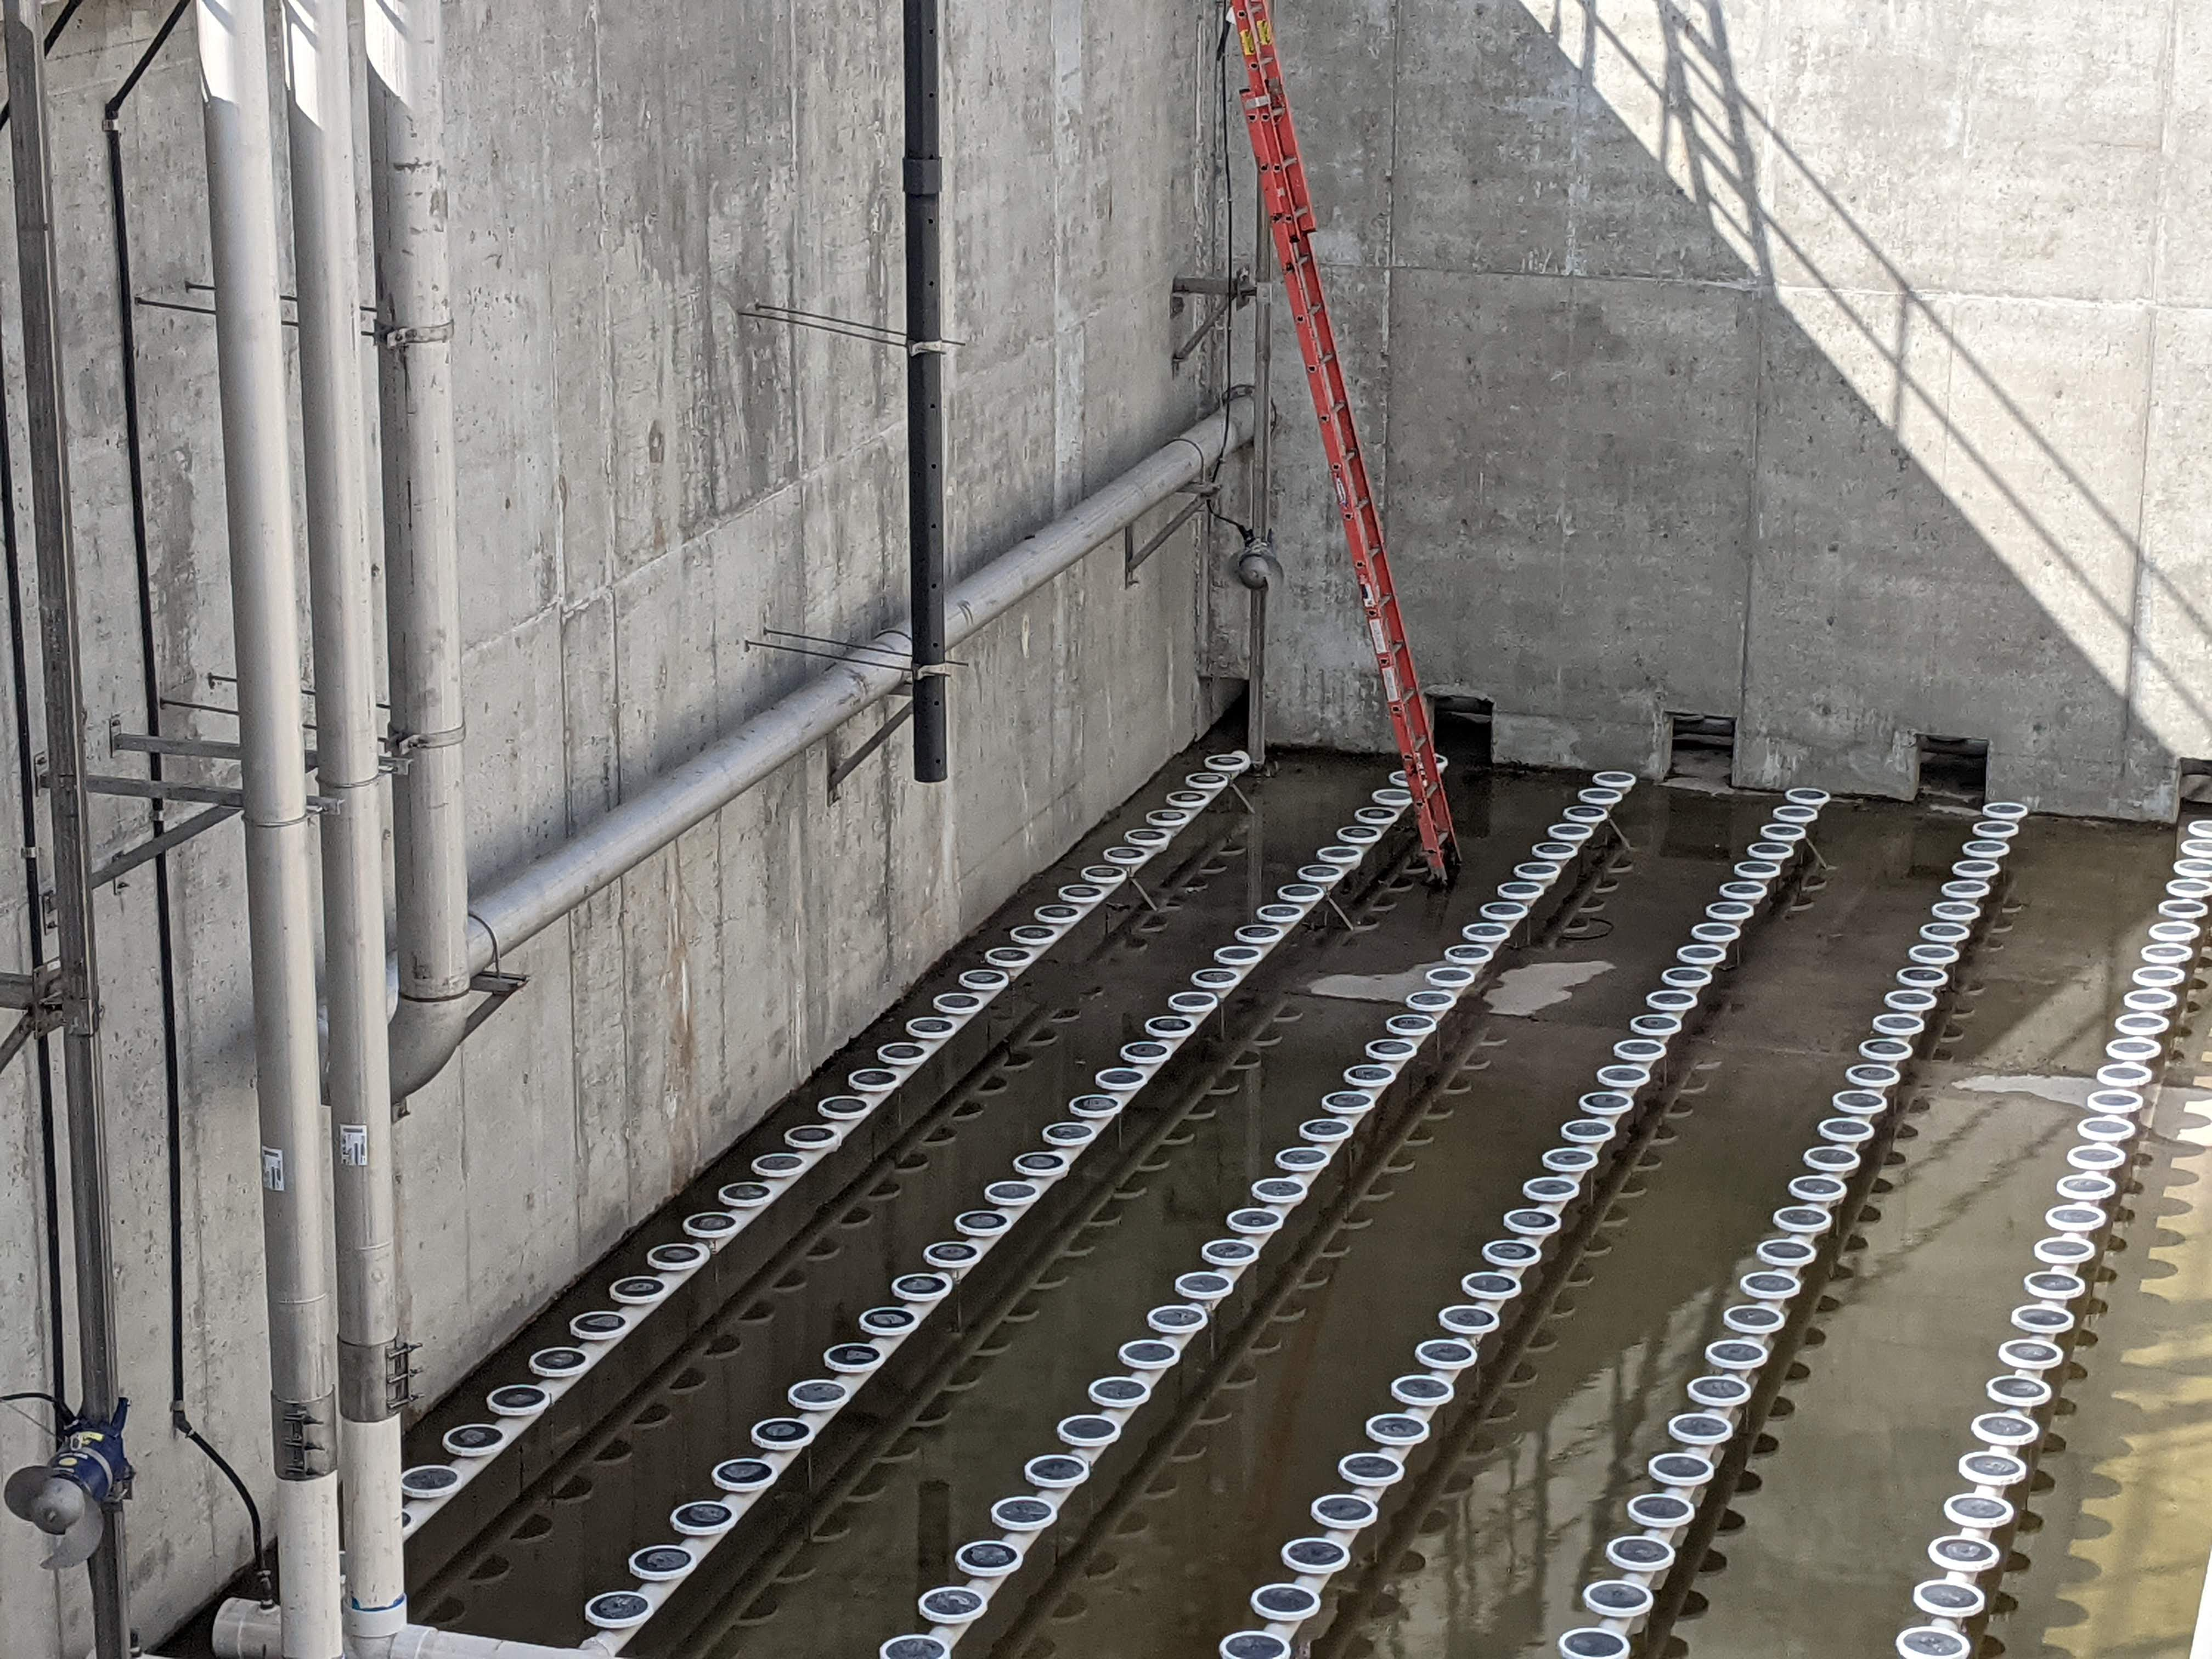

Slide 3
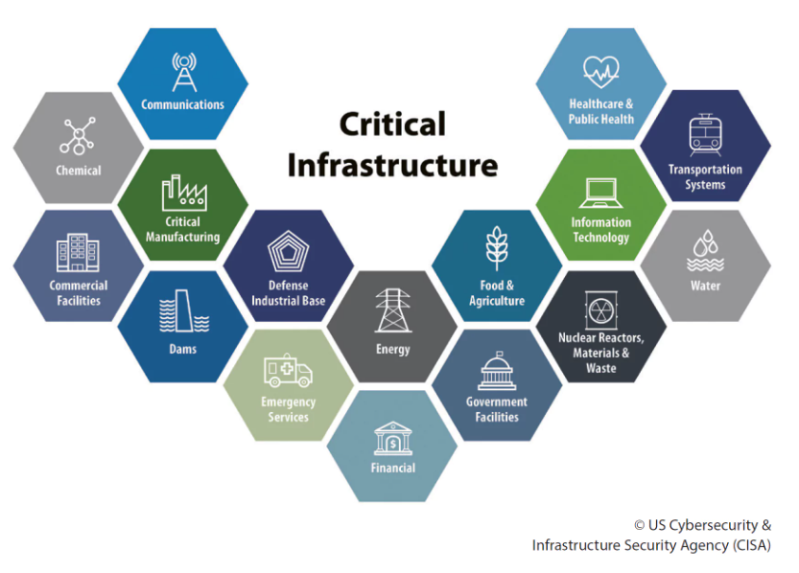
Importance of Critical Infrastructure
Notes:
If gas prices rise, can drive less, work form home, buy tesla or prius. But if energy prices rise for wastewater plant, generally have to keep functioning as usual.

Slide 4
Example: Energy at Water and Wastewater Facilities
Energy is critical to facility operation
Typical Energy Demands
    Pumping
    Aeration
    Mixing
    Heating/Cooling
    Disinfection

Slide 5
Energy History
1973 energy crisis
  Price of oil went from US$3 per barrel to nearly $12 per barrel globally; US prices were significantly higher.
  The crisis, or "shock", had many short- and long-term effects on the global economy. It was later called the "first oil shock“
1979 energy crisis
  Although the global oil supply only decreased by approximately four percent, the oil markets' reaction raised the price of crude oil drastically over the next 12 months, more than doubling it to $39.50 per barrel. The spike in price caused fuel shortages and long lines at gas stations similar to the 1973 crisis.

Slide 6
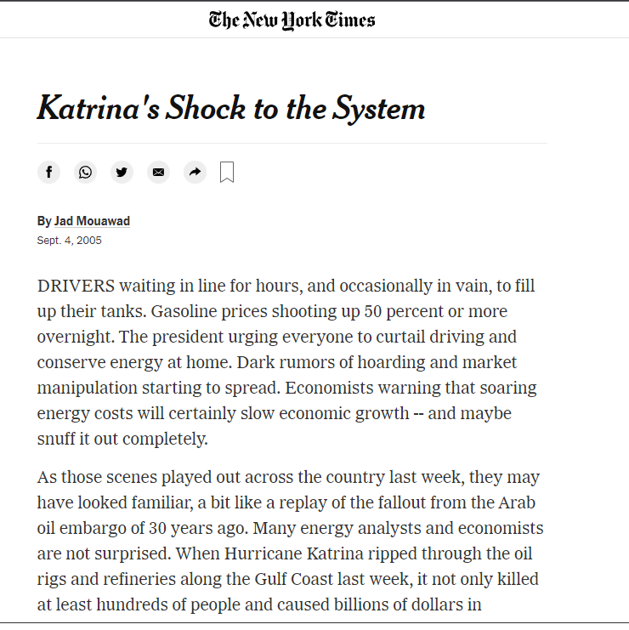
Energy History
Hurricane Katrina (2005)

Slide 7
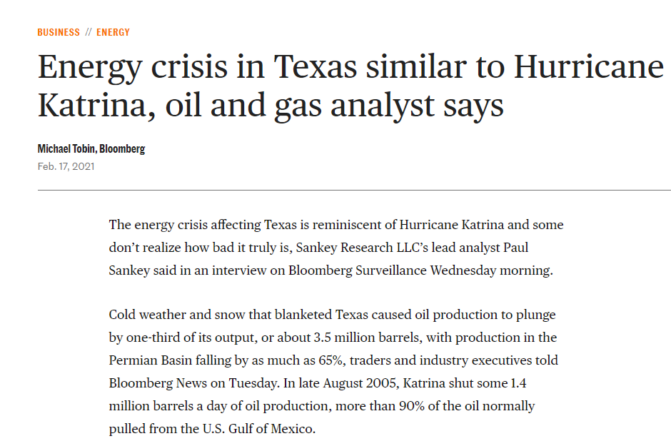
Energy History
Last year

Slide 8
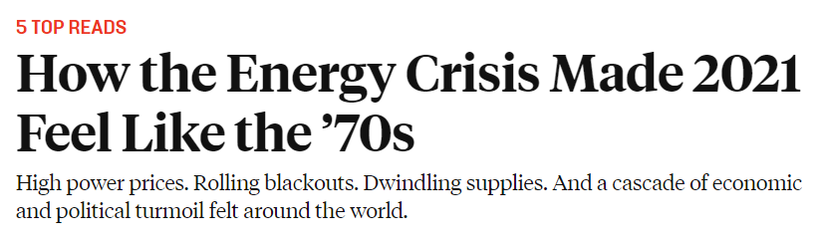
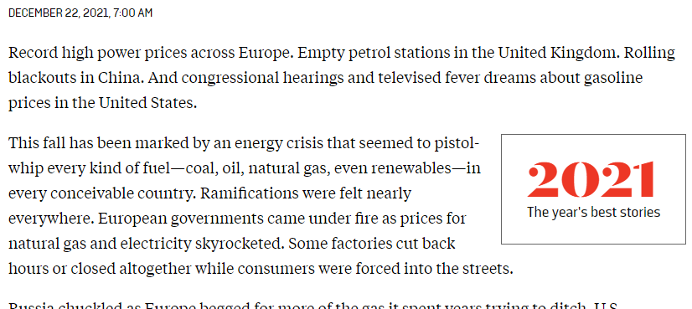
Energy History
Last year

Slide 9
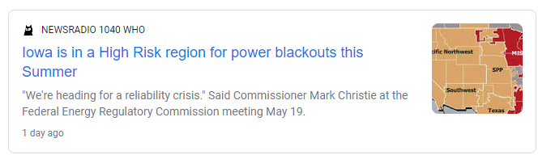
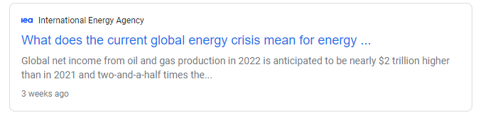
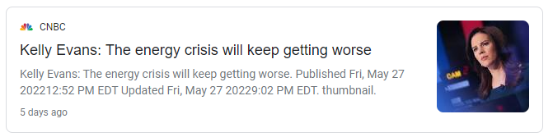
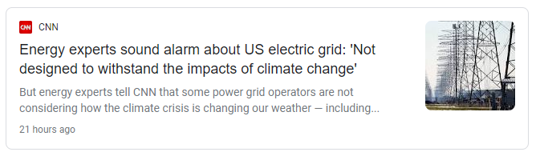
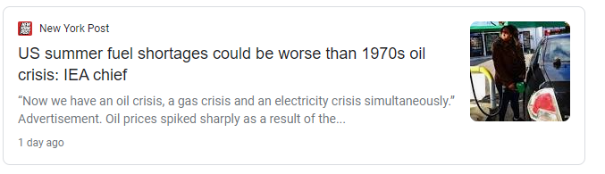
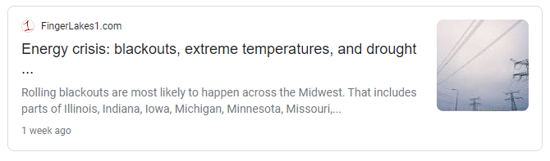
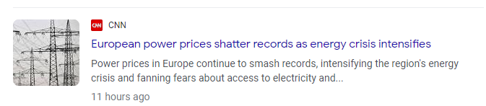
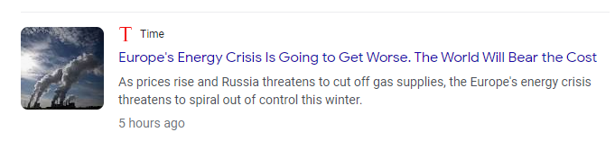

Slide 10
Risk and Resilience
Risk = Threat x Vulnerability x Consequence
Resilience
Before
During
After
Prevent, Protect, Mitigate
Respond
Recover,
Mitigate
CAPABILITIES
Preparedness
Resist
Absorb
Recover or Adapt
OUTCOME
Resilience
Reduce Failure Probability
Reduce Time
to Recovery
PRIORITIZATION
Risk Reduction
Reduce Consequences from Failure
Event Phases

Slide 11
How: Reduce Risk, Increase Resilience
Localize dependencies
Invest in up-front ownership
Universalize alternative inputs
Notes:
Localizing dependencies simply means that in order for our systems to be disrupted, they must be disrupted locally. If systems can only be disrupted locally, the chance of occurrence typically decreases significantly. For example, if a natural disaster or geopolitical occurrence takes place in one part of the country or world, this would mean that it does not necessarily affect a different part. Furthermore, this can help ensure that large scale disruptions are less likely.

Slide 12
Energy at Critical Facilities
Critical infrastructure (water/wastewater/etc) is essential to public health
Energy is a consistent need at facilities
Crises in global energy markets are not an unusual occurrence
Reducing risk and increasing resiliency at our facilities is an important consideration for the Facility Planning and Design process

Slide 13
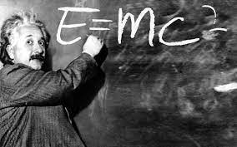
Where does it come from, where does it go?
We’ll keep it simple
Law of Conservation of Energy (energy can neither be created nor destroyed). Originates with beginning of the universe.
Energy-mass equivalence (energy = mass x speed of light squared)
The only way to use energy is to transform it from one form to another

Slide 14
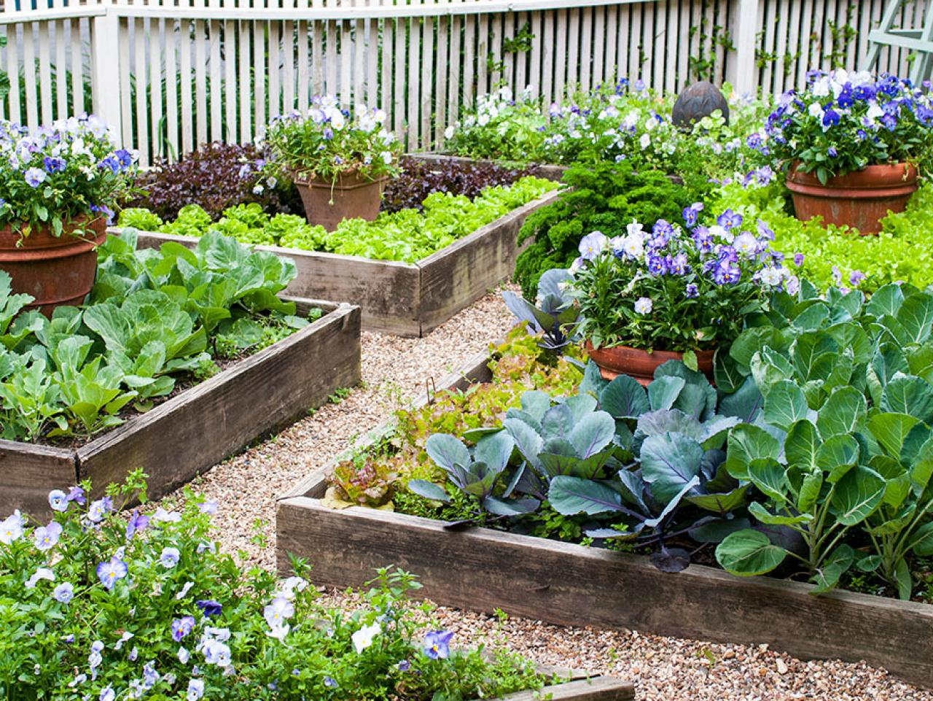
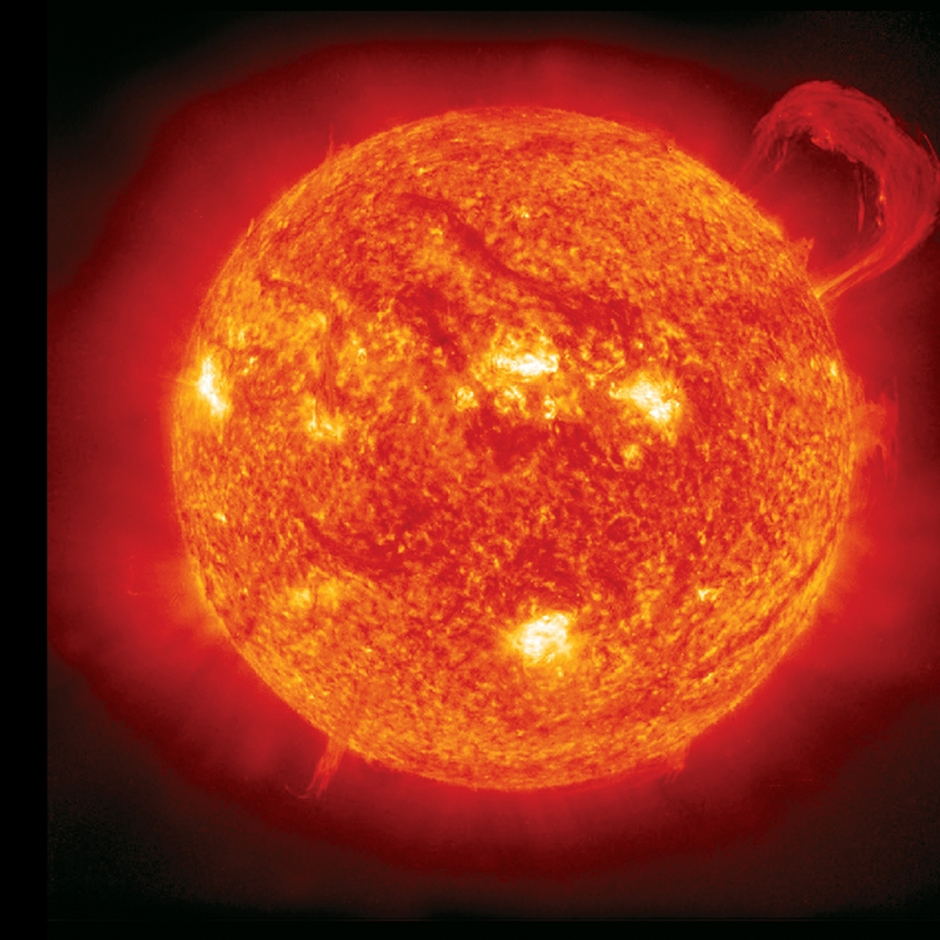
Origins
Thermal -> mechanical -> chemical -> …..
Notes:
Rub hands together

Slide 15
Energy Storage vs Energy Source
The difference depends on time scales
Energy sources:
  Solar
  Wind
  Natural hydro
  Geothermal
Storage:
  Coal, oil, natural gas are solar energy stored over millions of years
  Batteries
  Pumped hydro
  Hydrogen (fuel cells)
Somewhere in between
  Nuclear fission uses uranium to generate heat. Based on current designs, uranium is a limited resource
  Biomass (can be done on faster timescales)
  Biogas (the gas can be storage for long times, but can also be generated/used on faster cycles)

Slide 16
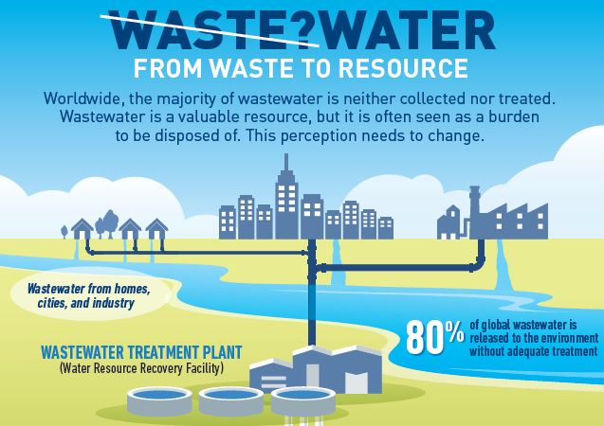
Our Facilities as a Resource
Facilities often seen as burdens rather than opportunities
Facilities are high energy users but can also be high producers
On-site energy can allow us to tap these resources while reducing risk and increasing resilience
Source: worldbank.org, Wastewater? From Waste to Resource, April 1, 2020

Slide 17
Technologies for On-site Energy at City Facilities
Geothermal
Plant Water
Biogas
Solar
Earth Vent

Slide 18
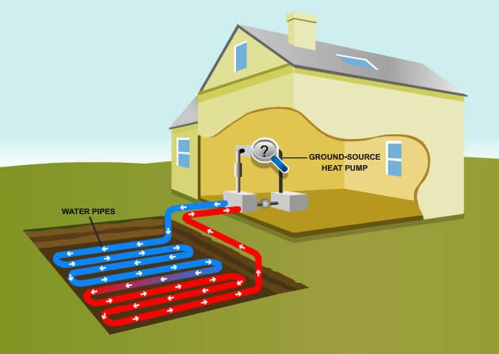
Geothermal
Uses naturally regulated temperature of the earth. Approx. 55 deg F
3 main types:
  Ground source heat pumps (most common)
  Direct use (underground hot water)
  Deep and enhanced
Can be used for both heating and cooling
Notes:
Adib

Slide 19
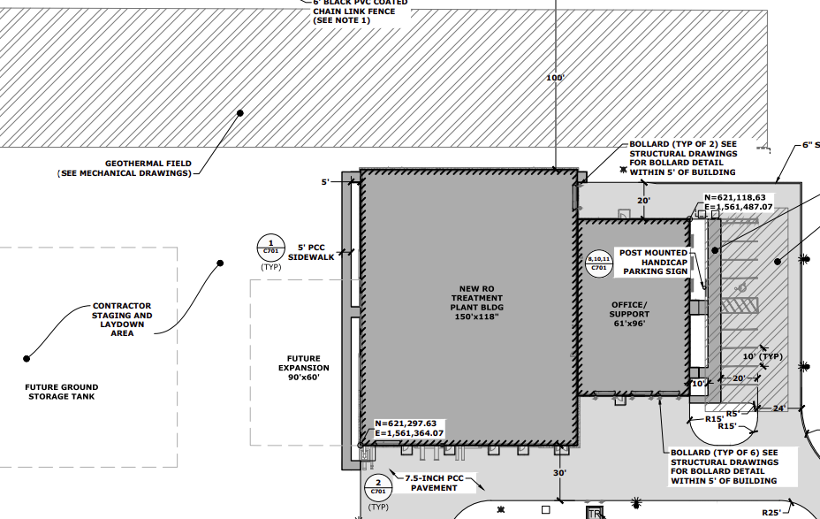
Geothermal Considerations
Buildings on site. Heating/cooling needs
Available space.
Future space
(facility planning)
4. Soil and site conditions
Notes:
Adib

Slide 20


Plant Water Systems
Extracts heat content of water or wastewater
Can be used for heating or cooling
Can be used for both heating and cooling
Relatively small footprint
Warm Wastewater
Cold Clean Water
Heat Use
Water Source at WWTP
Hot Clean Water
Warm Clean Water
Cold Wastewater
Heat Exchanger
Heat Pump
Notes:
Adib

Slide 21
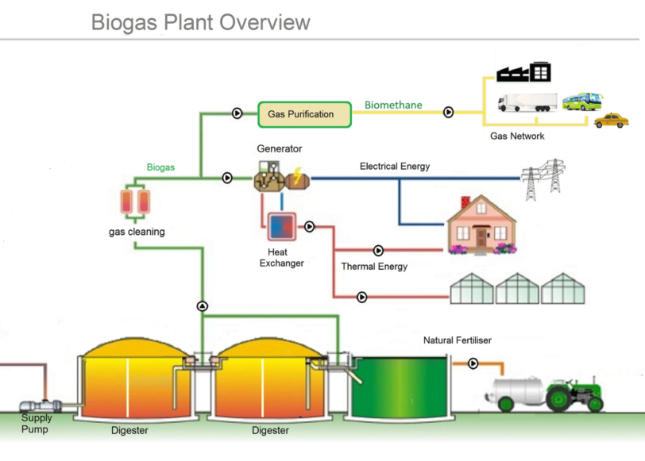
Biogas Systems
Wastewater, food, or other organic waste
Anaerobic digestion -> methane gas (pollutant and energy source)
Generate heat, power
Many different types of systems
5. Pipeline quality
Notes:
Adib

Slide 22
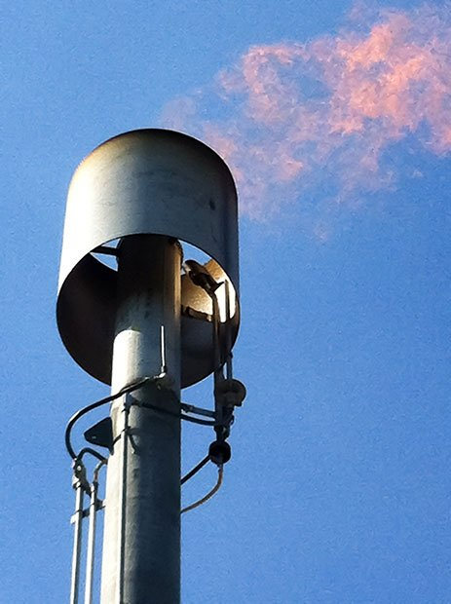

Biogas Considerations
Pollutant: Do not suggest creating if you do not want to use it to full potential (future headache). Flare
Consider future regulations on greenhouse gases
Maintenance considerations
Siloxane removal, H2S and moisture removal
Notes:
Adib

Slide 23
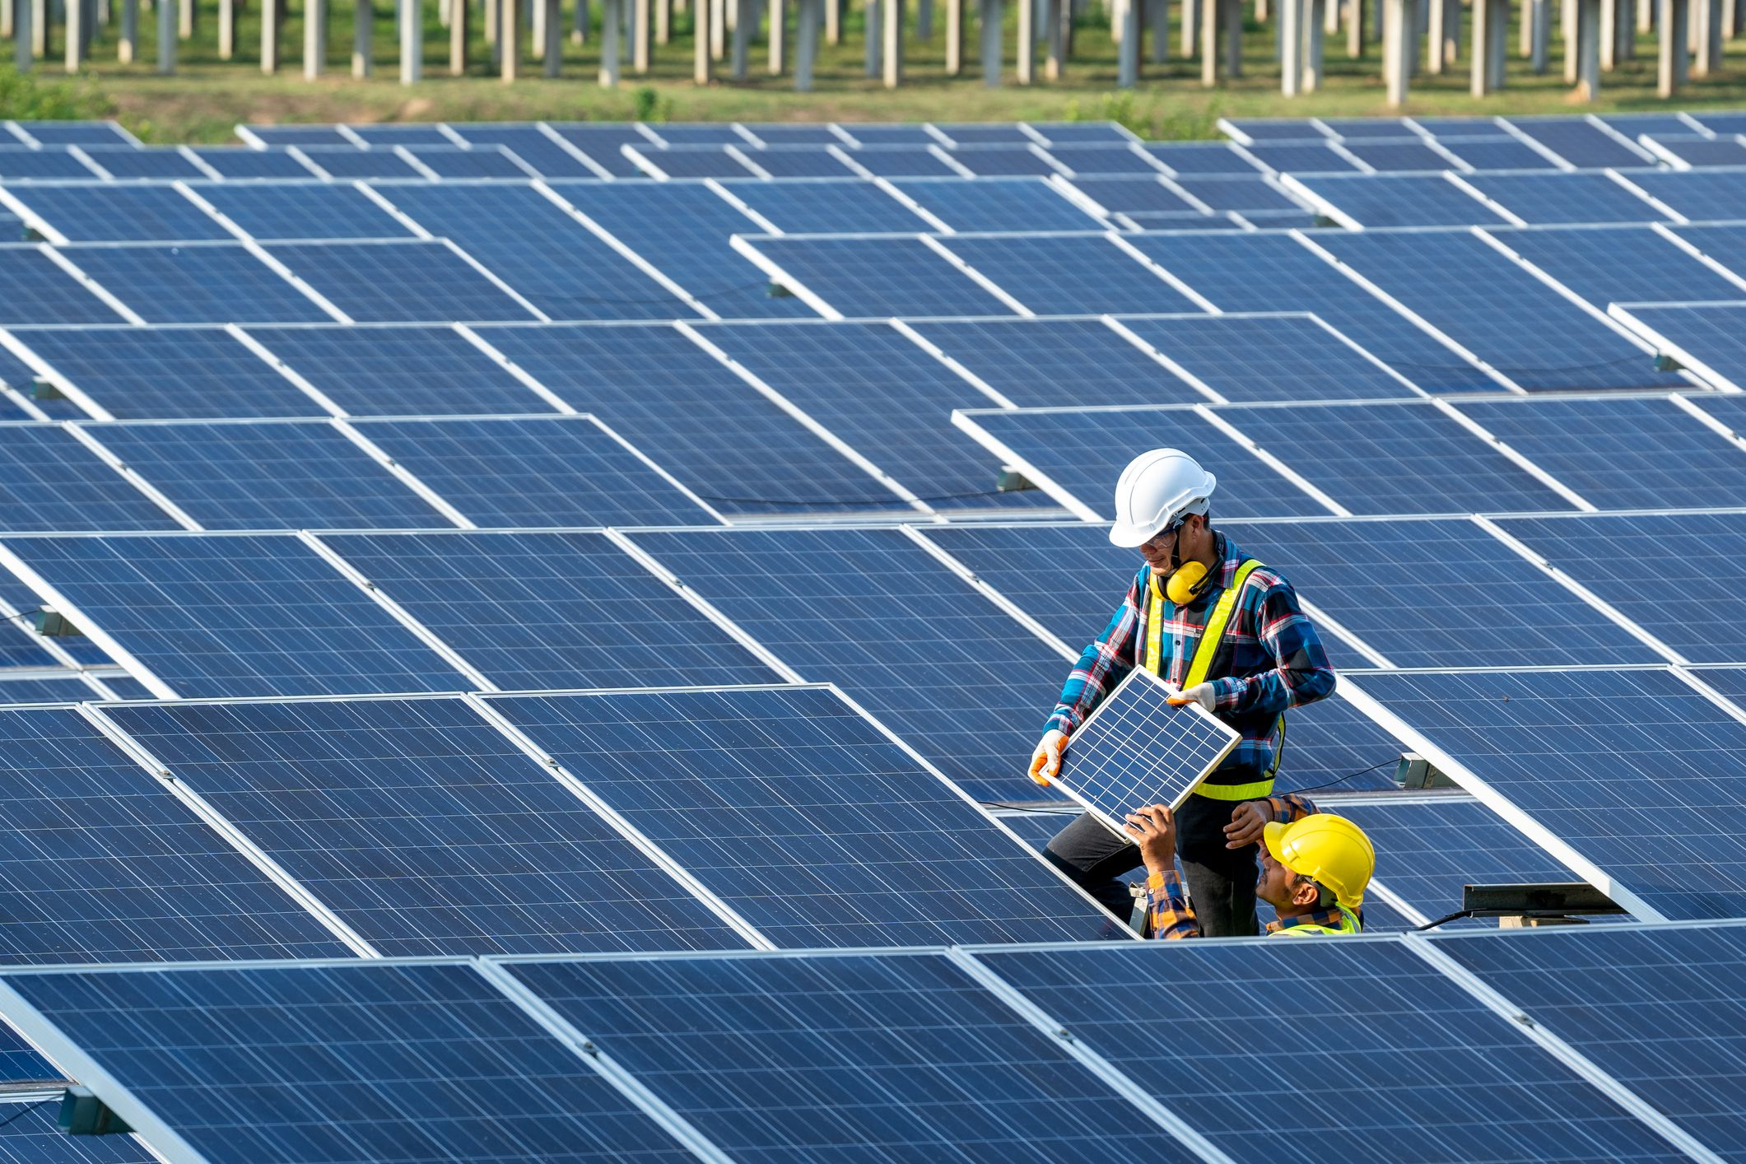
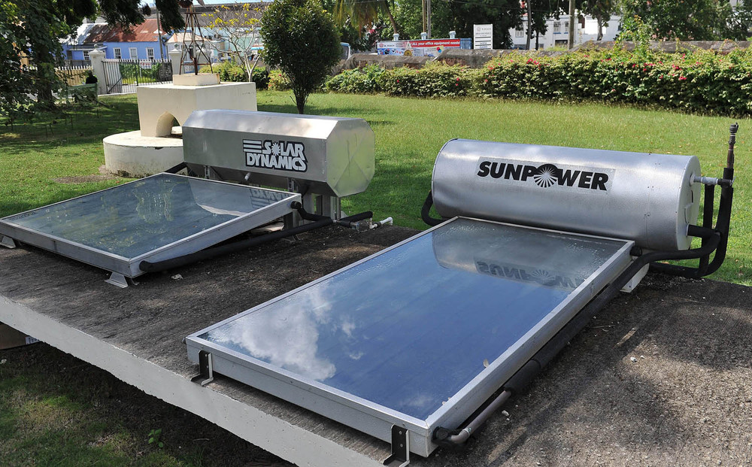
Solar Systems
Solar Photovoltaic (PV) vs Solar Thermal
Solar Thermal (Hot Water)
Solar PV
Notes:
Adib

Slide 24
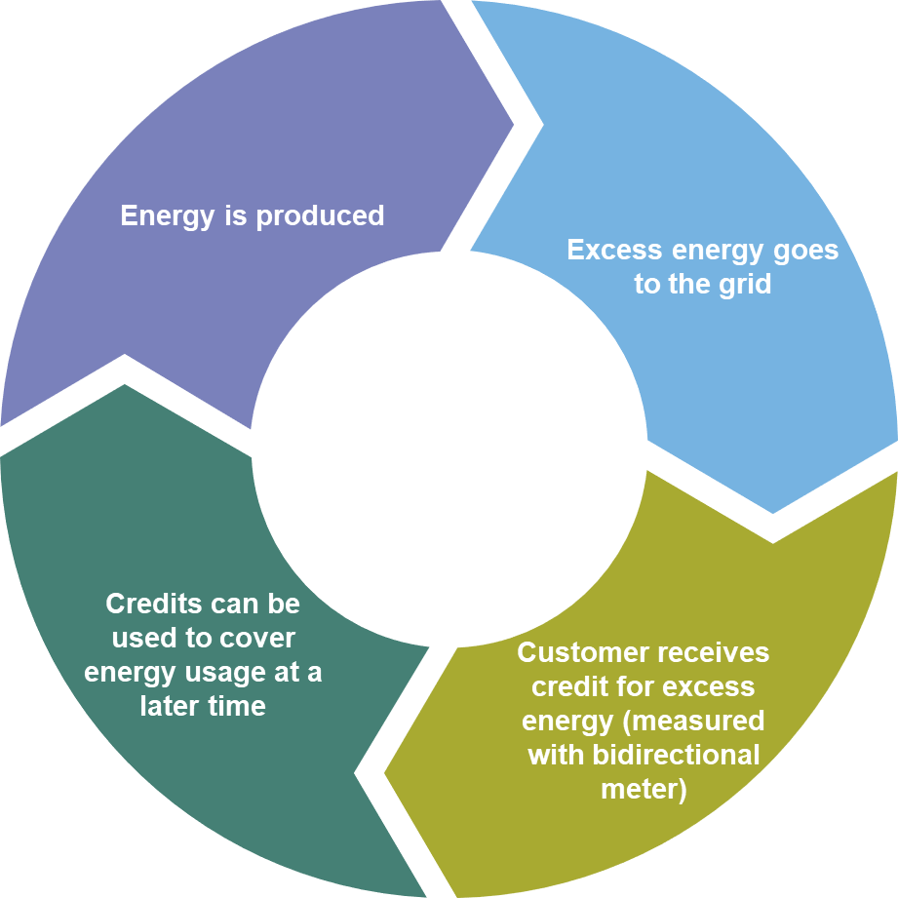
Solar PV Systems
Creates electricity from sunlight
Low maintenance
Utility policies and rates are very important
Net metering
Net Metering
Notes:
Adib

Slide 25
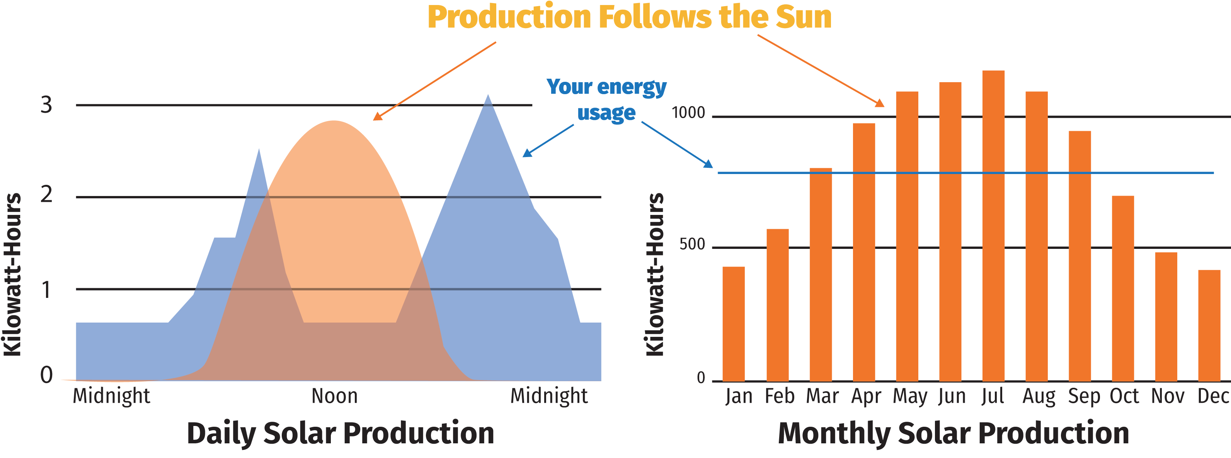
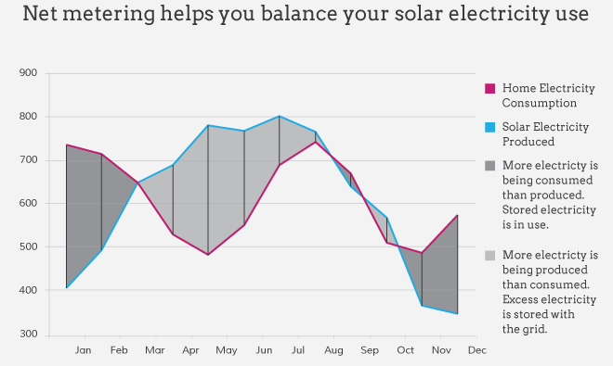
Utility Policy – Net Metering
Daily Balance
Yearly Balance

Slide 26
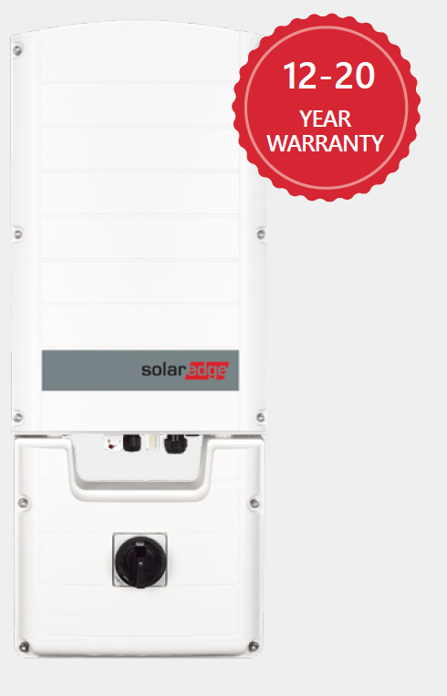
Solar: Additional Considerations
Space on site (Facility Planning)
  Mounting style. Soil conditions. Setbacks. Obstructions. Soil grading
Quality (Tier 1 equipment): Degradation, lifetime, etc
Warranties
Source: Preformed Line Products, Power PeakTM AL, June 2017
Notes:
Adib

Slide 27
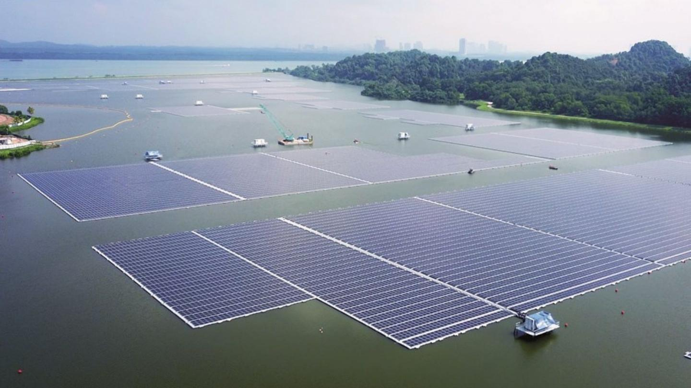
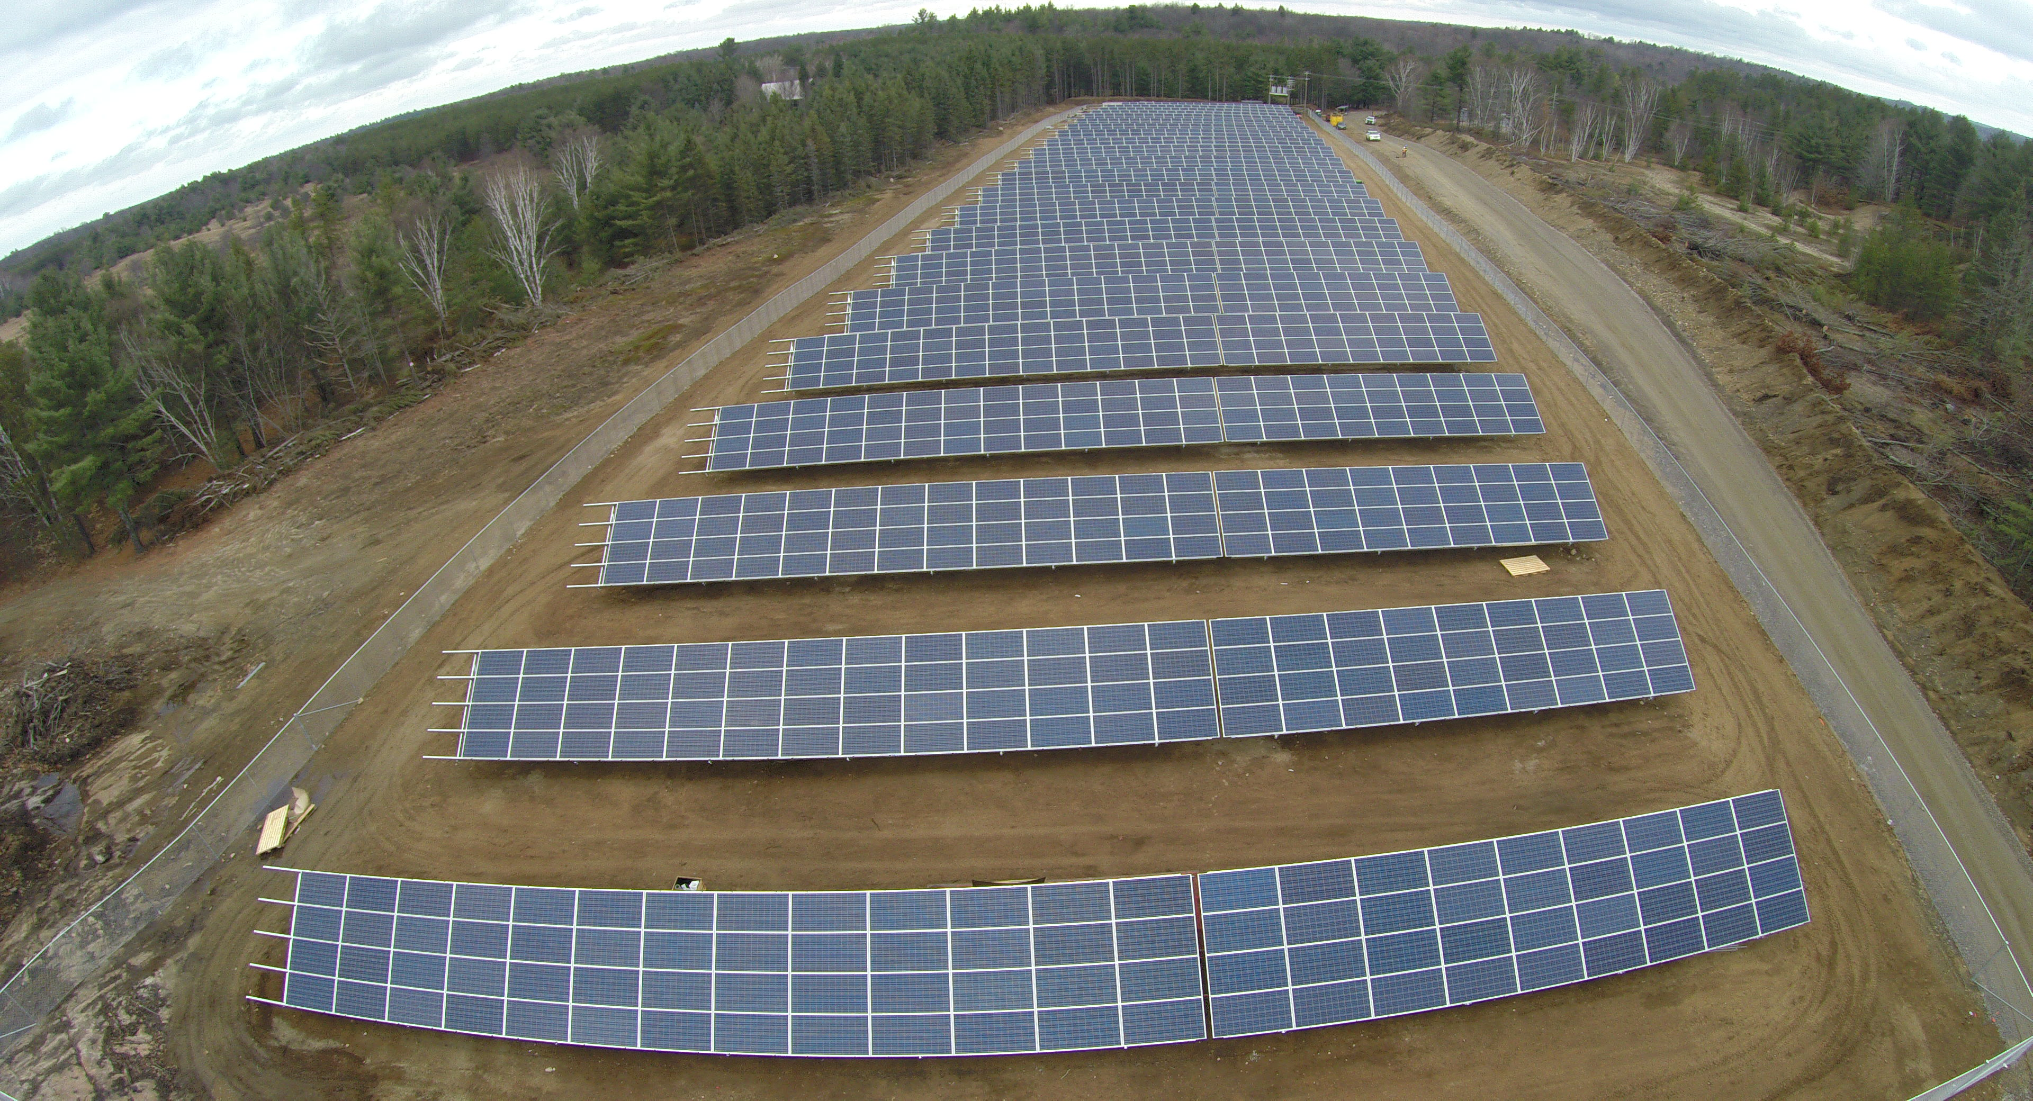
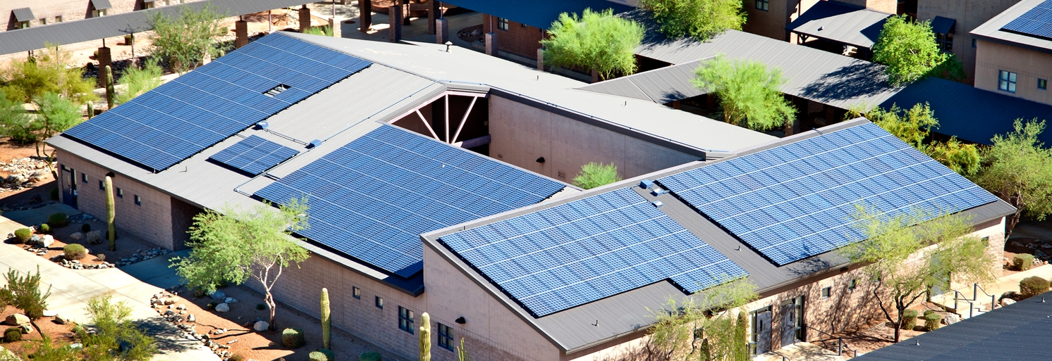
Solar Mounting
Notes:
Adib

Slide 28
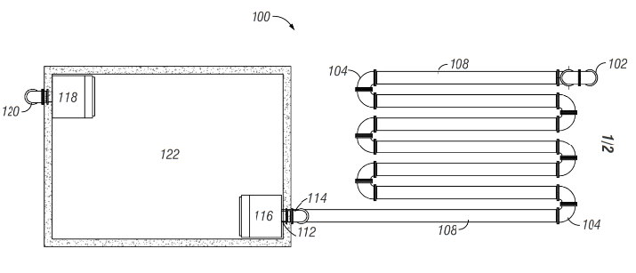
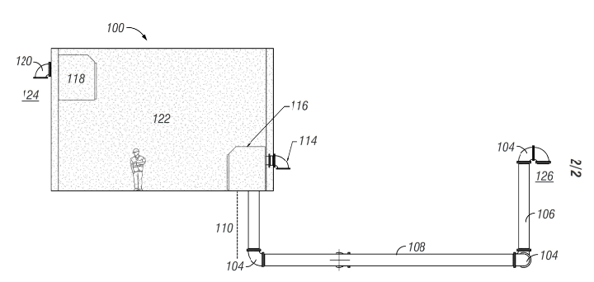
Earth Vent
Utilizes consistent geothermal temperatures to heat/cool ventilation air flow
Relatively simple/passive system
Low-cost operation
Can be paired with additional technologies
Particularly applicable to rated spaces that require significant ventilation
Notes:
Adib

Slide 29
Earth Vent Considerations
Space on site
Size of space being ventilated (affects size of system)
Soil conditions
Notes:
Adib

Slide 30
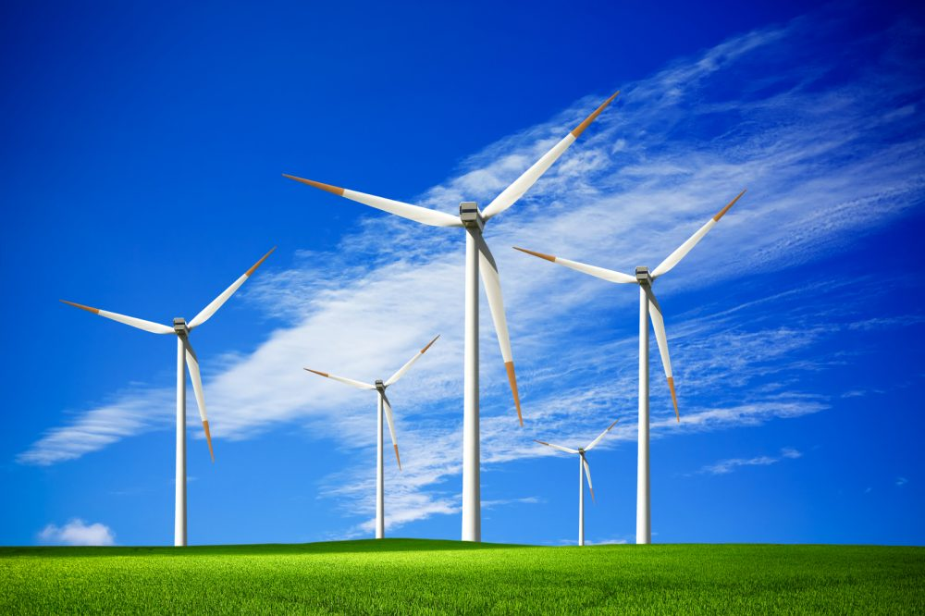
Wind Power
Very cost-effective at large scales (utility scale)
Technology always changing
Space considerations
Currently maintenance appears prohibitively expensive at small scales
Notes:
Adib

Slide 31
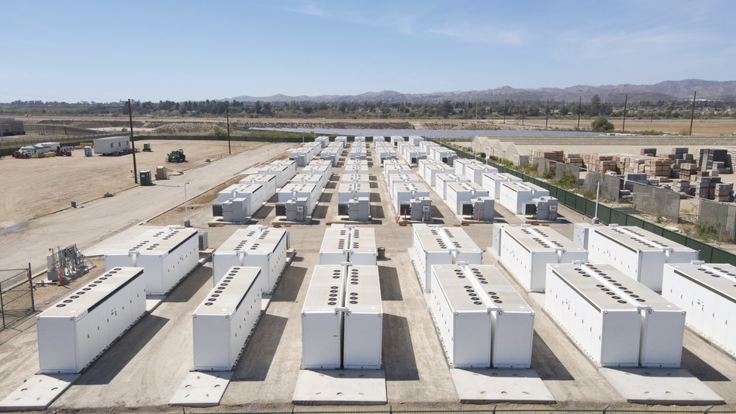
Energy Storage
A number of options for energy storage, but not all are practical:
  Batteries (lithium ion, etc.)
  Hydrogen (fuel cell)
  Fly wheel
  Pumped hydro
  Compressed air (above or below ground)
  And others
Within next few years some sort of storage will become very cost competitive
Source: Energy Storage News, Tesla deployed nearly 4GWh of energy storage in 2021, January 28, 2022
Notes:
Adib

Slide 32
Technologies for On-site Energy
Geothermal
Plant Water
Biogas
Solar
Earth Vent

Slide 33
Equipment Selection
Equipment are typically designed to work with certain energy forms (diesel, natural gas, electric, etc).
The choice should go beyond current cost and look at risk/resilience
Equipment can also be selected to take more advantage of on-site energy
In many cases, using electric equipment can universalize alternative inputs
Notes:
Adib

Slide 34
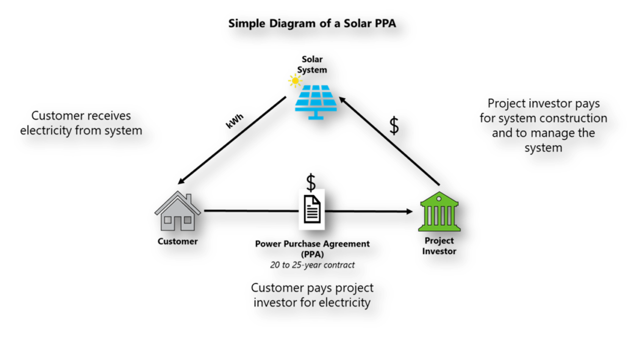
Funding Options
Cash Purchase
Power Purchase Agreements
Loans
Recent Legislation
And More

Slide 35


Funding Options
Cash Purchase
Power Purchase Agreements
Loans
Recent Legislation

Slide 36
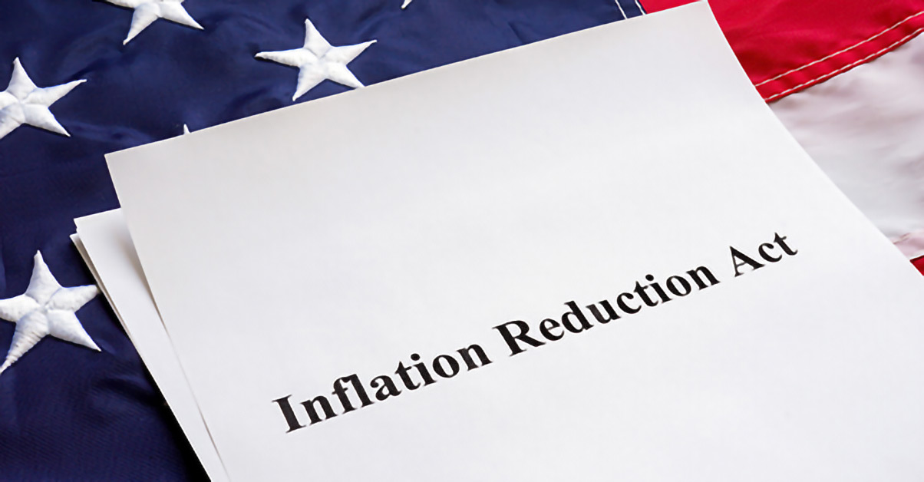
Funding Options
Cash Purchase
Power Purchase Agreements
Loans
Recent Legislation

Slide 37
Unique Financial Benefits for Cities
Financed with utility fund dollars (service fees) instead of general fund dollars
Financing utility project not subject to bond referendums that general fund might be
May be able to use space that’s not attractive for other uses (e.g. commercial, residential)
Facilities can be large energy users. Offsets a big cost base for city
Notes:
Adib

Slide 38
Example Solar Cost Evaluation
Case Study: Centerville, IA
400 kW System. Likely Cost: $2 per watt = $800,000
Parameter | Cash | Loan
Payback Period | ~10 Years | Loan Term (20 yrs)
Approx. 1st year Savings | $78,000 | $30,000 (Loan Cost ~$48k)
Approx. 20-yr Net Savings | $1.25 million | $1 million
Approx. 30-yr Net Savings | $2.6 million | $2.4 million
Approx. 40-yr Net Savings | $4.1 million | $3.9 million
  Savings essentially same as cash except for cost of interest during Loan Term.
Notes:
Cash purchase
Savings immediate
Savings go up due to increasing energy prices
Net savings = $1.2 million at 20 years
will continue to produce energy
Uncertain life of current panels – estimated 40 years
Loan
- Payback concept

Slide 39
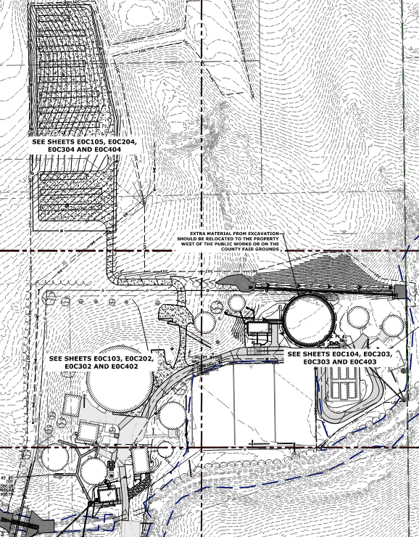
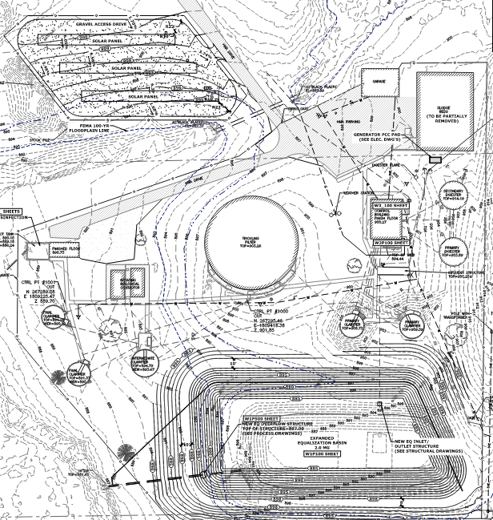
Centerville, Iowa Case Study

Slide 40
Reducing Risk, Increasing Resiliency
On-site energy keeps energy price at the facility consistent and expected for decades to come.
  Less susceptible to:
    Energy markets
    Price swings
    External crises
    Distant natural disasters, etc.
Facility can continue to meet energy demands with less influence from external factors
Protects public health and sanitation
Large reduction in future risk
Notes:
Adib

Slide 41
Comes back to the Importance of Facility Planning
Facility Plans are decision making-tools
  Capital cost, life cycle cost, and many non-economic considerations
Better facility planning can:
  Save money and time
  Reduce risk to our facilities
  Ensure we can consistently protect public health
Notes:
Adib

Slide 42
When to Consider Energy
Energy considerations need to be part of the Facility Plan process to be most effective
Facility Plans are decision making-tools
    Capital cost, life cycle cost, risk, resilience, and many other non-economic considerations
Better facility planning can:
    Save money and time
    Reduce risk to our facilities
    Ensure we can consistently protect public health

Slide 43
Thank you for your time!
Adib Amini, Ph.D., PE, ENV SP, BCEE
FOX Strand
Adib.Amini@strand.com
515-233-0000 (office)
540-244-1239 (cell)
Notes:
Questions
Long term projections about increased
Good estimate of savings
Operational strategies – demand charges during periods of low solar production
Planning for
Estimate energy usage – will know what equipment putting in – can plan when and how much energy using.
DEMAND Charges – how based.

