Slide 1

IOWA LEAGUE OF CITIES
ANNUAL CONFERENCE & EXHIBIT
Emotional Intelligence & Why It’s Important for You
Erica Tietz, Human Resources Officer, McClure
HANDOUTS & PRESENTATIONS ARE AVAILABLE THROUGH THE EVENT APP

Slide 2





Emotional Intelligence
Why it Matters & What EQ Can Do for You!

Slide 3

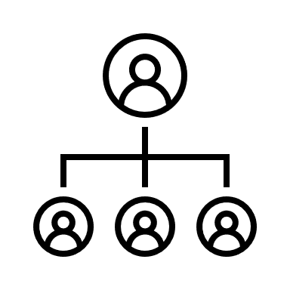

Why invest in EQ?
During interactions
Emotions are critical…
For leaders
To achieve your full potential
Great leaders manage emotions
Suppressing emotions can be costly

Slide 4


What are we going to learn?
Identification and management of emotions
  Identifying emotions is a core leadership skill
Emotional management tools
Be open and learn from each other -- EQ is a journey

Slide 5




Identifying Micro Expressions of Emotions
Why should you care about identifying emotions?
It’s a core leadership skill
  Emotions give us:
    Access to data we don’t normally look at
    Fast and subtle communication of a large amount of data
There’s a halo effect
  A subset of nonverbal decoding
    If you are good at identifying emotions, people will attribute other positive skills to you
Emotion identification is a skill to pay attention, practice, and verify

Slide 6



Emotions – fast and masked
Emotions flash very quickly throughout the course of a conversation
People will often hide their emotions, especially those that are seen as unfavorable or inappropriate in a certain situation
Coming up next…
Micro components of facial expressions
Step 1: Pay Attention

Slide 7
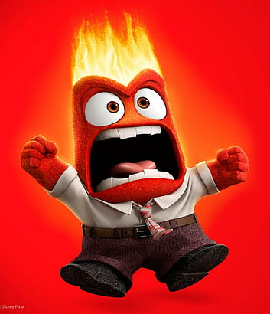

Anger
How to recognize:
Eyebrows in “V” shape
Directed gaze
Eyelids raised
Lower eyelid tension
Jaw jutting forward
Thin lips

Slide 8



Fear
Surprise
How to recognize:
How to recognize:
Eyebrows and eyelids raised
  Raises quickly and drops back down
Open mouth
Dropped jaw
Eyebrows and eyelids raised
  Raises and is held for some time before dropping back down
Tension in eyebrows
Tension in lower eyelids
Jaw pulled back
Tension around the mouth

Slide 9


Sadness
How to recognize:
Eyebrows in inverted “V”
Eyelids partially covering eyes
Downcast eyes
Mouth in inverted “U” shape
Pouted lips (in extreme cases – more common with children)

Slide 10



Disgust
Contempt
How to recognize:
How to recognize:
Tension around nose to close off nasal passages
Mouth recoils from aversive stimulus
Asymmetric tension around nose and mouth
  A very powerful and often masked emotion

Slide 11


Happiness
How to recognize:
Smile
  Real smile – gradual onset, doesn’t stay at peak, gradual offset
  Fake smile – instant peak, held at peak, instant offset
Tension around outer corner of the eye

Slide 12
Activity
Identify the Emotions

Slide 13
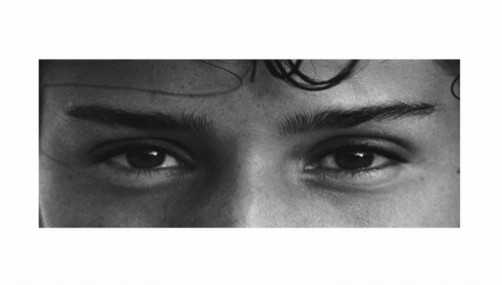
#1
A. Playful | B. Comforting
C. Irritated | D. Bored

Slide 14
#1
A. Playful | B. Comforting
C. Irritated | D. Bored

Slide 15
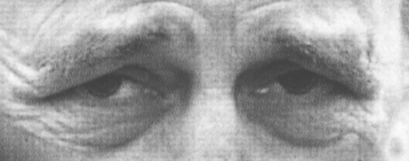
#2
Terrified | B. Upset
C. Arrogant | D. Annoyed

Slide 16
#2
Terrified | B. Upset
C. Arrogant | D. Annoyed

Slide 17
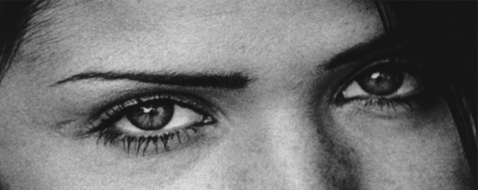
#3
Joking | B. Flustered
C. Desiring | D. Convinced

Slide 18
#3
Joking | B. Flustered
C. Desiring | D. Convinced

Slide 19
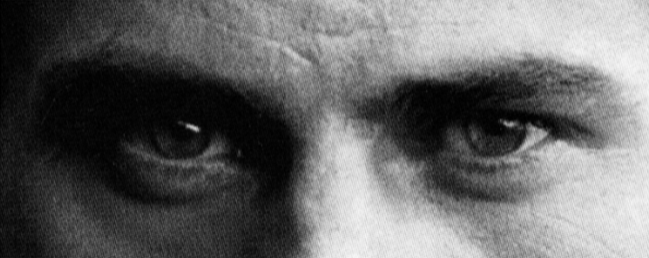
#4
Joking | B. Insisting
C. Amused | D. Relaxed

Slide 20
#4
Joking | B. Insisting
C. Amused | D. Relaxed

Slide 21
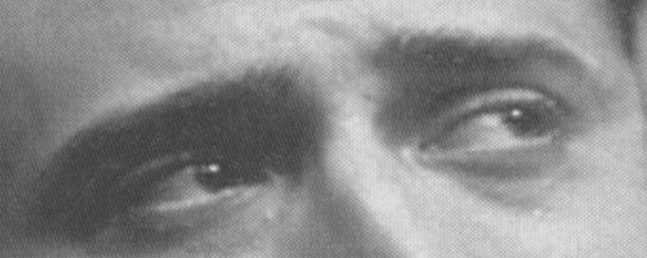
#5
Irritated | B. Sarcastic
C. Worried | D. Friendly

Slide 22
#5
Irritated | B. Sarcastic
C. Worried | D. Friendly

Slide 23
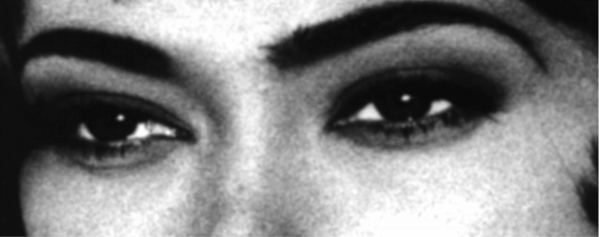
#6
Aghast | B. Fantasizing
C. Impatient | D. Alarmed

Slide 24
#6
Aghast | B. Fantasizing
C. Impatient | D. Alarmed

Slide 25
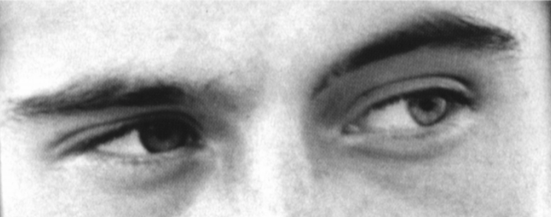
#7
Apologetic | B. Friendly
C. Uneasy | D. Dispirited

Slide 26
#7
Apologetic | B. Friendly
C. Uneasy | D. Dispirited

Slide 27
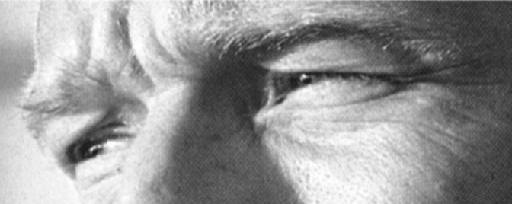
#8
Despondent | B. Relieved
C. Shy | D. Excited

Slide 28
#8
Despondent | B. Relieved
C. Shy | D. Excited

Slide 29
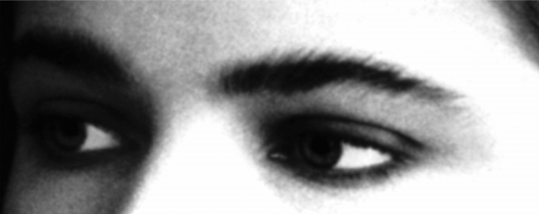
#9
Annoyed | B. Hostile
C. Horrified | D. Preoccupied

Slide 30
#9
Annoyed | B. Hostile
C. Horrified | D. Preoccupied

Slide 31
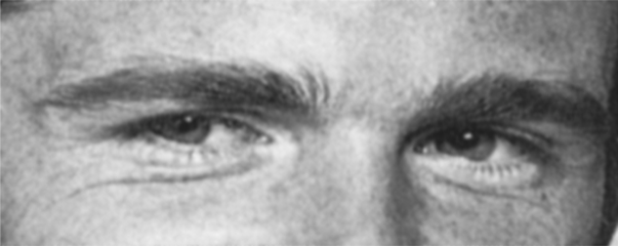
#10
Cautious | B. Insisting
C. Bored | D. Aghast

Slide 32
#10
Cautious | B. Insisting
C. Bored | D. Aghast

Slide 33
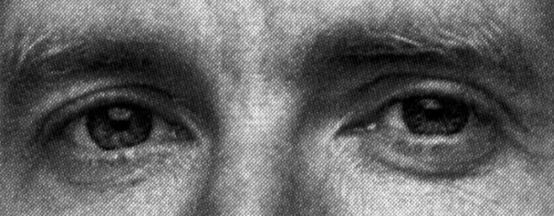
#11
Terrified | B. Amused
C. Regretful | D. Flirtatious

Slide 34
#11
Terrified | B. Amused
C. Regretful | D. Flirtatious

Slide 35
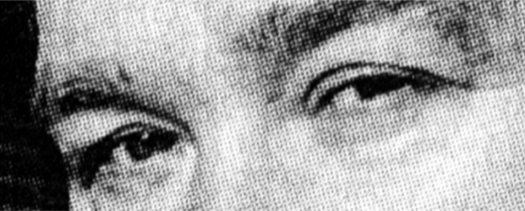
#12
Indifferent | B. Embarrassed
C. Skeptical | D. Dispirited

Slide 36
#12
Indifferent | B. Embarrassed
C. Skeptical | D. Dispirited

Slide 37
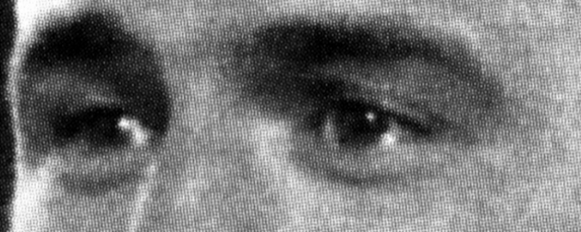
#13
Decisive | B. Anticipating
C. Threatening | D. Shy

Slide 38
#13
Decisive | B. Anticipating
C. Threatening | D. Shy

Slide 39
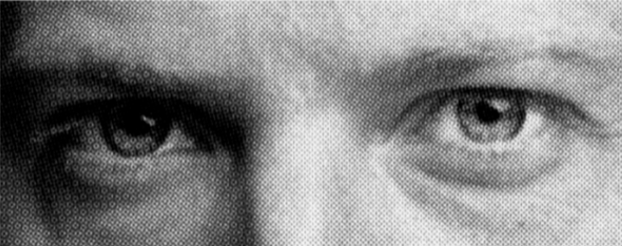
#14
Irritated | B. Disappointed
C. Depressed | D. Accusing

Slide 40
#14
Irritated | B. Disappointed
C. Depressed | D. Accusing

Slide 41
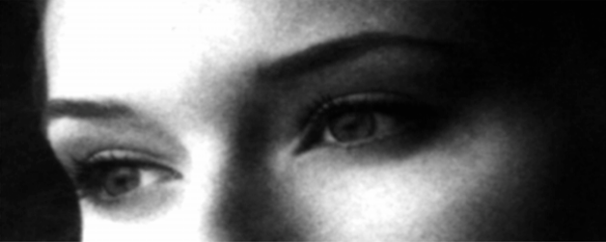
#15
Contemplative | B. Flustered
C. Encouraging | D. Amused

Slide 42
#15
Contemplative | B. Flustered
C. Encouraging | D. Amused

Slide 43
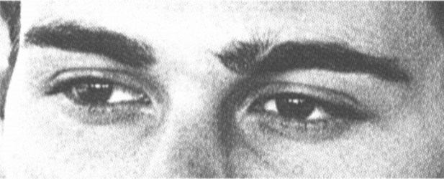
#16
Irritated | B. Thoughtful
C. Encouraging | D. Sympathetic

Slide 44
#16
Irritated | B. Thoughtful
C. Encouraging | D. Sympathetic

Slide 45
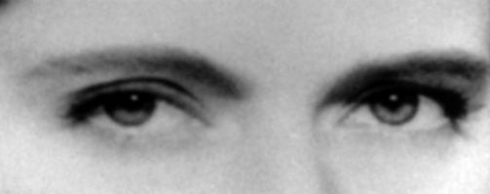
#17
Doubtful | B. Affectionate
C. Playful | D. Aghast

Slide 46
#17
Doubtful | B. Affectionate
C. Playful | D. Aghast

Slide 47
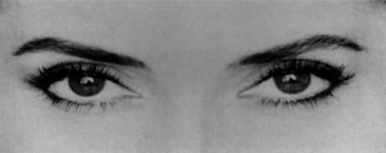
#18
Decisive | B. Amused
C. Aghast | D. Bored

Slide 48
#18
Decisive | B. Amused
C. Aghast | D. Bored

Slide 49
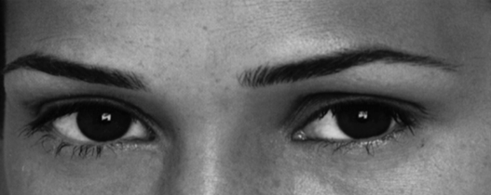
#19
Arrogant | B. Grateful
C. Sarcastic | D. Tentative

Slide 50
#19
Arrogant | B. Grateful
C. Sarcastic | D. Tentative

Slide 51
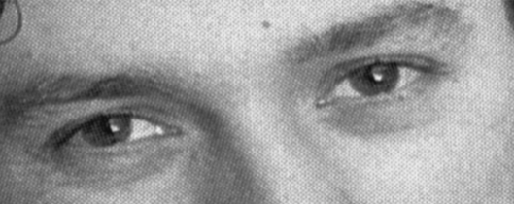
#20
Dominant | B. Friendly
C. Guilty | D. Horrified

Slide 52






Verify the Presence of a Problem
If you notice someone is angry…
  Don’t say: “You seem angry”
  Try: Using the negative emotion as a cue to stop talking and start listening, so you can verify if there is a problem

Slide 53


Why Should You Manage Emotions?
Your impact as a leader & the powerful effect that your emotions have on others

Slide 54
Good Leaders Manage Emotions
Trait: A person’s stable tendency to respond to certain kinds of events with certain emotions
Trait Negative Affect: How a person responds to negative events
People high in trait negative affect tend to respond to negative events with a lot of negative emotion (anger, sadness, anxiety)
Trait negative affect:
  Influences leadership outcomes
  Declines with leadership positions
  Is a movable number
Within team dynamics, the person who emerges as a leader often has the lowest trait negative affect
Teams with leaders who have a low trait negative affect tend to perform better

Slide 55

The Contagion Effect of Emotions
Emotional contagion
  We can catch emotions, which can change the vibe of a room
Leaders have asymmetrical attention related to power, so it’s even more important for them to manage their emotions

Slide 56
Group Share: Have you ever caught an emotion?

Slide 57



Leaders Shape Emotional Culture
A leader’s mood shapes the behaviors of those surrounding them
WHY?
Our brains have an open loop limbic system (an emotional center)
  An open loop system depends on external sources to manage themselves – so a person’s mood can affect another person’s physiology (hormone levels, sleep rhythms, immune functions), therefore changing their emotions
There’s a direct correlation between emotional culture and task performance, job engagement, creativity and commitment to the organization
WHAT DOES THIS MEAN?
Building your team’s emotional culture is IMPORTANT

Slide 58

Emotional Suppression
Why should we care about managing emotions?
  Good leaders do this well – the higher up you go in an organization, the less a leader will respond to negative events with negative emotions
  Your emotions have a disproportionate impact on the people around you and can be caught by others
Costs of Emotional Suppression
  When you spend a significant amount of energy suppressing negative emotions vs. dealing with them in a healthier manner, it impacts your ability to make decisions
    You are using up self-regulatory resources

Slide 59

Biased Emotions Add Noise
Intrapersonal level – your expertise translates through your emotions
If you’re always feeling a certain emotion, like anxiety, it becomes harder to differentiate if that emotion is from a problem or something else
  There’s noise on the channel that makes it harder to decide

Slide 60
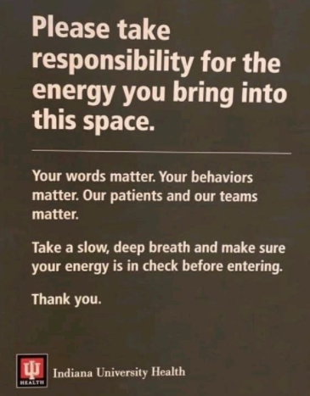
You should be dedicating time to managing your emotions
Your emotions are the primary driver or impediment to realizing your full career potential
Coming up next…
Understanding your emotional profile

Slide 61





Understand Your Emotional Profile
Learn if you display certain emotions more frequently and more intensely than others

Slide 62
Emotional Traits
Assessment – The Positive and Negative Affect Schedule (PANAS) Questionnaire
Positive Affect
Raw Score
10 – 26
27 – 32
33 – 37
38 – 50
Percentile Rank of Score
0% – 25%
26% – 50%
51% – 75%
76 – 100%
Negative Affect
Raw Score
10 – 12
13 – 15
16 – 18
19 – 50
Percentile Rank of Score
0% – 25%
26% – 50%
51% – 75%
76 – 100%

Slide 63




Knowing Where You Stand
In the U.S., it is generally accepted and expected to have a high positive affect level
  Different in other countries
Want to move negative affect down to give ourselves behavior flexibility
  Give ourselves the opportunity to choose how to react or respond to what’s happening
  In the occurrence of a negative event, the only choice for people with a high negative affect is to get angry

Slide 64


Manage Your Emotional Reactions
Our emotions come from our thoughts, which may or may not be accurate
We typically don’t check if our thoughts are accurate
  We build up systemic drift and biases about our environment
Improve your emotional intelligence by improving your biases

Slide 65
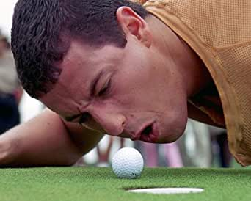
How You Think About Events in the Environment
Accurate Emotional Appraisal & Recovery
Avoid situations that make you anxious, angry, and/or depressed
Suppress your emotions (works, but affects your psychological and physical systems)
Tactics that actually work:
Accurate emotional appraisal
  Helps us analyze our thoughts and retrain/relearn how we think about our environment to become more accurate with our thoughts
Rest and recovery

Slide 66
Raw vs. Self-Corrected Thought
Self-corrected – more accurate interpretation of what happened (weaker level)
Raw – your level of anger (high level)
By continuing to do this, you will start to bring your negative trait emotions down so you can more appropriately respond to a situation

Slide 67


Removing Systemic Drift in Thought
Step 1: Freeze how you’re thinking of the event and any other thoughts associated with it
Step 2: Check what biases or distortions are in those frozen thoughts
Step 3: Clean up the distortions
Remember:
  This is not a real-time process – you do this when you are replaying your day and thinking about what had occurred
  The more you practice and use this tool, the better you are going to get

Slide 68
Step 1 – Freeze the Emotion
Step 2 – Write Down Your Raw Emotions
Think of a time when you felt a strong negative emotion (anger, anxiety, etc.)
Go back to that incident and remind yourself how you felt
  On a scale of 0-100, this emotion is likely being felt within the 80-100 range
Write down the raw emotions that you were thinking during this time
  Don’t correct them or clean them up – these are raw emotions!
Raw emotions – thoughts that run through your head that aren’t verbalized, or might not be verbalized in a professional setting

Slide 69



Recover From Repeated Negative Events
Leaders are valuable due to their ability to lead others through challenging situations
At some point, many negative things will come towards you at once, which can have a significant effect
  Need to learn how to recover

Slide 70

Higher levels of leadership = higher stress level?
National Academy of Sciences found that those in leadership roles actually have a lower stress level
  Why?
    You are in control of many different events – more control = less stress
    Individuals with lower stress levels may be particularly well-suited for leadership
Four ways to deal with negative events
  Avoid them
  Suppress them
  Think about them accurately
  Recovery
Rest and recovery are even more important when you need to accurately think about a really, really bad situation

Slide 71
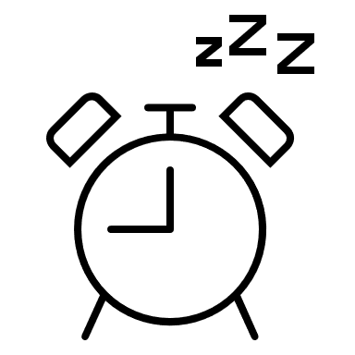

Negative Events – What Can You Do?
When you’re tired, nothing is right
  Sleep is important
    Many benefits of getting sleep, and many costs if you don’t get enough sleep
When we face repeated negative events, our fight or flight response kicks in
  Heart rate increases and blood pressure goes up
    Cumulative – builds up and makes you increasingly susceptible to similar triggers causing this to occur
Meditation can help you recover from repeated negative events

Slide 72

What’s the Benefit?
Short-term benefits of meditation
  10 – 20 minutes → oxygen consumption drops
  You start to slow yourself down
Short-term benefits of sleep
  3 – 4 hours → oxygen consumption drops
  Meditating for a short period of time can help you slow yourself down and allows you to take advantage of the recovery elements of meditation
Continued meditation can give you interpersonal benefits
  Better with people
  Less angry/anxious
  Attention and ability to learn increases

Slide 73
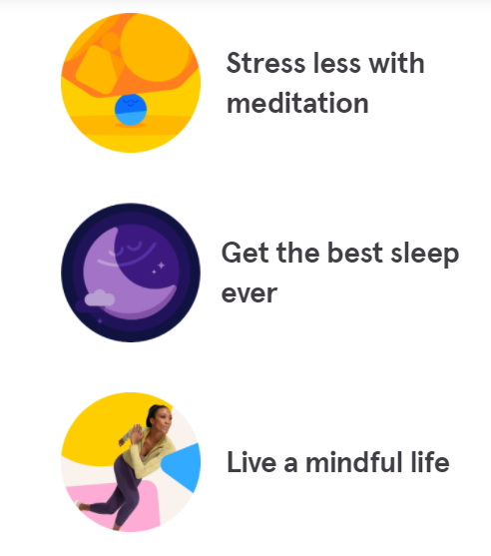

Mindful Meditation
These skills can be practiced at home and/or with a trained/licensed professional
  You don’t have to be highly skilled to take advantage of meditation’s benefits
https://www.headspace.com/meditation/meditation-for-beginners
  Free meditation for beginners
  Take time for yourself

Slide 74
Wrapping Up Emotional Intelligence
What did we learn?
How to identify emotions
  The powerful information identifying emotions provides us
  Pay attention to emotions, practice your skills, and verify the presence of a problem
Emotional management tools
  More accurate thoughts about our emotions
  Practice, practice, practice
The importance of rest and recovery
  Meditation – Headspace

