Slide 1
Economic Development:
Managing your Debt for Growth in your Community
Maggie Burger, Sr. Vice President
Speer Financial, Inc.

Slide 2
DOES YOUR CITY WANT ECONOMIC DEVELOPMENT?
YES

Slide 3
DOES ECONOMIC DEVELOPMENT COST YOUR CITY MONEY?
YES
It doesn’t have to
“break the bank”

Slide 4
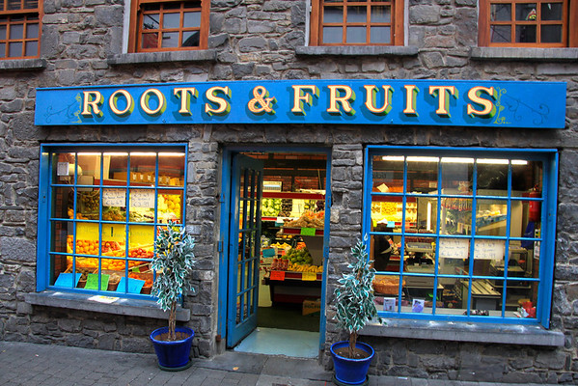
TYPES OF ECONOMIC DEVELOPMENT
Commercial & Industrial
  Incentive for creating a new business, # of new employees
  Infrastructure needs to these developments
Residential & Multi-Residential
  Infrastructure needs to development
  Land purchase costs

Slide 5
ECONOMIC DEVELOPMENT INCENTIVES
COMMERCIAL & INDUSTRIAL
TIF Rebate Agreements
LOST Rebate Agreement
GO Borrowing for Infrastructure or Grant Incentive
Tax Abatement
RESIDENTIAL & MULIT-RESIDENTIAL
TIF Rebate Agreements
  Subject to Low to Moderate Income set aside
Tax Abatement
  Limitations on Abatement of new single-family housing
GO Borrowing for Infrastructure
  Paid with TIF collections or debt service levy

Slide 6
INCENTIVES
TIF Rebate
Tax Abatement
LOST Rebate
New valuation creates TIF increment
Collect increment annually to rebate back to developer
Housing rebates may require LMI set aside
Housing rebates can only be tied to infrastructure costs, not land costs/housing costs
Commercial & Industrial immediate growth in valuation
Housing may take years of growth to maximize.
Urban Renewal Plan work required
Counts against debt capacity
New valuation does not appear on tax rolls or is reduced for set number of years.
Commercial & Industrial sliding scale over 10 years
Residential first $75,000 of new growth abated for up to 5 years
Multi-Residential up to 100% for 10 years
Urban Revitalization work required
Revit plan must be in place before project begins
Set amount annually from total LOST collections of City
New business receipts, based on financials or receipts paid in by new development
No urban renewal or revitalization work needed

Slide 7
GENERAL OBLIGATION BORROWING
Borrow for incentive grant (one time to developer)
Borrow for City to build infrastructure to development; water, sewer, stormwater
Debt repayment from TIF collections, debt service levy or water/sewer/stormwater revenues
  Establish a stormwater utility if not already done
Counts against the City’s debt capacity
Risks in City issuing the debt
City is a developer or partner in development if a GO issuance is done

Slide 8
DEBT CAPACITY CALCULATION
5% OF 100% Actual Valuation
  use military exemption amount
  use regular & agricultural
Total principal of GO; LOST Revenue and TIF Revenue debt counts against debt capacity
Total aggregate amount of rebate agreement counts against, if no annual appropriation language is used
Total annually appropriated amount of rebate counts against
100% Valuation
$109,526,378
At 5%
=$5,476,318
Total GO outstanding $4,205,000
No Rebates outstanding
Remaining Debt Capacity
=$1,217,318
Approximately 22.2% Remaining in
Total Debt Capacity

Slide 9
DEBT CAPACITY
City is NOT developer
City IS developer
Rebate or annual appropriation of rebate counts against debt capacity (minimal amount)
LOST Rebate has no impact on debt capacity
Tax Abatement stalls the growth in valuation until abatement is completed.
All debt should not exceed 80% of total debt capacity, leaving 20% for emergency borrowings
City needs to hold back 50-60% of debt capacity for development borrowings; leave 40-50% for general borrowing needs of City
City should have ample (50-100% of expenses) in capital improvements fund balance to purchase land – no borrowing (do not take from general fund)
City should have “claw back” with developer in case development does not happen, City can ask for money back to pay down/off debt

Slide 10
RISKS TO CITY BEING DEVELOPER- GO ISSUANCE
What if City borrows GO debt and the development never grows new valuation?
  The current residents may feel the debt burden by paying a debt service levy for debt issued
  GO debt payments begin immediately, even with successful development, you are 18-24 months before new valuation is available
  If granting to developer, only grant amounts incrementally when certain development levels are achieved
City cannot collect TIF receipts to pay themselves for land purchase, only infrastructure costs on residential
Did the City put infrastructure to an area that is attractive for development by another developer?
If the City bought the land and gives it away how is the debt paid?
  Important to have cash for these purchases if you MUST buy land
IS A BANK LOAN GENERAL OBLIGATION DEBT? YES YES YES!!

Slide 11
IDEAS – SOLUTIONS- BEST PRACTICES
Update or have a comprehensive plan done, see what your City’s needs are
Utilize Capital Improvement Planning: PLAN, PLAN, PLAN
Align common stakeholders around a common vision
Establish an Economic Development Incentive Policy
Partner with developer, pay a portion of costs, not ALL the costs
  Or partner with local economic development group
In partnership City is paid back first before developer
Know the economic benefits of development, not just social benefits
Work to save money, grow fund balances, review utility rates regularly

Slide 12
DISCUSSION TAKE AWAYS
Debt Capacity is precious and does not grow quickly
Economic Development is vital to sustaining most Cities
Do not make snap decisions- PLAN
Look for economic development partners
Make the City’s repayment of their commitment first above all partners
THANK YOU
Maggie Burger, Sr. Vice President
Speer Financial, Inc.
mburger@speerfinancial.com

