Slide 1
IOWA LEAGUE OF CITIES
ANNUAL CONFERENCE & EXHIBIT
Being/Become Disaster Strong: Harnessing Disaster Volunteers
Lori Williams, Iowa Department of Homeland Security and Emergency Management
Michael Rojas, Volunteer Iowa
Rick Wulfekuhle, Buchanan County Emergency Management Agency
HANDOUTS & PRESENTATIONS ARE AVAILABLE THROUGH THE EVENT APP

Slide 2
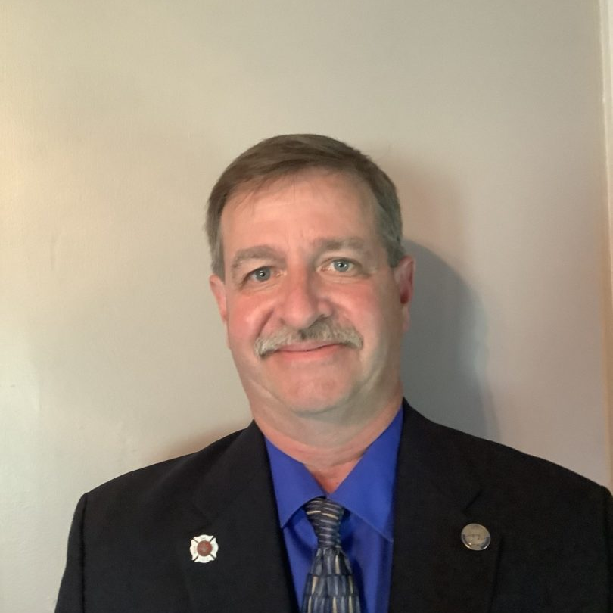
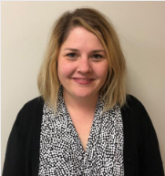
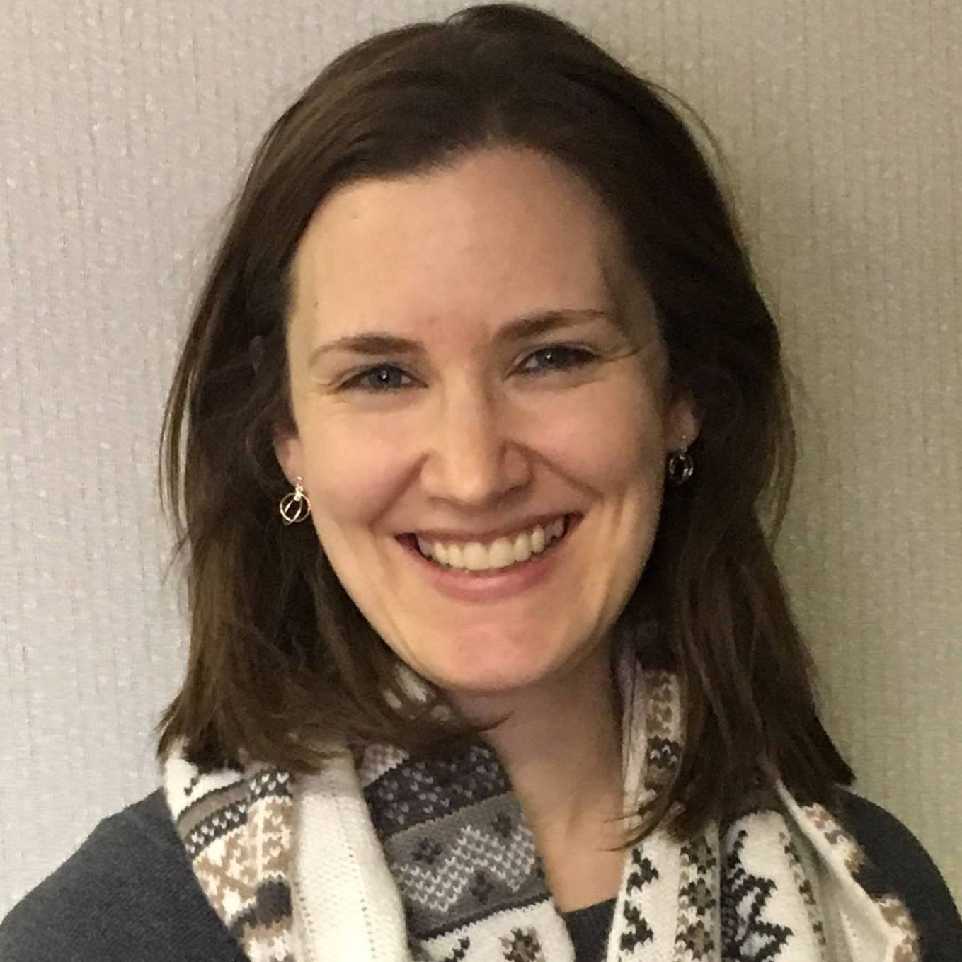
Welcome & Introductions
Rick Wulfkuhle
Buchanan Emergency Management Office
Julie Struck
VISTA & Disaster Program Officer
Lori Williams
Iowa Department of Homeland Security and Emergency Management

Slide 3
HOUSE KEEPING

Slide 4
AGENDA Why Planning and Volunteers Matter Disaster Volunteer Groups Collaborative Disaster Organizations Group Discussion: How does disaster/emergency volunteerism and planning impact your community?

Slide 5
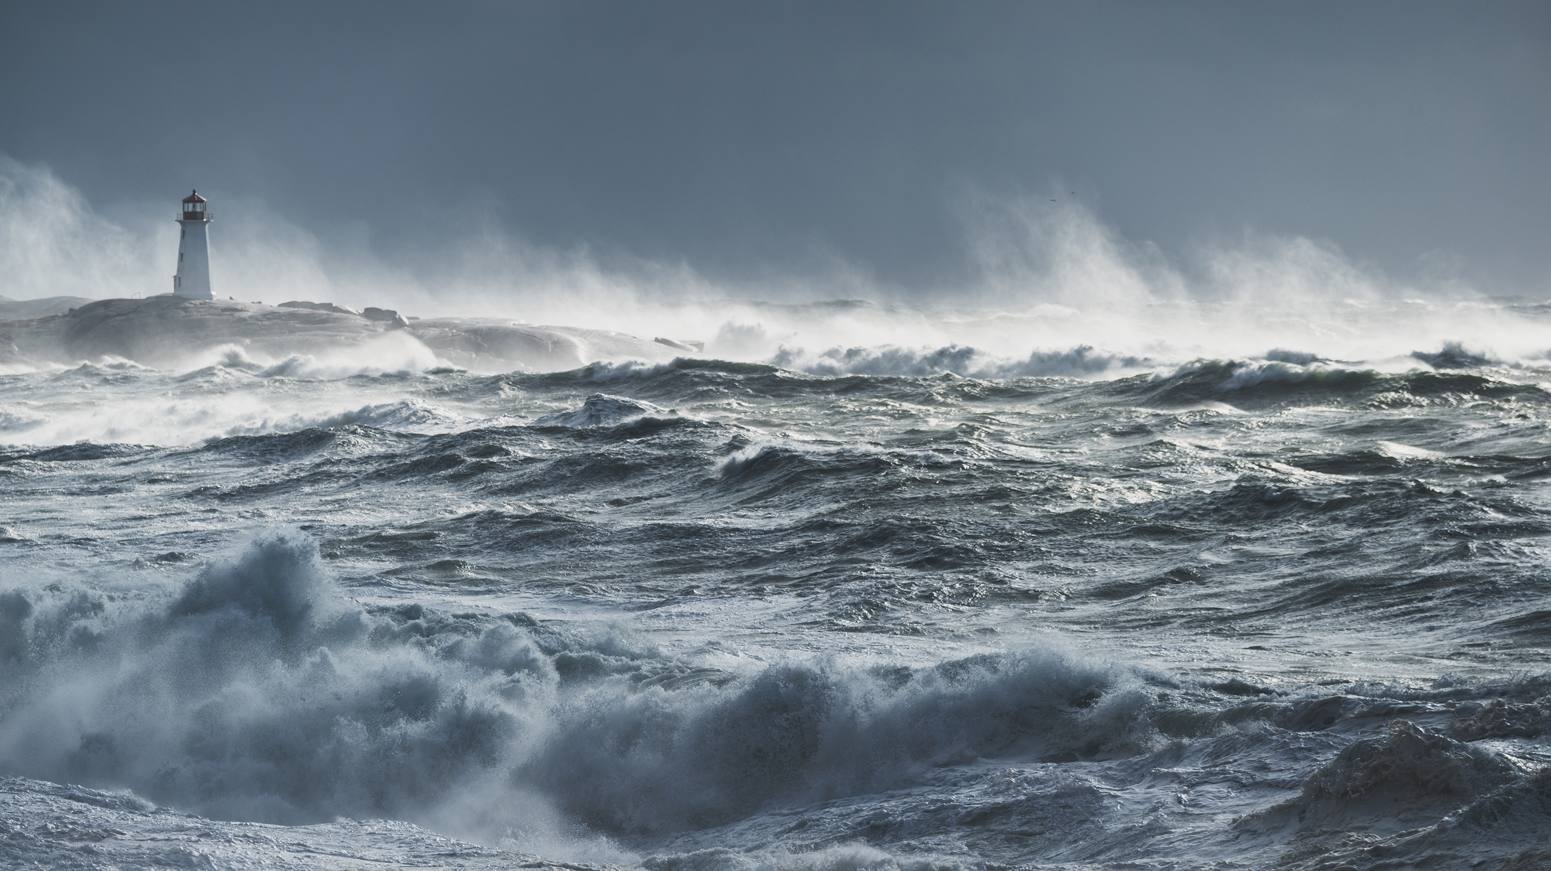
It begins
and Ends Local
Notes:
- 2 minutes (RICK)
Benefits the organization, volunteer, and community at large
Cost Match to the Community and State
(volunteers are going to show up; make sure highest elected officials are involved and know their role)

Slide 6
5 W`s of Disaster
Who – all populations
What – to do (as officials) when disaster happens
When – (ideally) before it happens
Where – starts and ends locally
Why – it's the true key to recovery

Slide 7
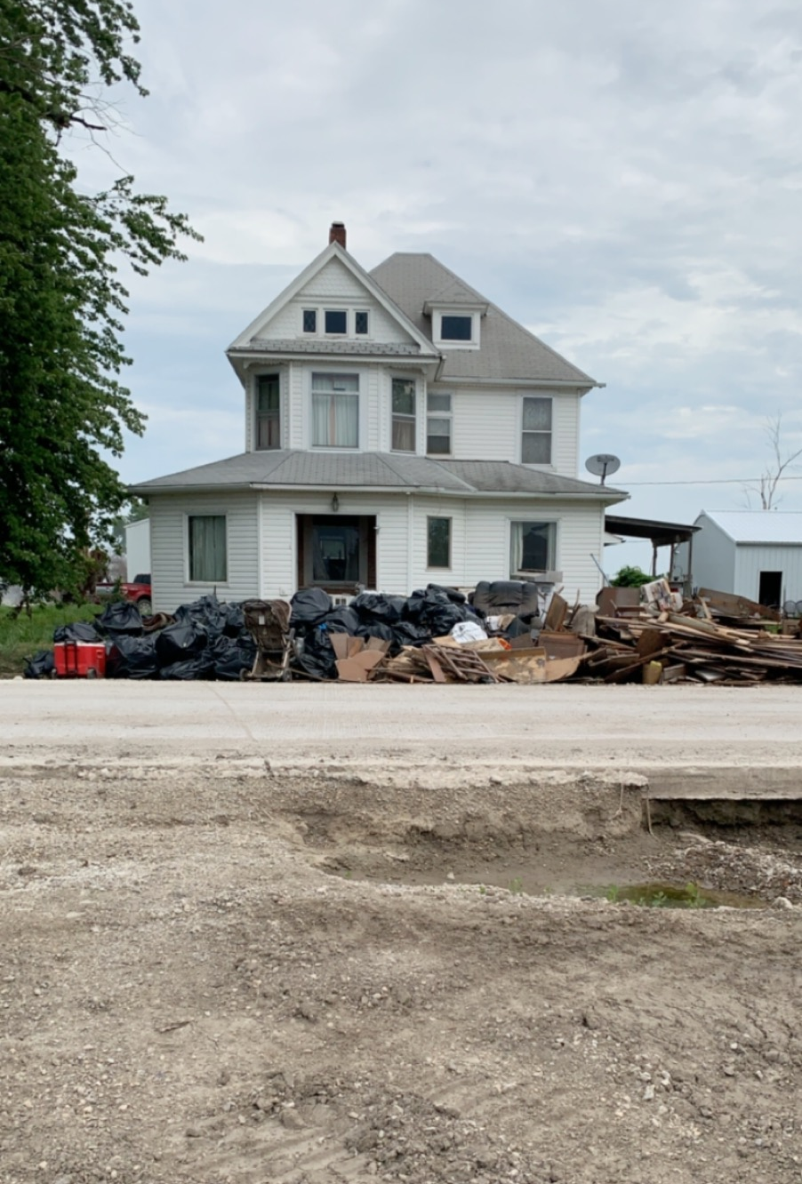
National Service & Disaster Volunteers​
AmeriCorps Disaster Response Teams​
2020 COVID-19 Pandemic ; Derecho : Feeding Iowan`s Task Force, Clean-Up Volunteer Mgmt. , Mission Assignment management and organization.
2019 Floods: (Fremont County along Missouri River) Volunteer Reception Center, clean - up efforts; (Scott County along Mississippi River) in-kind Donations Management​.
2018 Marshalltown Tornado: Volunteer Cleanup, Long Term Recovery Group (LTRG) stood up.
Notes:
Examples of how National Service, Volunteering, and Planning have supported Iowa Communities.
How to harness them and get connected from the Local to the State level.

Slide 8
"Having established partnerships with organizations, businesses, and the governments of the communities in Black Hawk County as we prepare to manage volunteers during times of disasters has been vital! We all understand the impact volunteers can provide, but creating a plan, highlighting partners, and defining timelines has been so important in the preparedness of our community."
Lauren Finke, Executive Director​ Volunteer Center of Cedar Valley

Slide 9
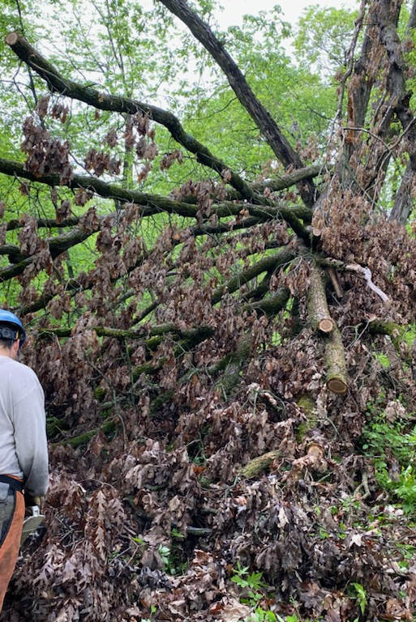
AmeriCorps Disaster Response Teams
AmeriCorps Disaster Response Teams (A-DRT)​ Grantees and NCCC
Overview:​
Current AmeriCorps programs with heightened focus on disaster services​
Serve as nationally deployable resources​
Follow standard, established protocol in the field when deployed and are under the management of the CNCS Incident Command System​
Tactical ​
Provide direct service support:​
Volunteer and donations management​
Leadership​
Capacity building​
Technical assistance​
Direct Field work: mucking/gutting/debris removal/shelter assistance/ etc.​
​

Slide 10
AmeriCorps & Emergency Management
​
AmeriCorps Member Training​
Introduction to Disaster Preparedness Training​
CPR & First Aid Training​
​
AmeriCorps Program Disaster Role​
Programs establish and maintain a disaster-oriented role with Volunteer Iowa to assist in disaster preparedness, response, recovery and/or mitigation activities.

Slide 11
Joplin Missouri Initial AmeriCorps Response
Sunday May 22, 2011
17:50 – Tornado hits
19:30 – AmeriCorps Teams convened at HQ
20:45 – AmeriCorps St. Louis Director arrives in Joplin
Monday May 23, 2011
02:30 – 1st Wave of AmeriCorps arrive
24 Members on the ground
07:00 – 3 Members arrive at United Way 211 to support overflow call volume
12:00 – 2nd Wave of AmeriCorps arrive
62 Members on the ground

Slide 12
How Volunteer Iowa can get you started?
Before Disasters
Help identify resources you need to get started​
Volunteer Reception Center training & simulation​
Connect to relevant partners​
Connect Corporate Volunteers​
Engage national service resources​
Student Volunteers ​
Support/lead partner meetings ​
During disasters​​
Provide Just in time volunteer management training​​
Assist with volunteer data collection and reporting​​
Support organization to stand-up operation ​​
Partner with state VOAD
Connect with local COAD/VOAD/LTRG’s​​
Triage issues related to vol/don management
Notes:
State of Iowa Response Plan
Volunteer and Donations Annex lead
AmeriCorps disaster response team - ADRT
Partner with state VOAD
Facilitate trainings for Volunteer Reception Centers

Slide 13
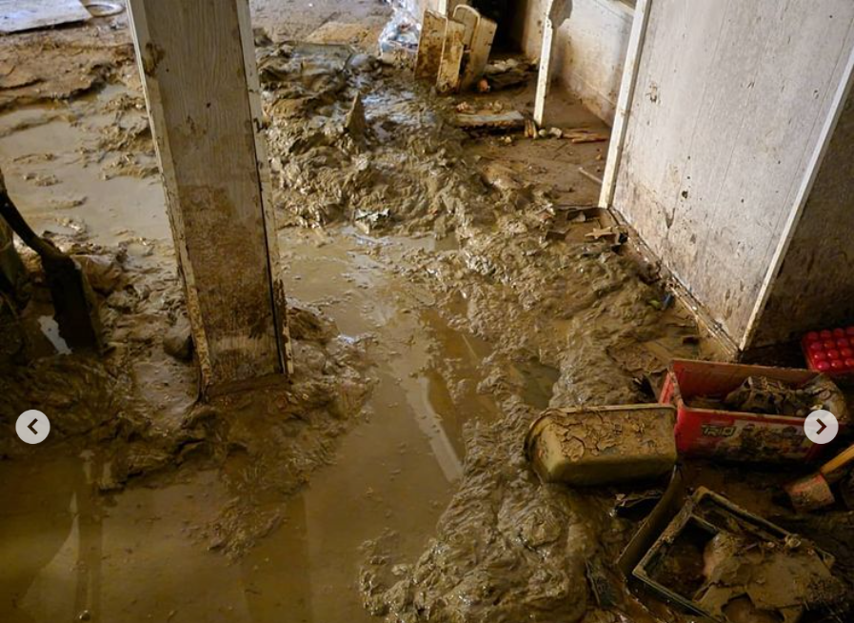
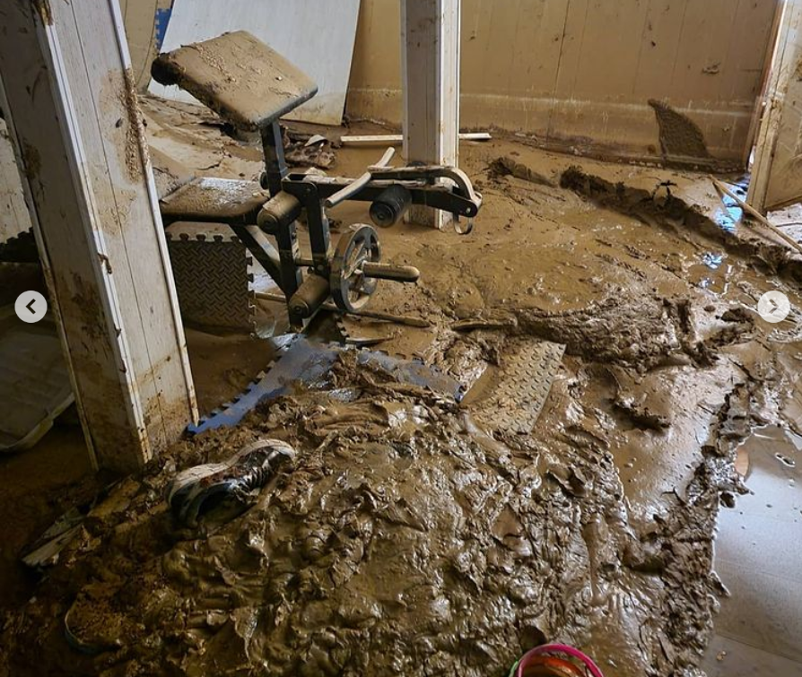
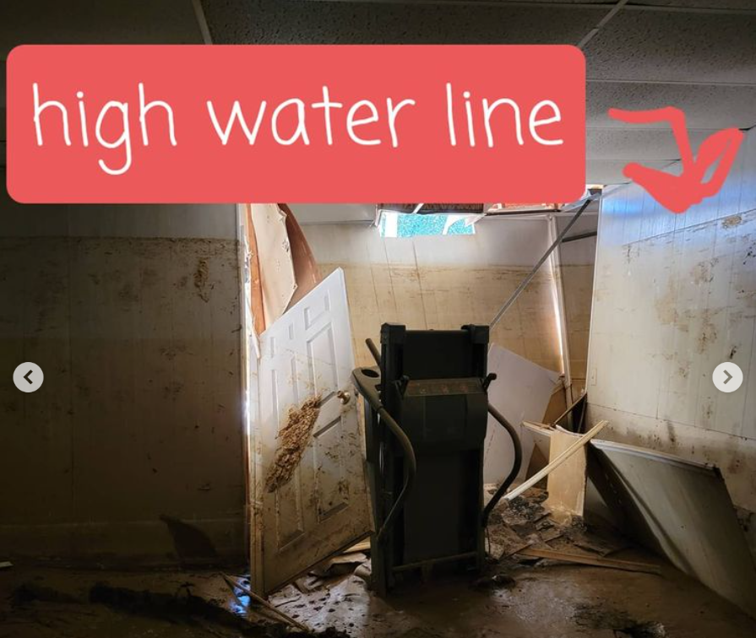
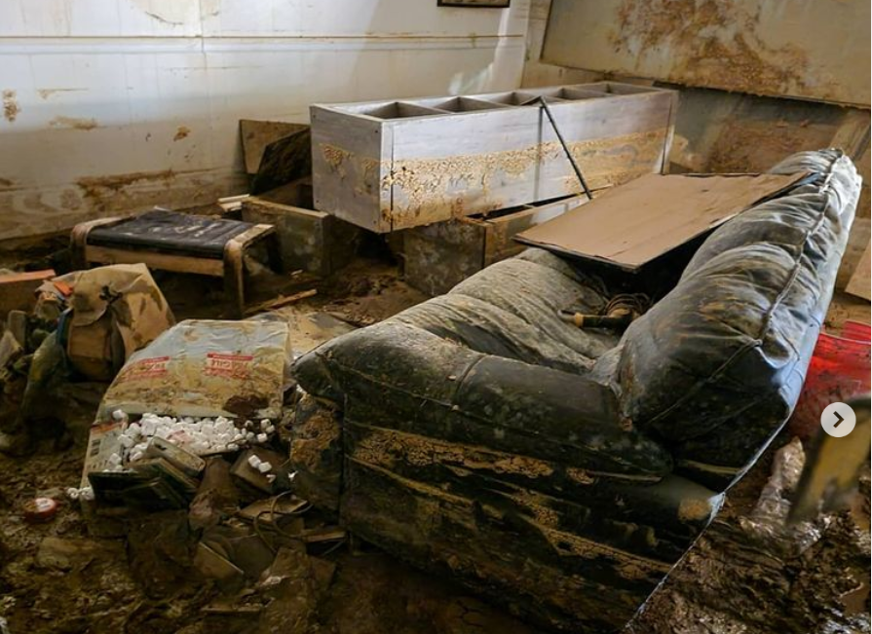
Before AmeriCorps Disaster Response Teams (A-DRT)
Hurricane Ida 2021

Slide 14
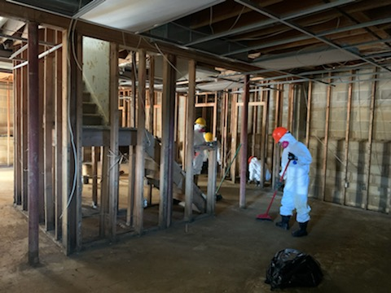
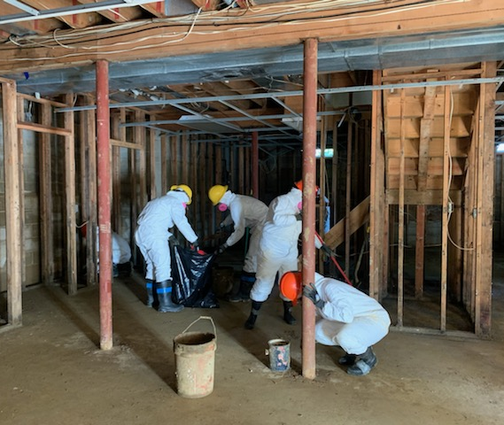
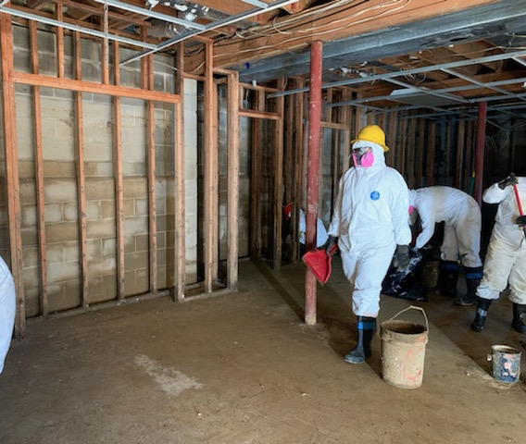
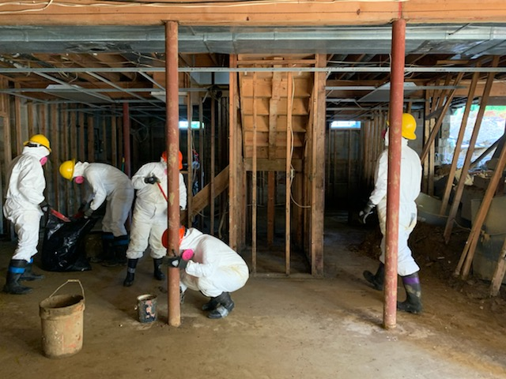
After AmeriCorps Disaster Response Teams (A-DRT)
Hurricane Ida 2021​

Slide 15
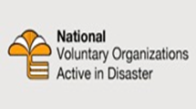
Collaborative Disaster Organizations
Learn More Donate Volunteer

Slide 16
Iowa Disaster Human Resource Council
Statewide
Established in 2001 by the Iowa Department of Homeland Security and Emergency Management at the request of the Iowa Emergency Management Association.
Umbrella organization bringing together faith-based, voluntary, nonprofit, and public organizations active in disaster services.
A forum where organizations share knowledge and resources throughout the disaster cycle – preparation, response, recovery and mitigation – to help disaster survivors and their communities.

Slide 17
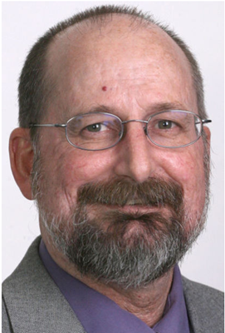
Benefits of COAD Engagement
“I can safely say that after going through the floods of 2008, that without having a COAD it would have been very difficult for our county to recover from all of the damage that happened to individuals and the businesses. A COAD is a definite necessity to help those people that normally would fall through the cracks.
I'd like to say that our COAD maintained through the years, but it did drop off. But, it is such an important institute to have that we have actually started, not just Cerro Gordo County, but a four county area to build a new COAD and to get proactive and to actually have it before another disaster hits… so that if that does happen we are ready to cover and help those people to get through the disaster and move as quickly as we can.”
Steve O’Neil ​, Emergency Management Coordinator,​ Cerro Gordo County​
​

Slide 18
Community Organizations Active in Disaster (COAD)
Goals
Establish Communication, Cooperation, Coordination and Collaboration
Enhance the community’s ability to prepare, respond, recover and mitigate
Alleviate the suffering caused by disasters
Develop a coordinated approach to resources and human services
Develop plans, training, and exercises for disaster operations
A community organization, based within a county or geographic area, made up of representatives from public, private, volunteer and nonprofit agencies and organizations who may be active in all phases of disaster: mitigation, prevention, preparedness, response and recovery.​

Slide 19
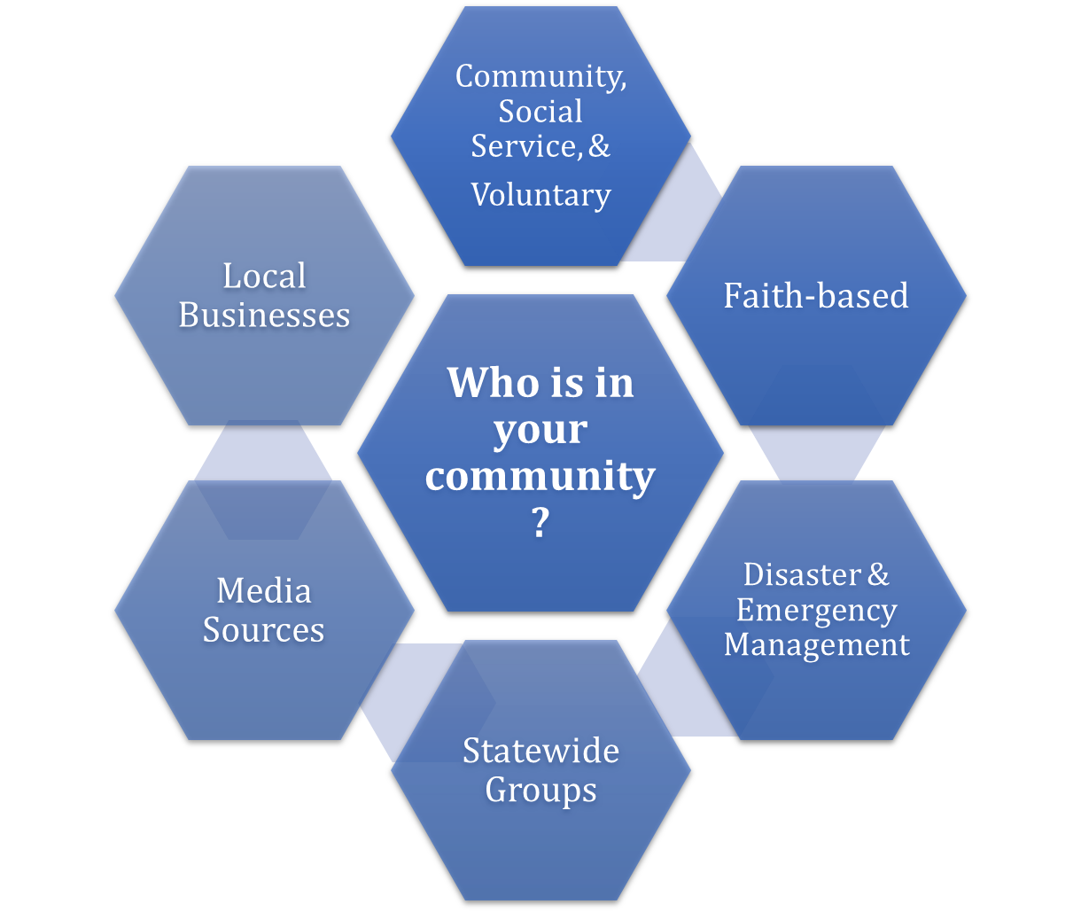
Collective Coordination

Slide 20
Impact Areas
Communication​​​​
Donations Management​​​​
Emergency Assistance​​​​
Emotional, Mental and Spiritual Care​​​​
Volunteer Coordination​​​​
Financial/Resource Assistance​​​​
Mass Care

Slide 21
Benefits of COAD Engagement
Quicker Response
Learn and Improve – Apply the lessons learned
Build trust BEFORE disaster
Reduce duplication
Identify and fill gaps
Broad, unified communication
Situational awareness
Monetary benefit
Force multiplier
= Resilient and strong communities

Slide 22
Public-Private Partnerships
"Any type of mutually beneficial cooperative arrangement, informal or formal, between two or more organizations of private industry and the public sector to enhance the life safety, economic security and resilience of jurisdictions."
FEMAs Building Private-Public Partnerships guide
Notes:
(add either a quote or examples or maybe details on HSEMD's priority on public-private partnerships)
Address resilience challenges
Confirm mutual priorities
engage in problem-solving dialogue
identify capabilities that benefit the whole community
scalable from a local crisis to a national disaster

Slide 23
Group Discussion: How does disaster/emergency volunteerism and planning impact your community?
What disasters have you experienced in your community? Did you have opportunities as community members to help with the recovery? Or your organization? What did you observe?
Do you interact with your county emergency management office/coordinator?
Have you been involved in updating or exercising your disaster response plan?
Are you responsible for organizing volunteers or currently a volunteer in your community?
What activities do you currently do that would also benefit your community after a disaster?
If there is one thing from our discussion today that you would like to bring back to your community, what would that be?
What questions do you need to ask in your community to learn?
Notes:
- 25 minutes
(A panel discussion to allow all individuals who are part of Disaster Preparedness, Response, and Recovery to discuss their experiences with previous disaster and how volunteerism played into the overall response. Prompts will be given with regards to planning, structure, and overall readiness in the likelihood of a Disaster.)
Round Robin style discussion with prepared questions/prompts

Slide 24
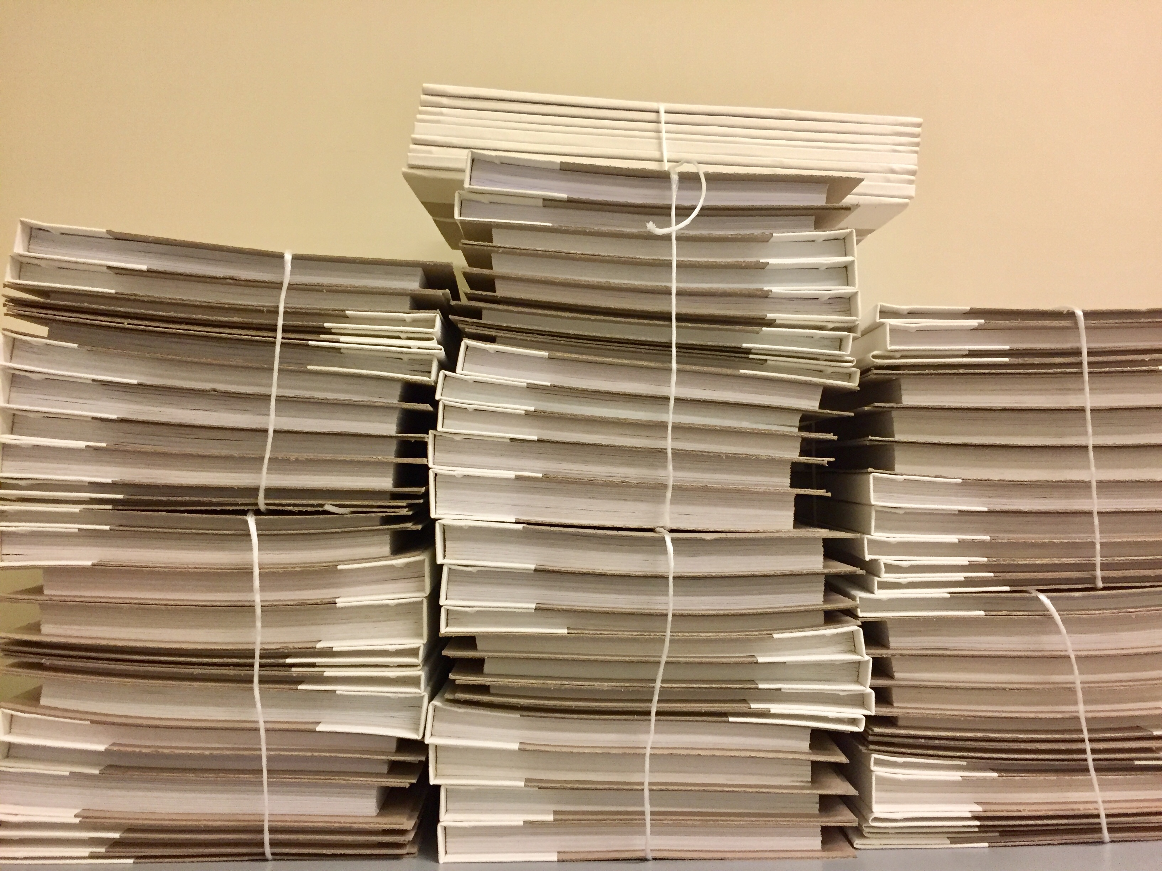
Helpful Resources/Websites
Find your Emergency Management Coordinator https://homelandsecurity.iowa.gov/county-EM/ ​
Iowa Disaster Human Resource Council https://www.iavoad.org/ ​​​
Ready Iowa https://ready.iowa.gov/ ​​​
Volunteer Iowa (Iowa Commission on Volunteer Service) https://www.volunteeriowa.org
National VOAD nvoad.org
Resource Center
Points of Consensus
Committees with subject matter expertise
HandsOn Network & Points of Light Institute https://www.pointsoflight.org
Catholic Charities USA https://www.catholiccharitiesusa.org/resource/disaster-training-videos/
FEMA https://www.fema.gov
Notes:
Handouts – Starting a COAD document (Lori), CERT, IDHRC Flyer
Copies of the ppt?

Slide 25
Questions?

Slide 26
CONTACT INFO
Julie Struck, Julie.Struck@volunteeriowa.org
VISTA & Disaster Program Officer, Volunteer Iowa
Disaster Training, Volunteer Coordination, Facilitating Conversation & Connections, Disaster Response
Lori Williams, Lori.Williams@iowa.gov
Voluntary Agency Liaison, Iowa Department of Homeland Security and Emergency Management
Training/Coordination/Community Support for: Volunteer, Donations, COADs, Long Term Recovery Groups, Mass Care, Unmet Needs
Rick Wulfkuhle, rwulfekuhle@co.buchanan.ia.us
Coordinator, Buchanan County Emergency Management Agency
Emergency Management, CERT, COAD/VOAD networks

Slide 27
Thank you!!!

Slide 28
Hand Outs

Slide 29
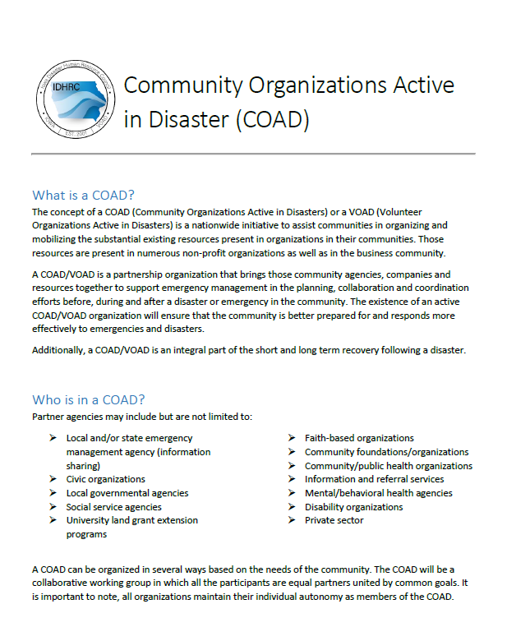
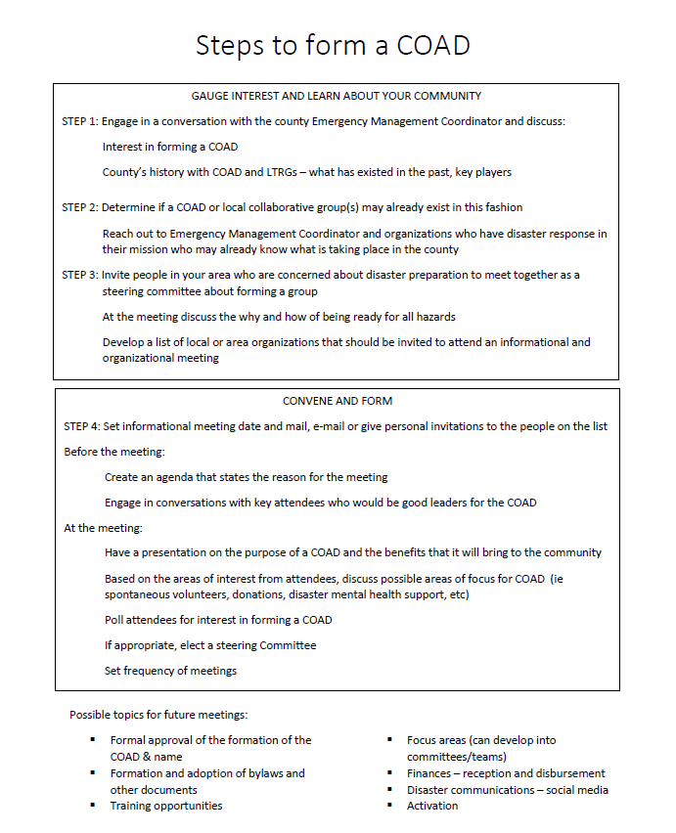

Slide 30
CERT Trifold page 1

Slide 31
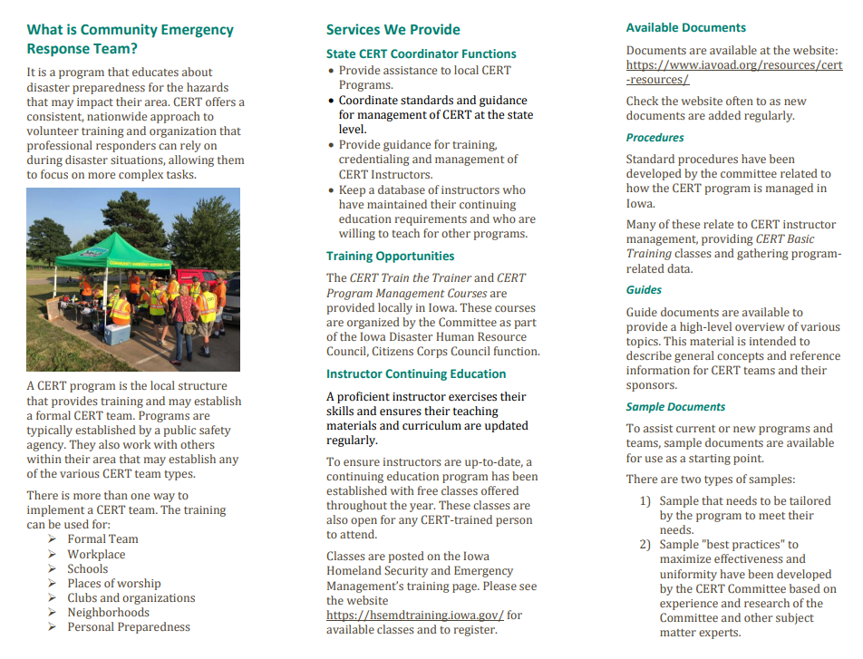
CERT Trifold page 2

Slide 32
