Slide 1
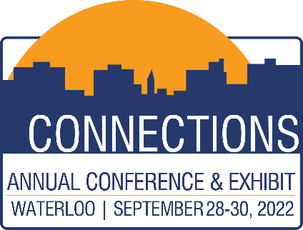
IOWA LEAGUE OF CITIES
ANNUAL CONFERENCE & EXHIBIT
Building Community Through Arts and Culture
Jon Berg, Program Manager, Iowa Department of Cultural Affairs
Heidi Fuchtman, Director, Youth Art Team
Chawne Paige, Curator, Waterloo Center for the Arts
HANDOUTS & PRESENTATIONS ARE AVAILABLE THROUGH THE EVENT APP

Slide 2
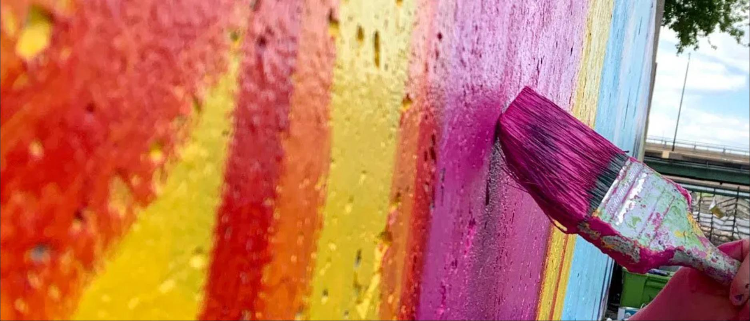

Building Community
THROUGH ARTS & CULTURE

Slide 3



CHAWNE PAIGE
waterloocenterforthearts.org
HEIDI FUCHTMAN
youthartteam.com
JON BERG
iowaculture.gov/arts.com

Slide 4
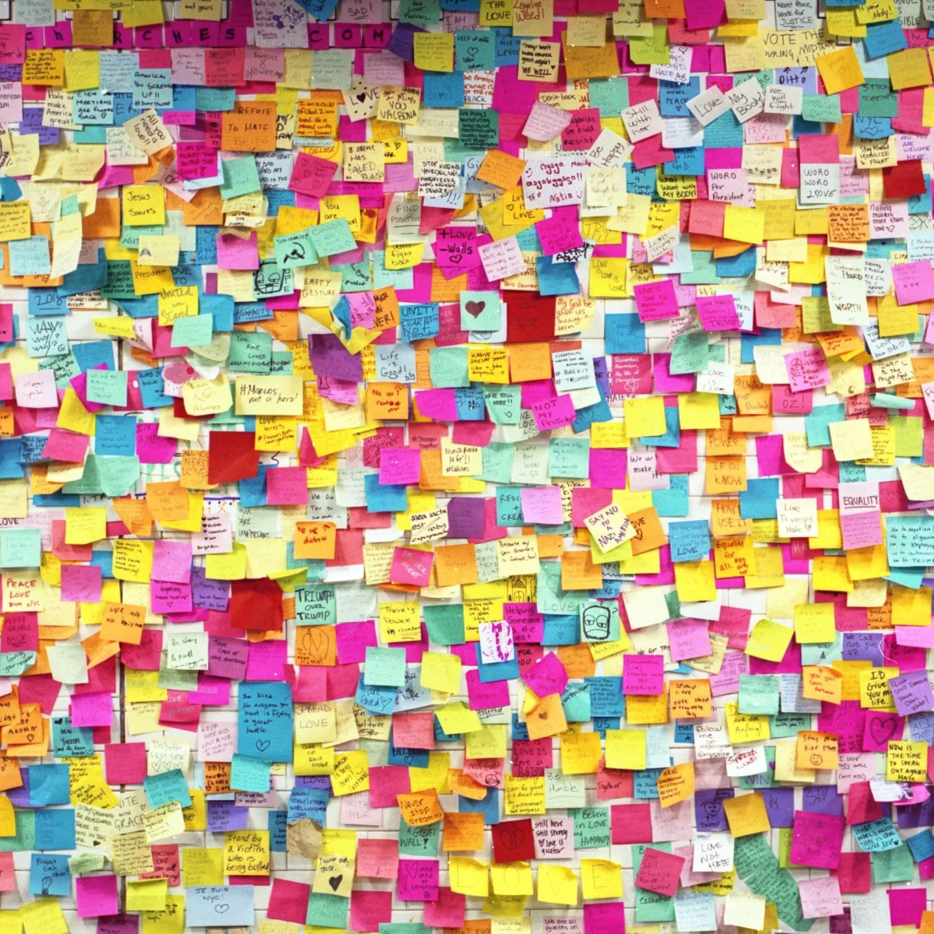
Lets make a 20’ post-it sculpture thats solar powered?

Slide 5
Creative place-making in urban centers
and rural communities

Slide 6

CHAWNE PAIGE
Waterloo Center for the Arts
Curator

Slide 7
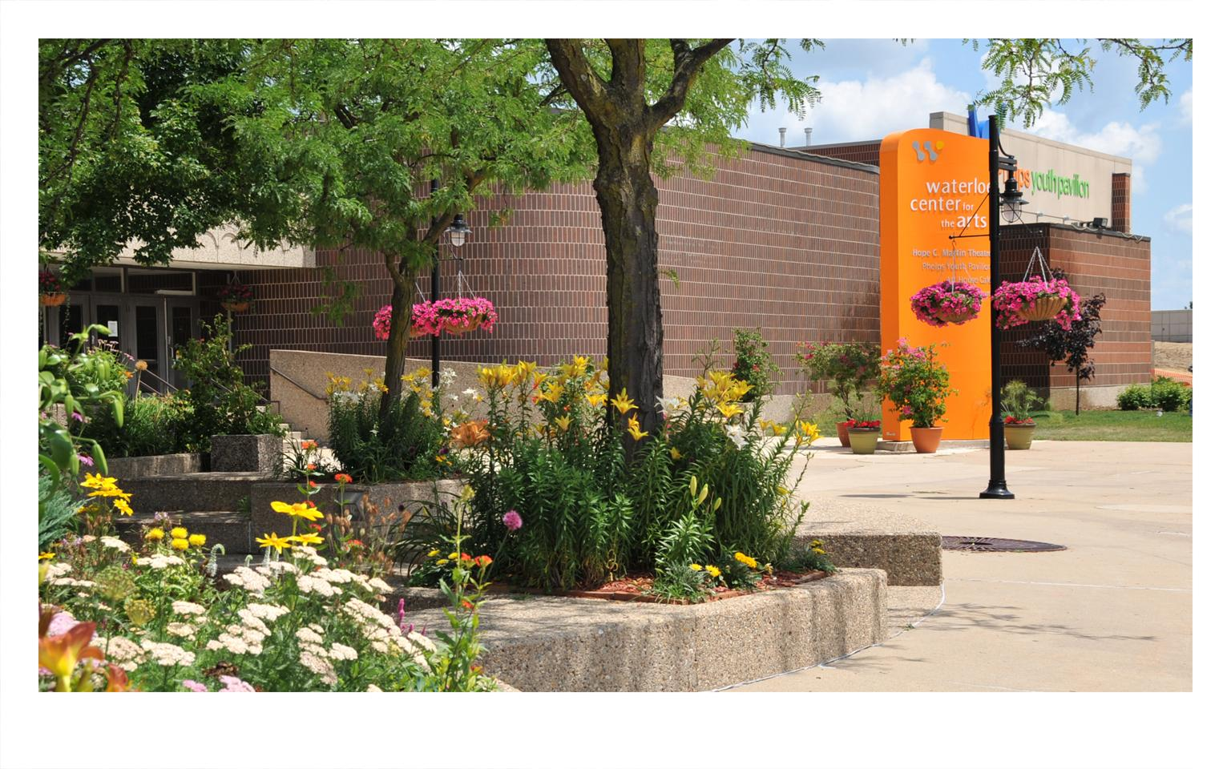

Slide 8
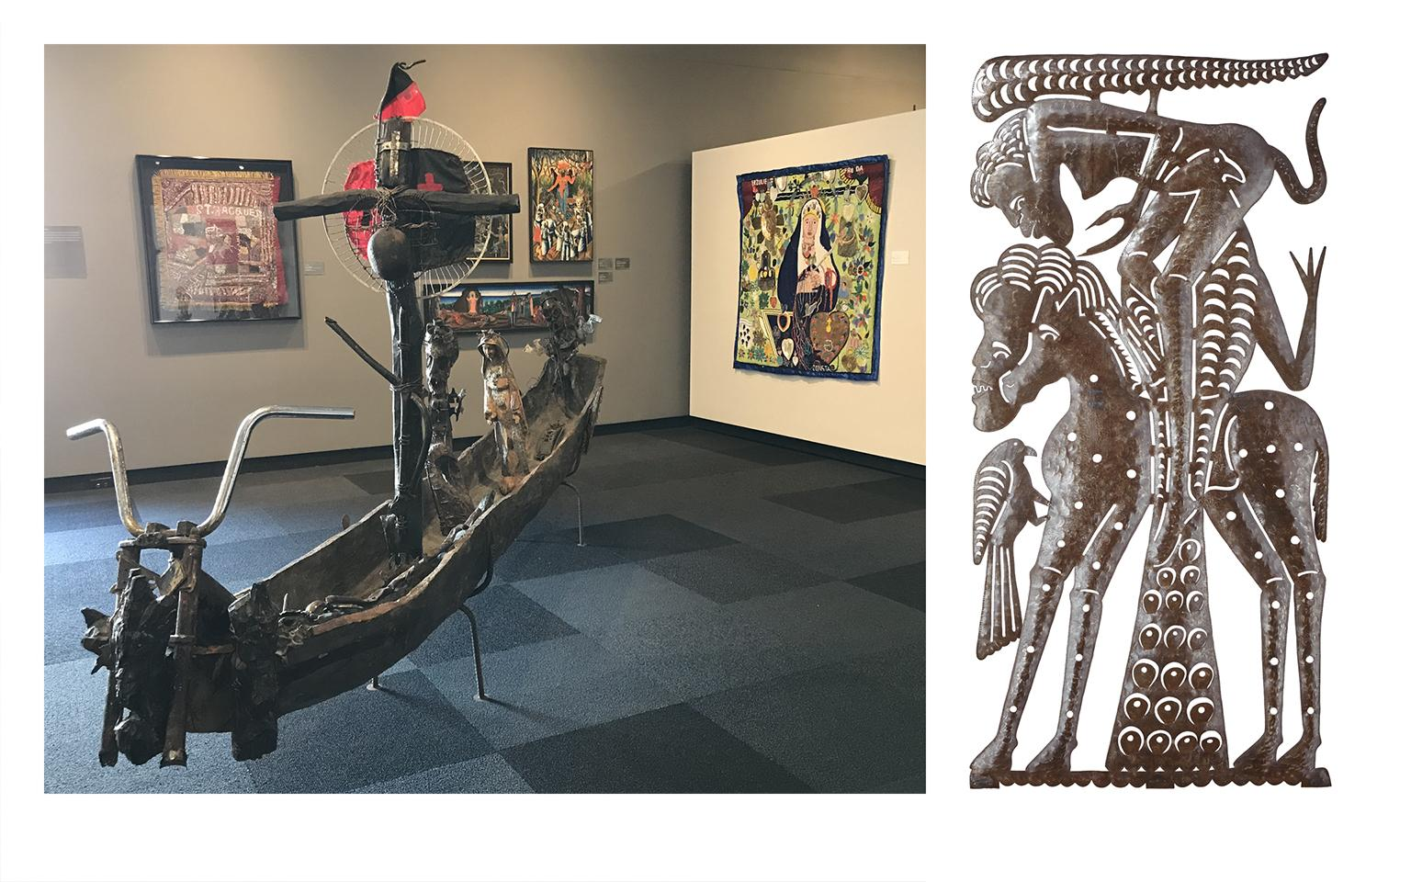

Slide 9
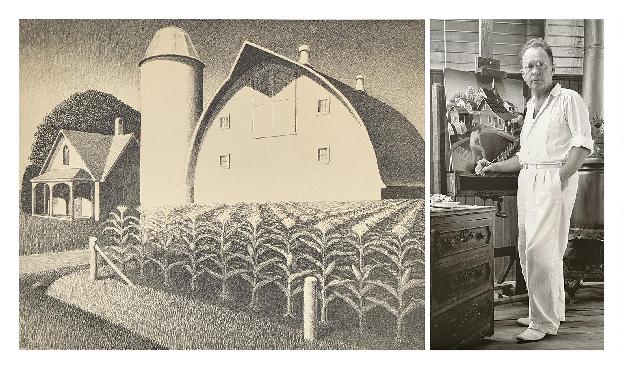

Slide 10
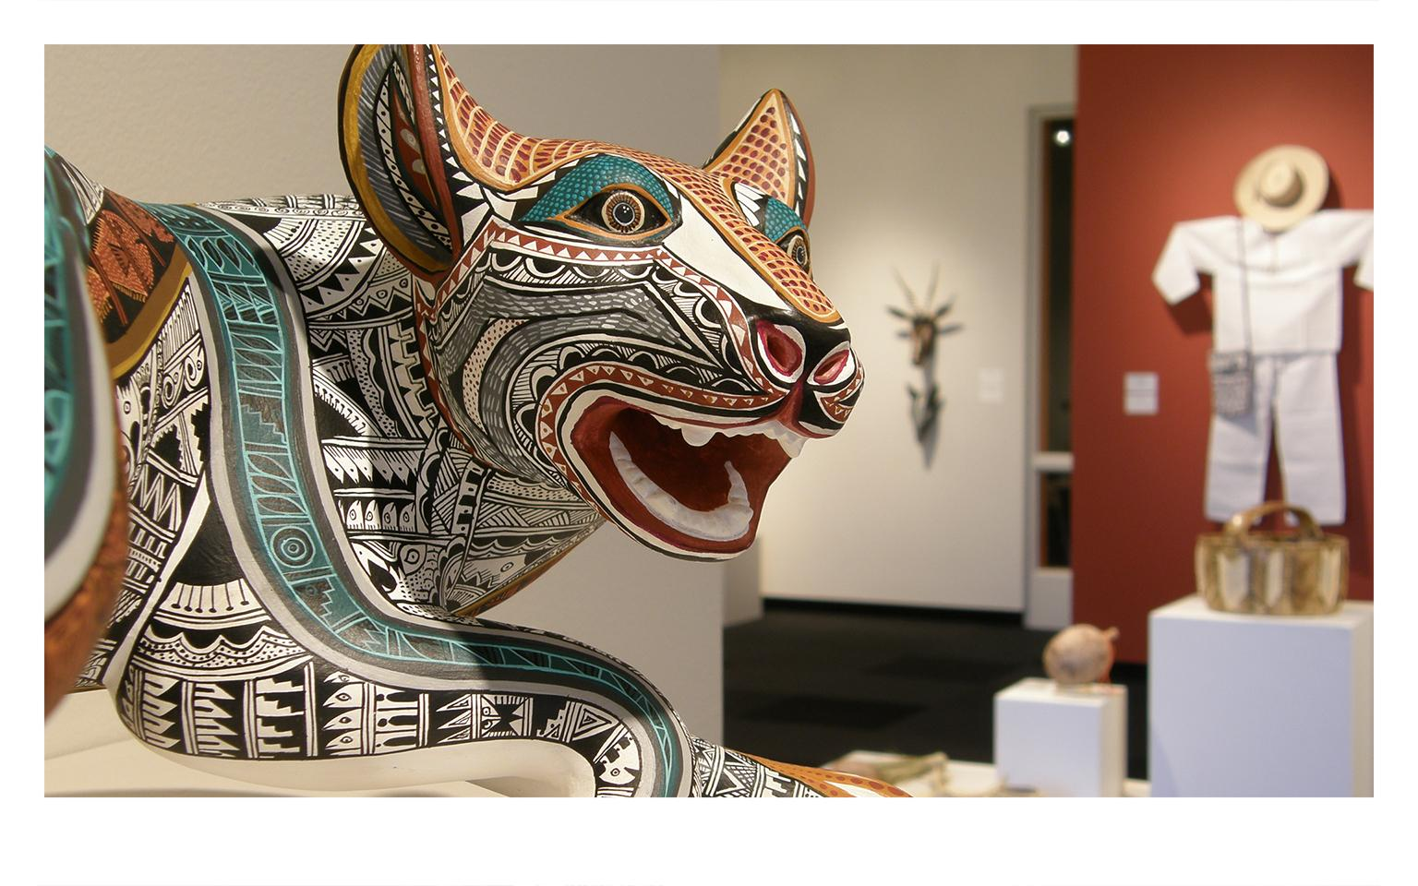

Slide 11
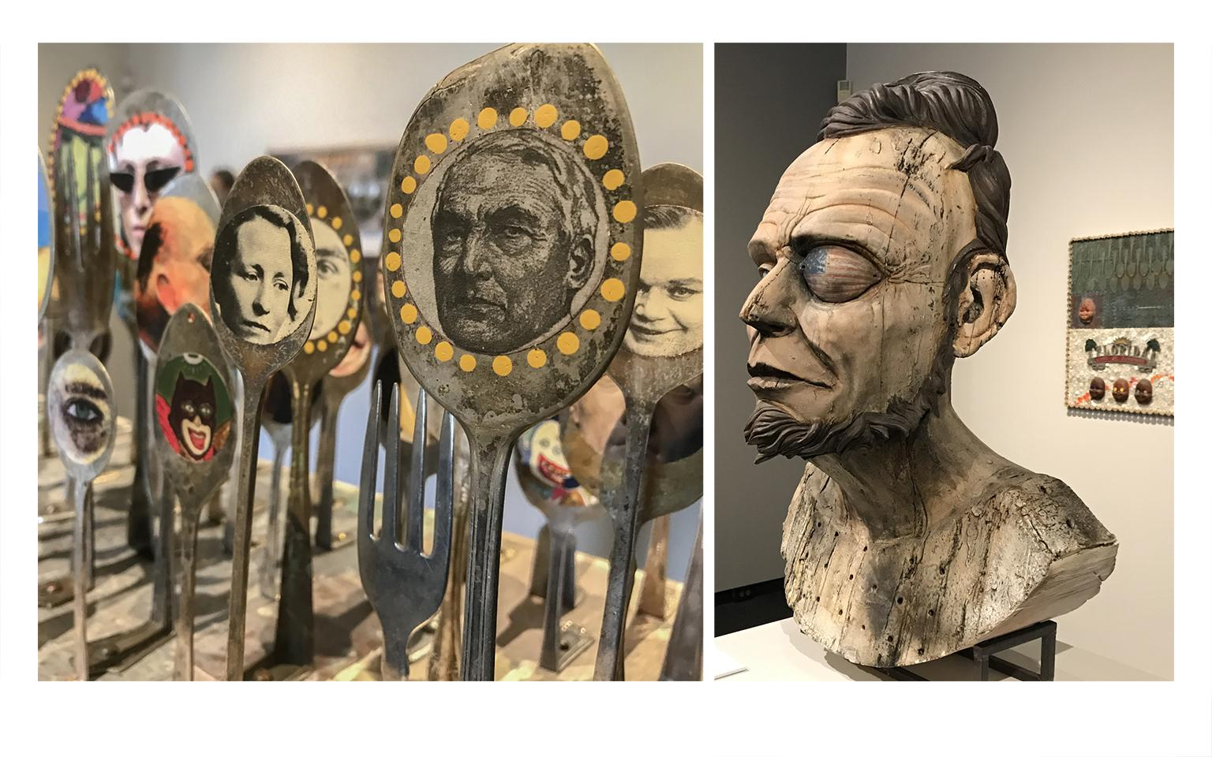

Slide 12
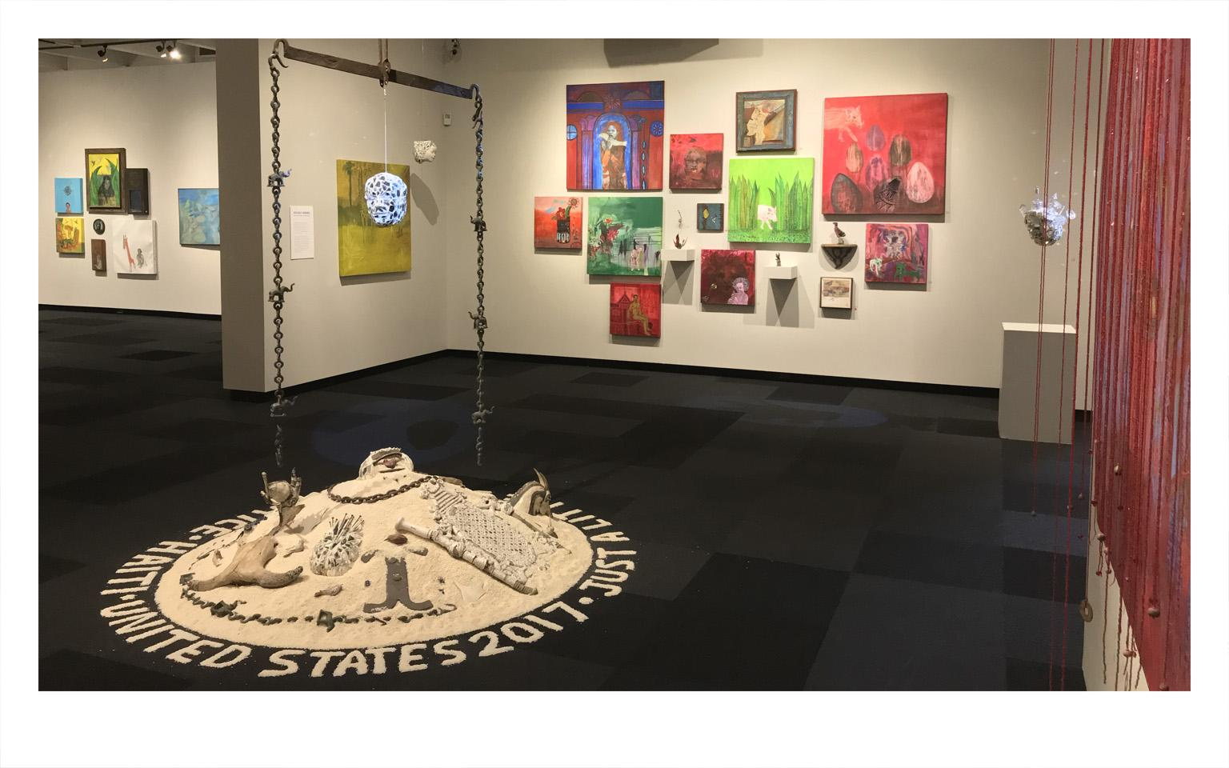

Slide 13
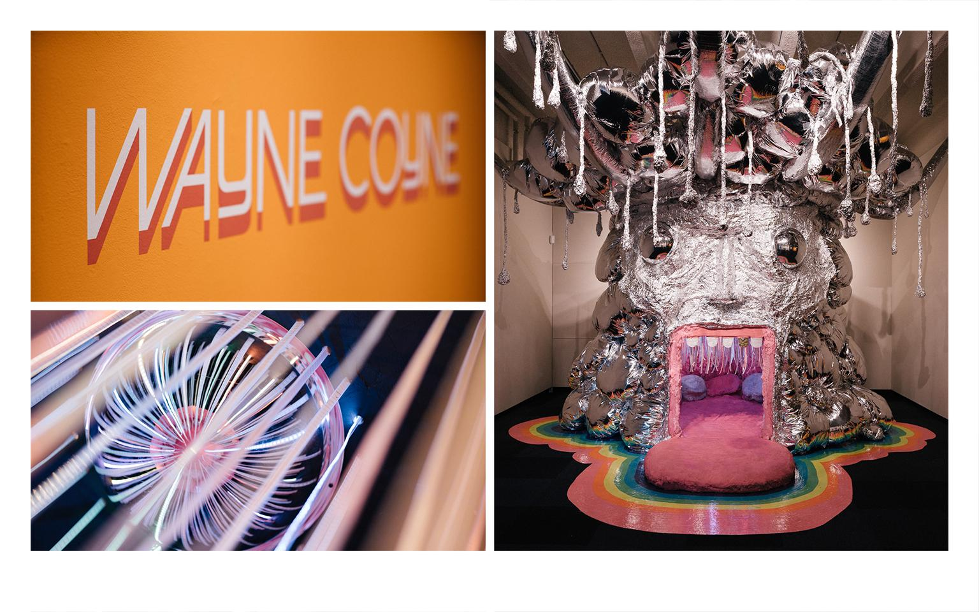

Slide 14
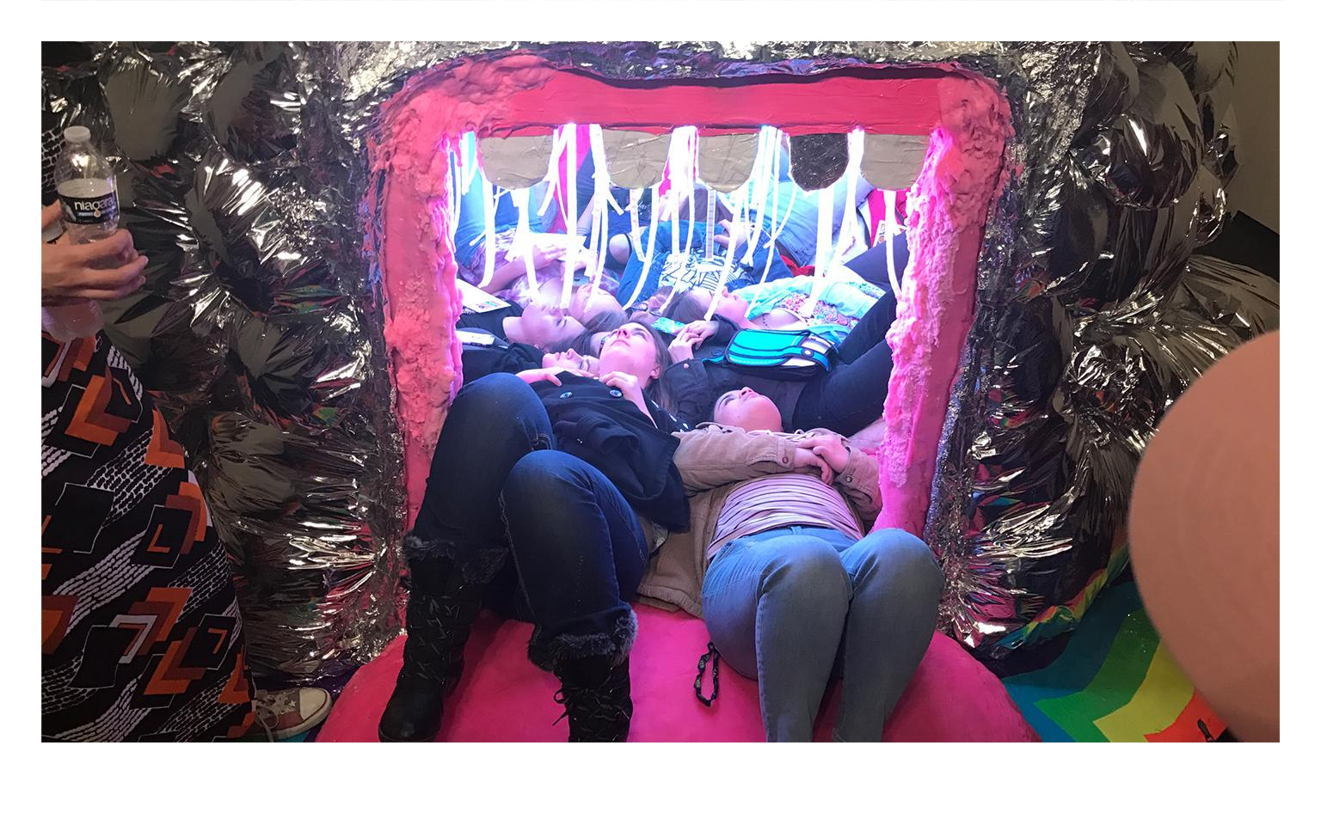

Slide 15
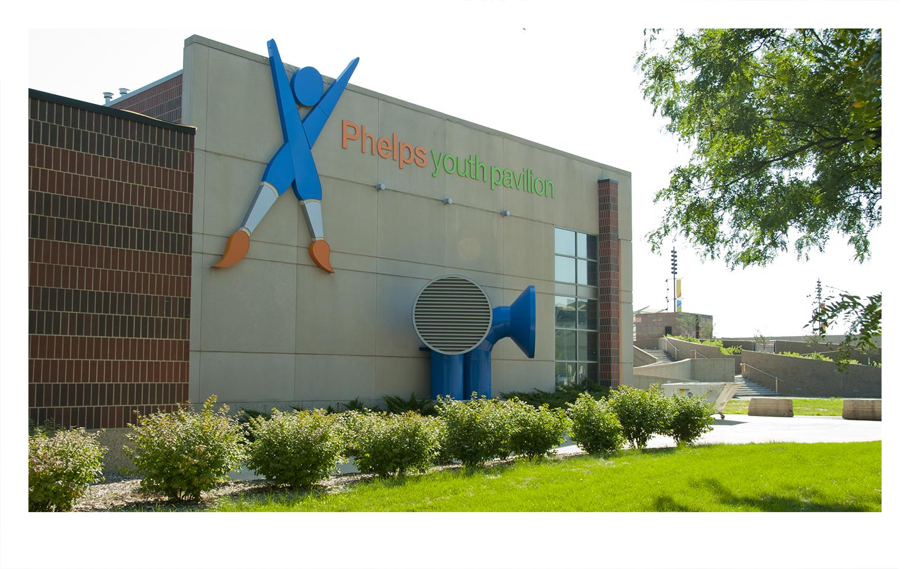

Slide 16
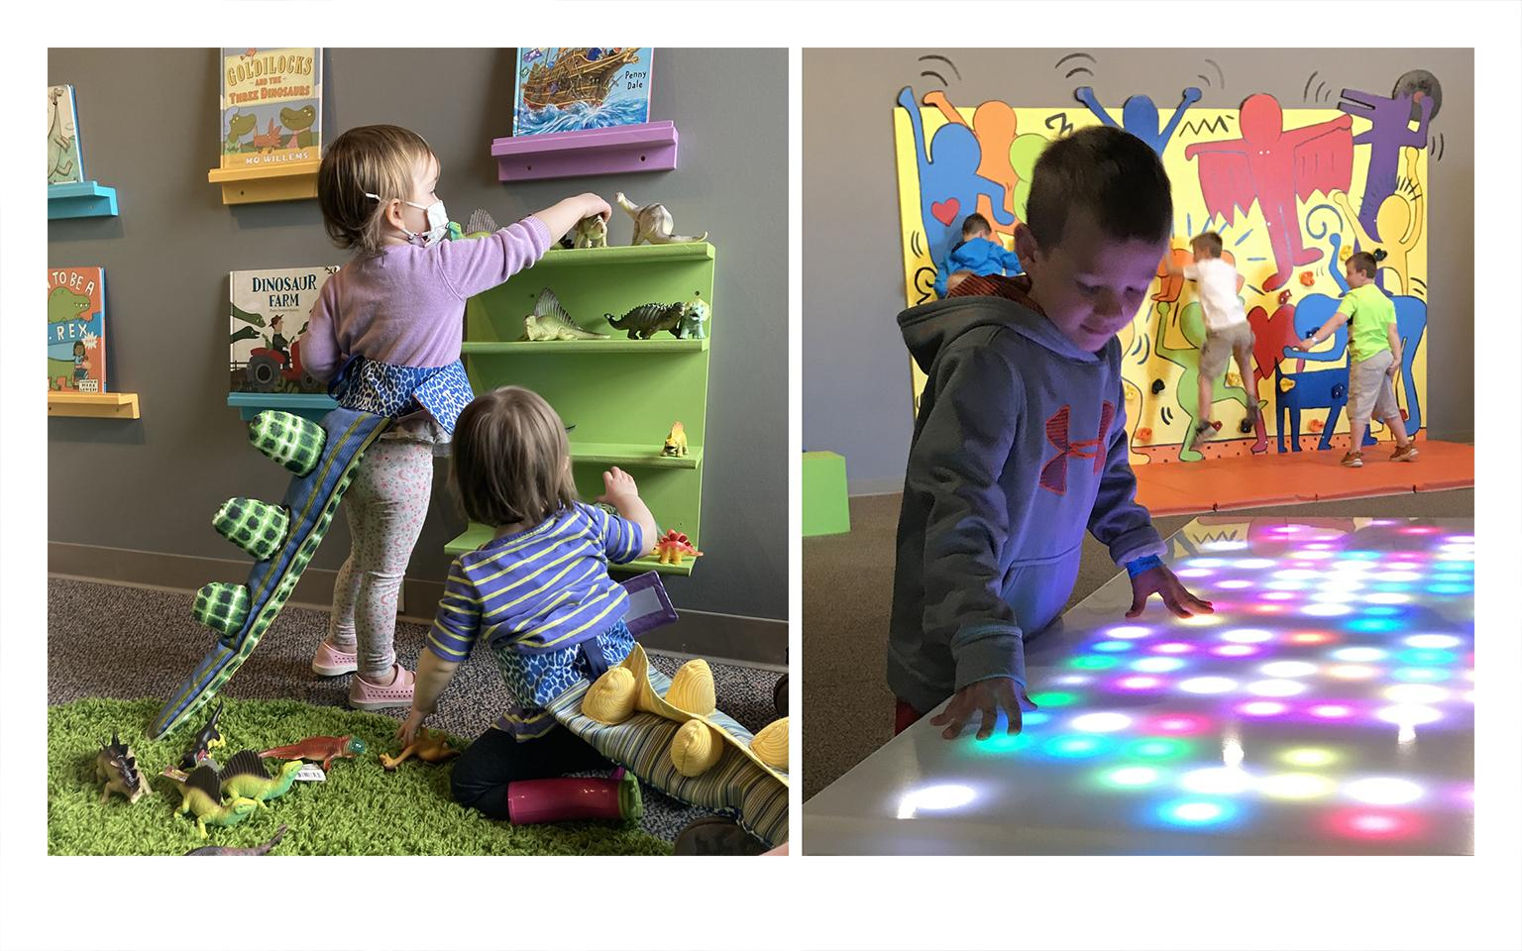

Slide 17
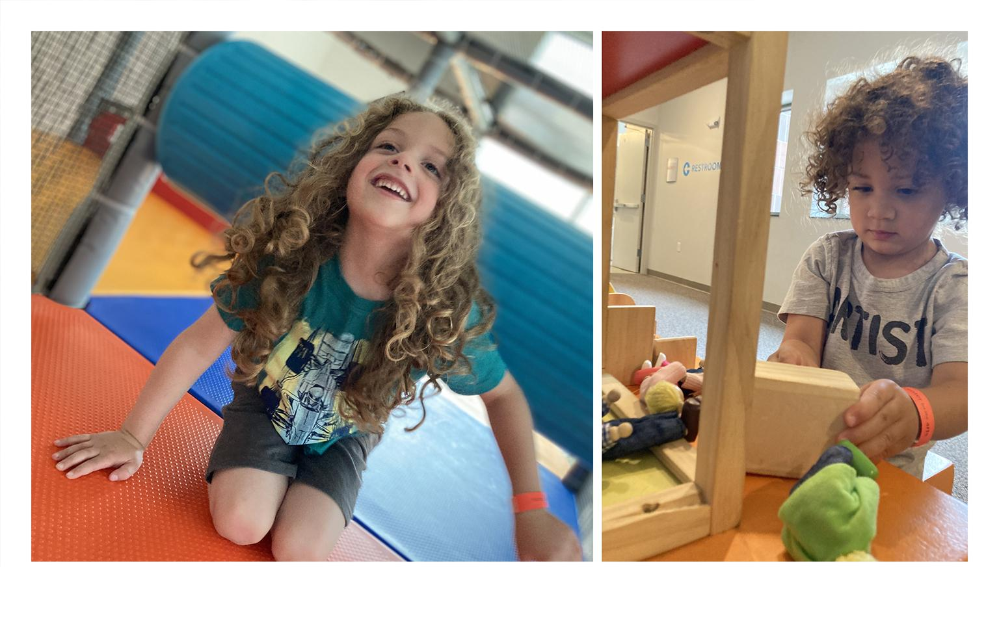

Slide 18
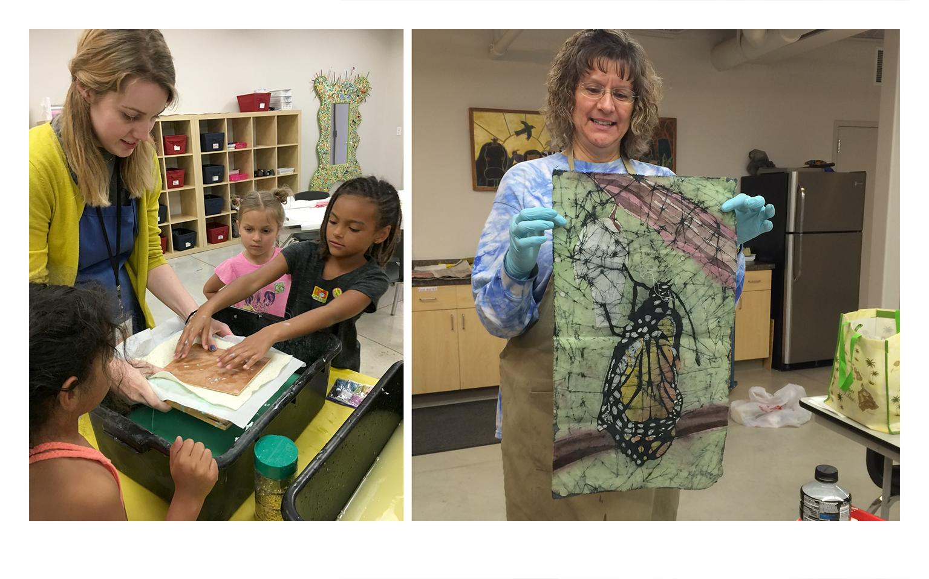

Slide 19
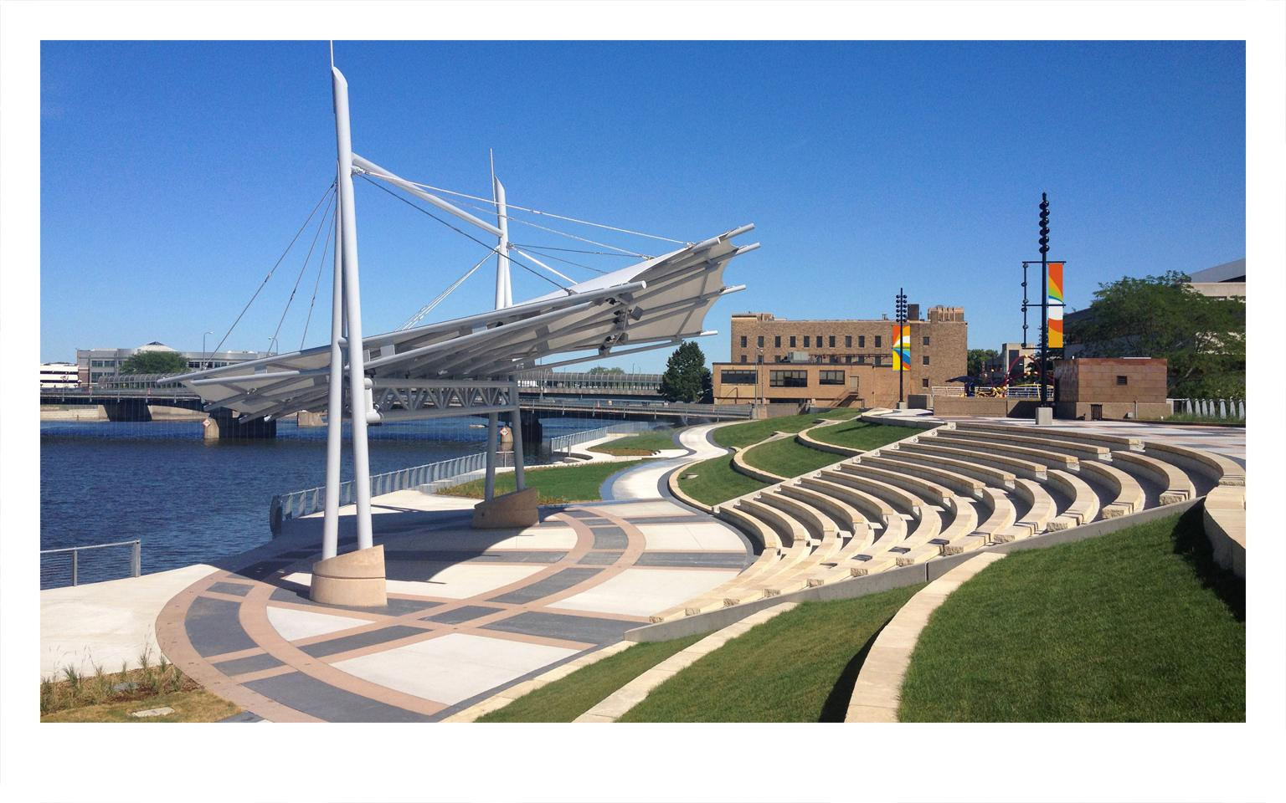

Slide 20
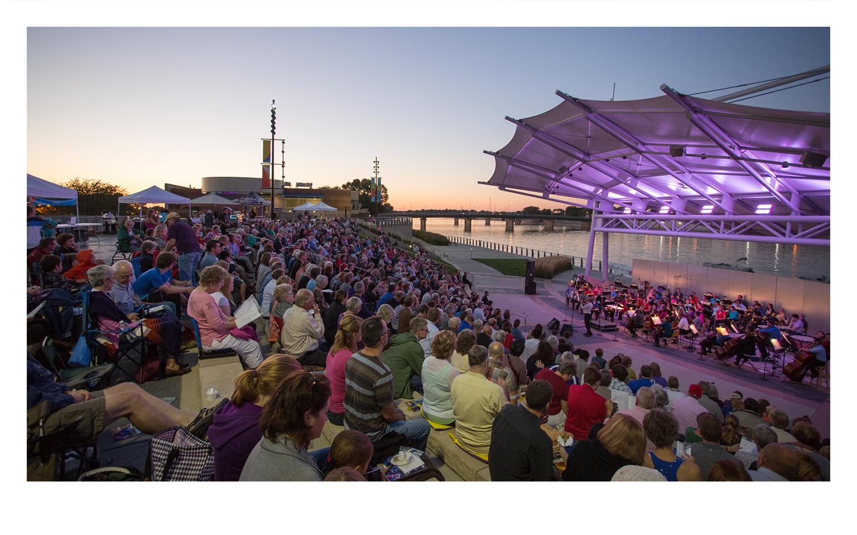

Slide 21
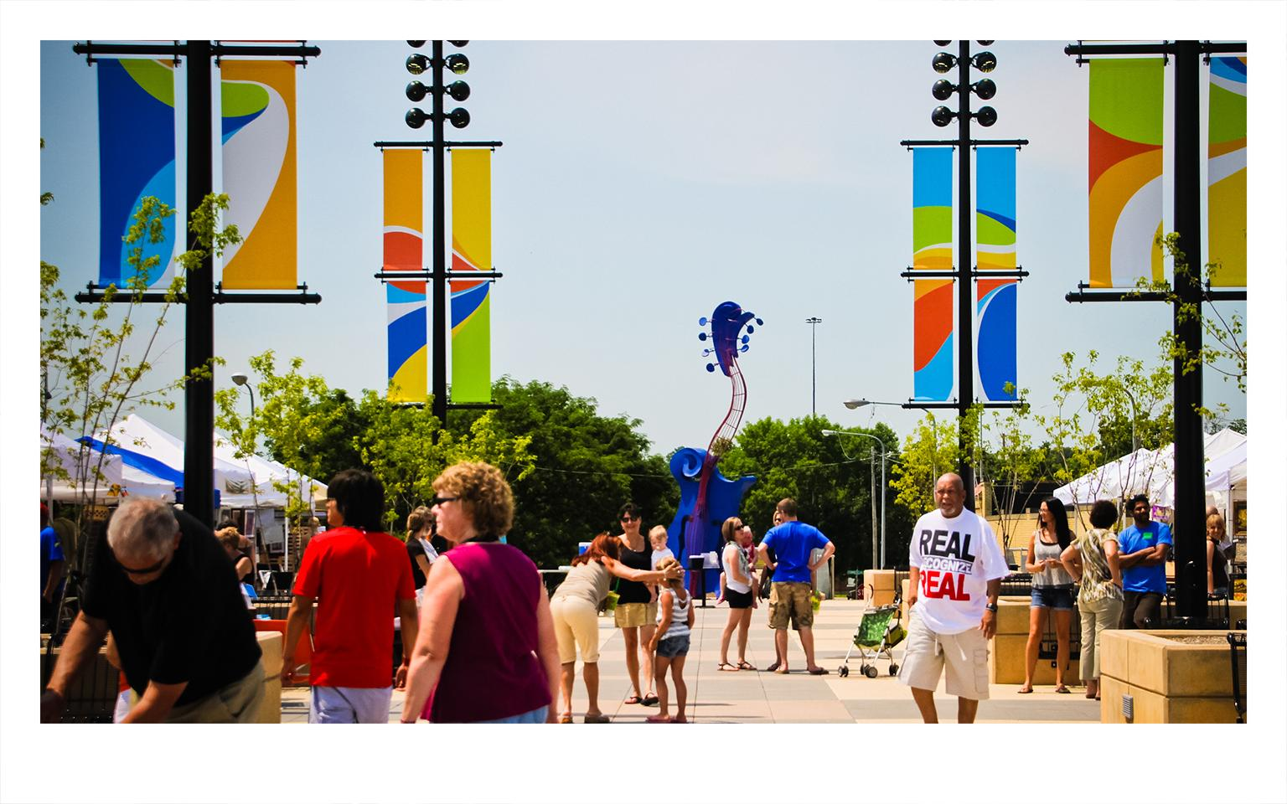

Slide 22
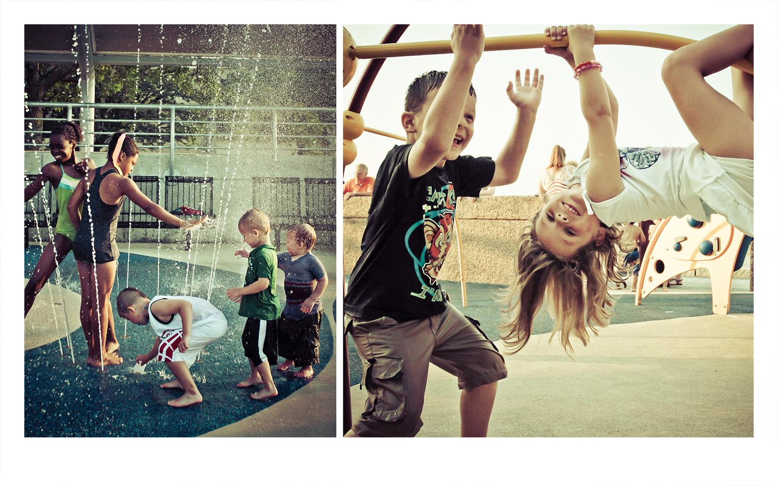

Slide 23
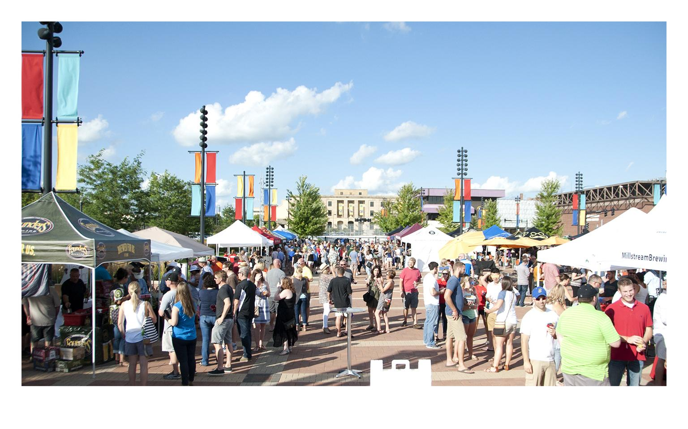

Slide 24
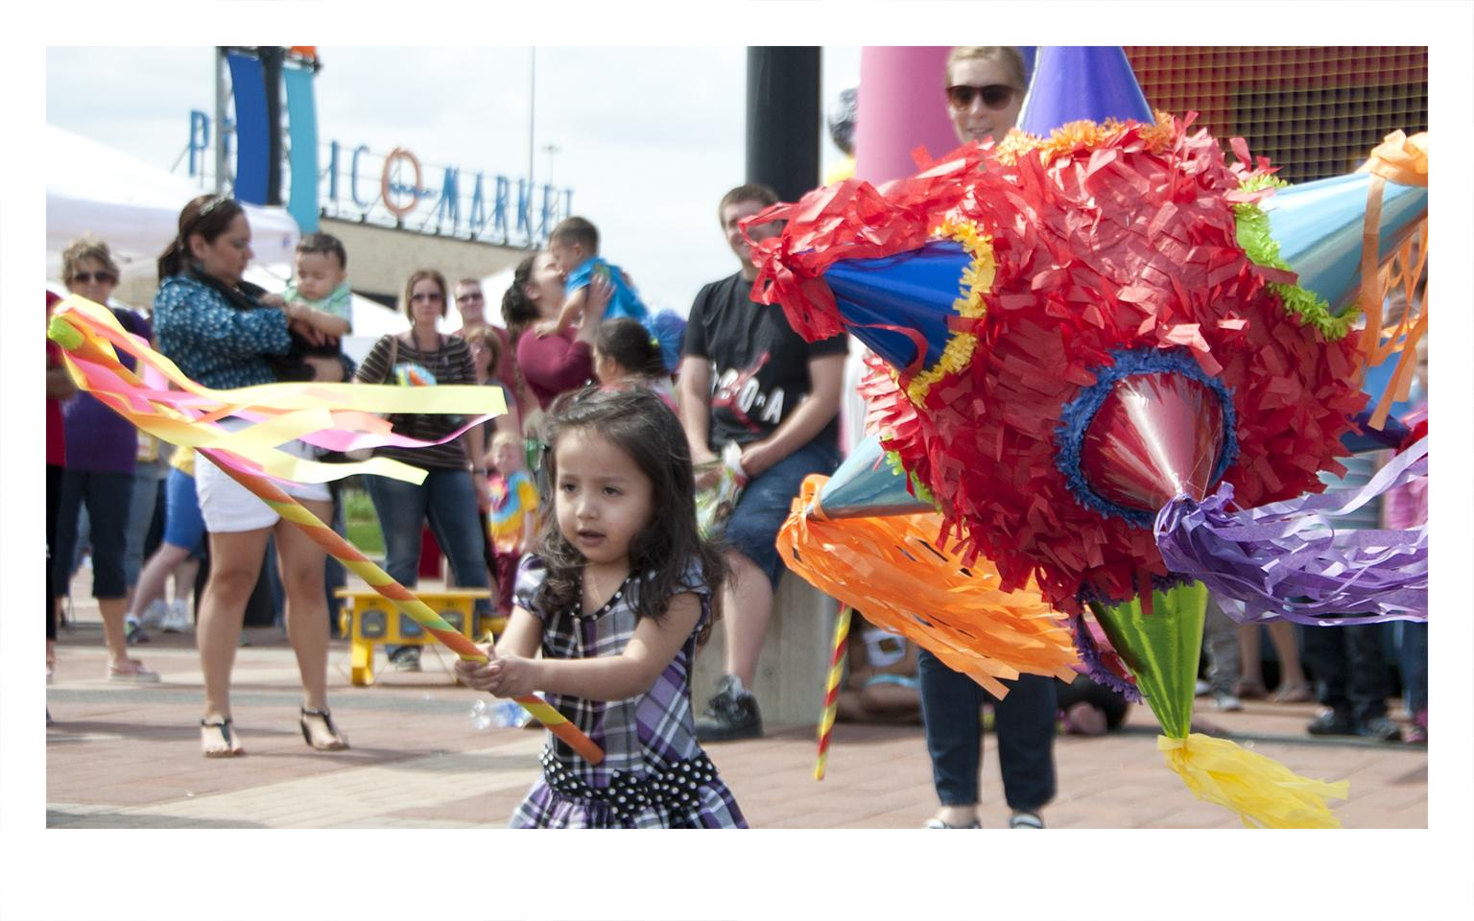

Slide 25
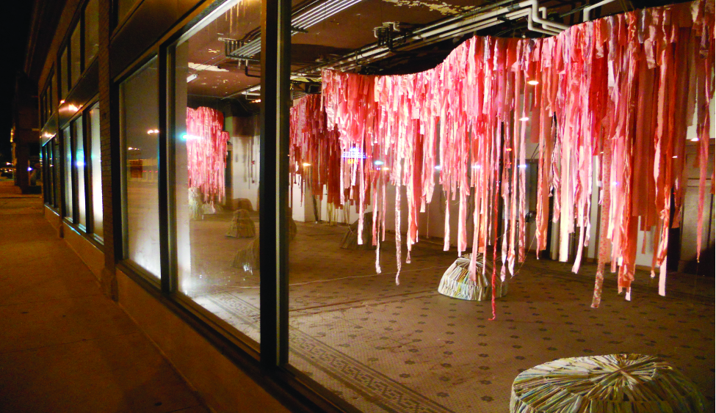

Slide 26
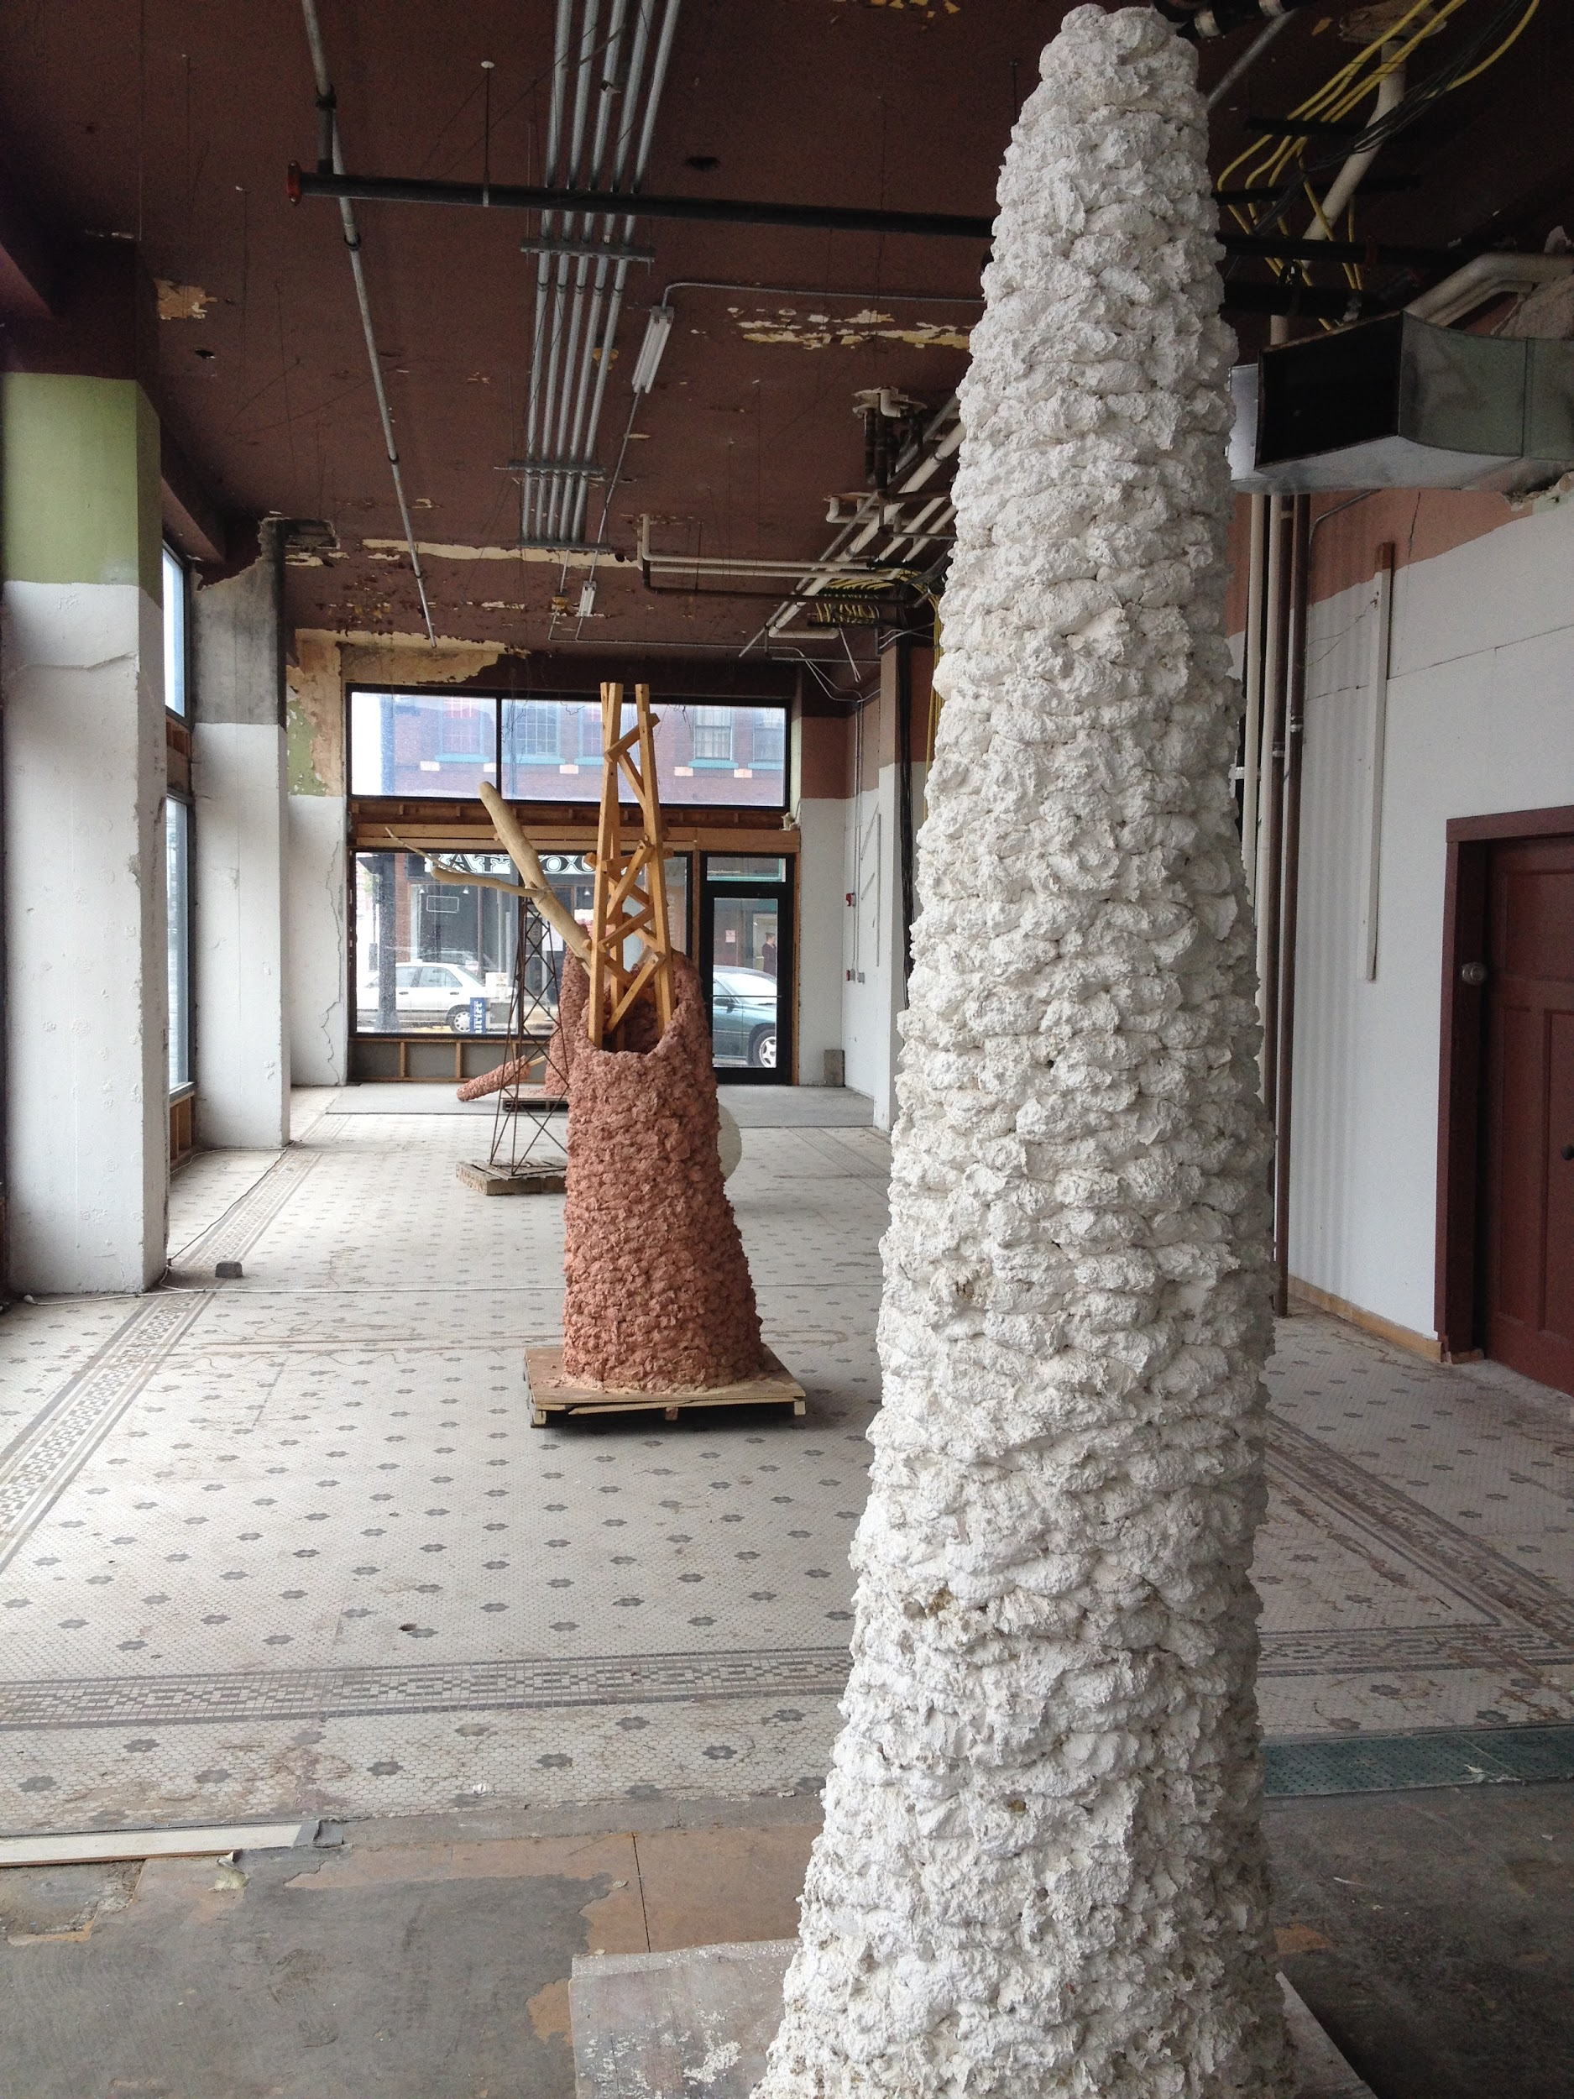
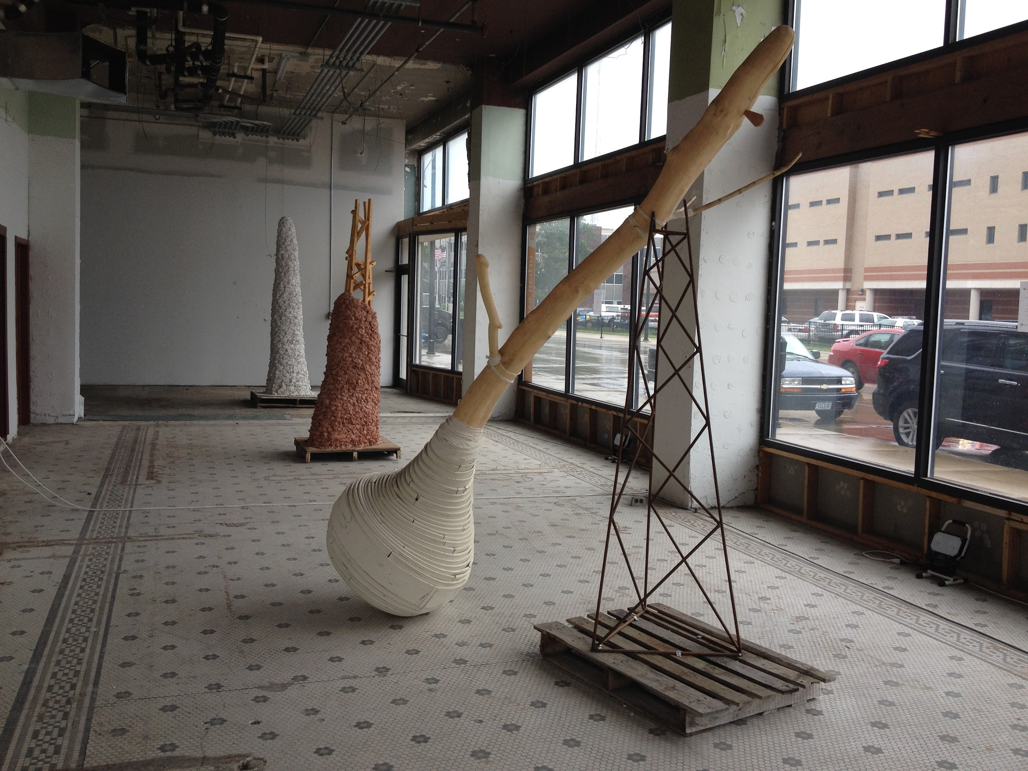

Slide 27
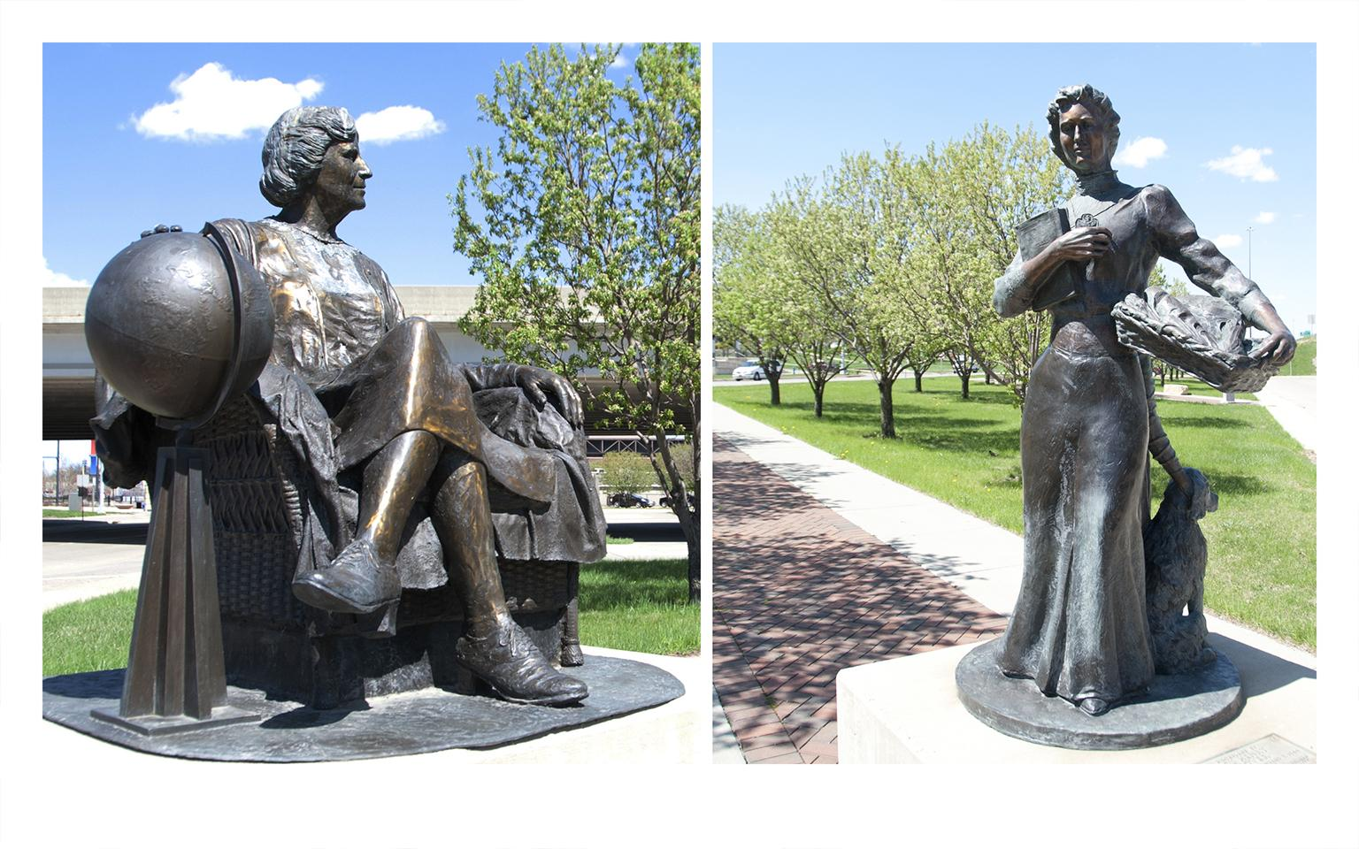

Slide 28
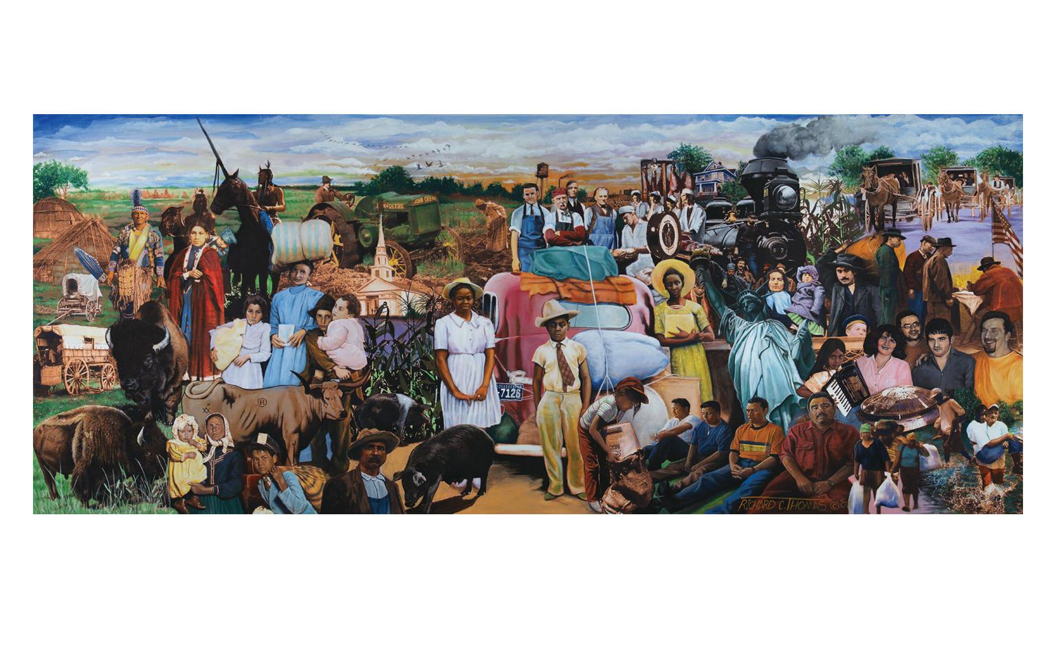

Slide 29
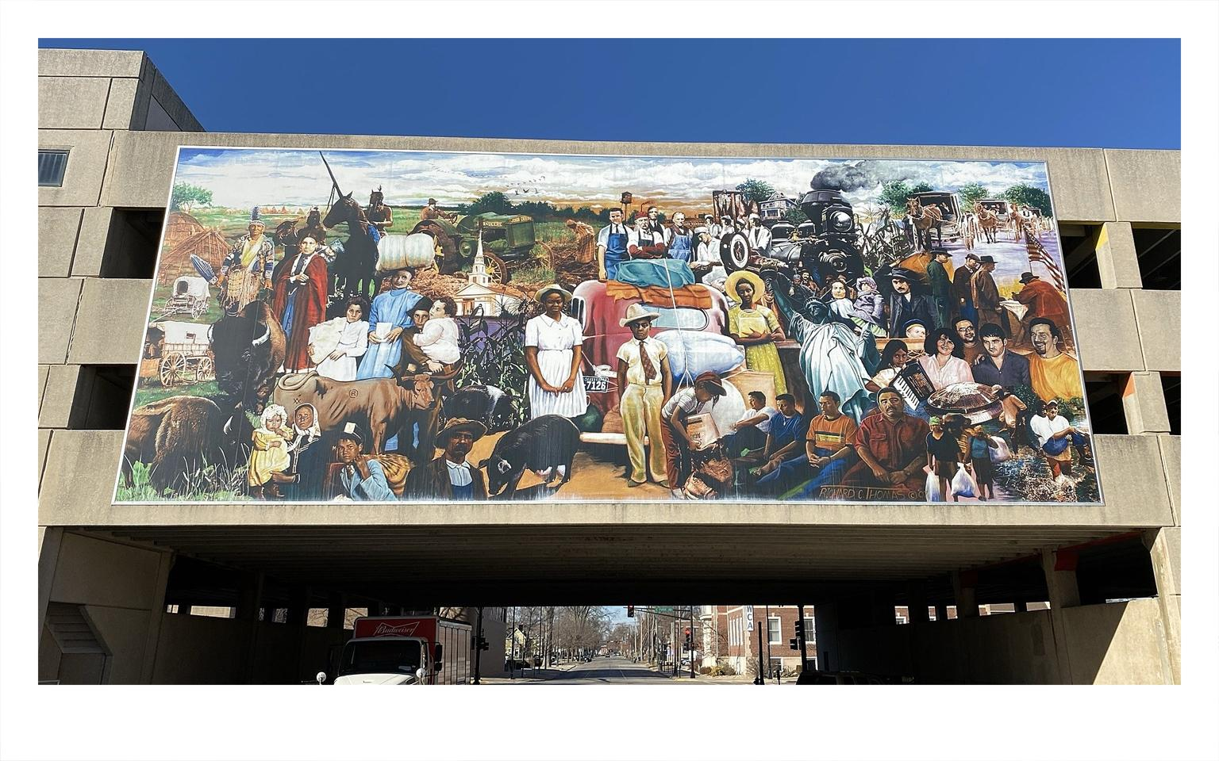

Slide 30
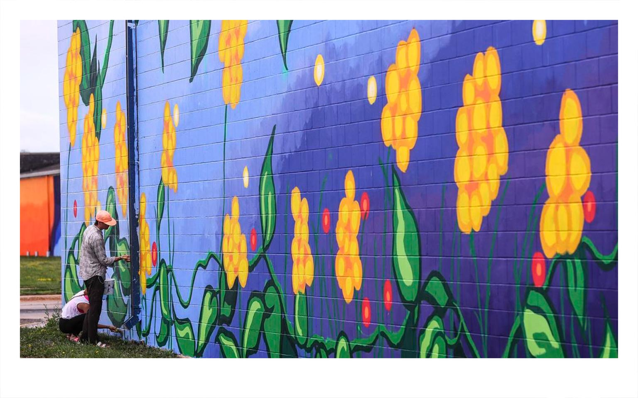

Slide 31
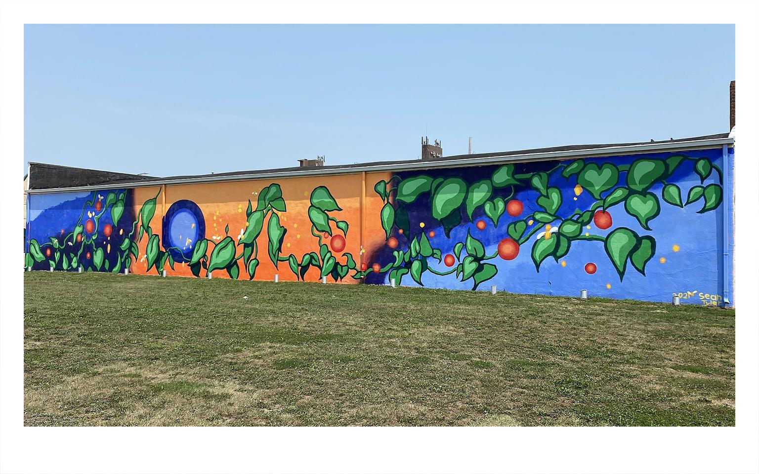

Slide 32
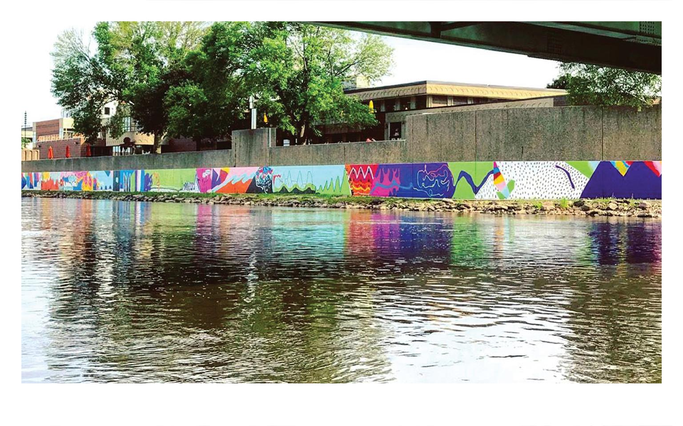

Slide 33

HEIDI FUCHTMAN
Youth Art Team
Founder / Executive & Creative Director

Slide 35
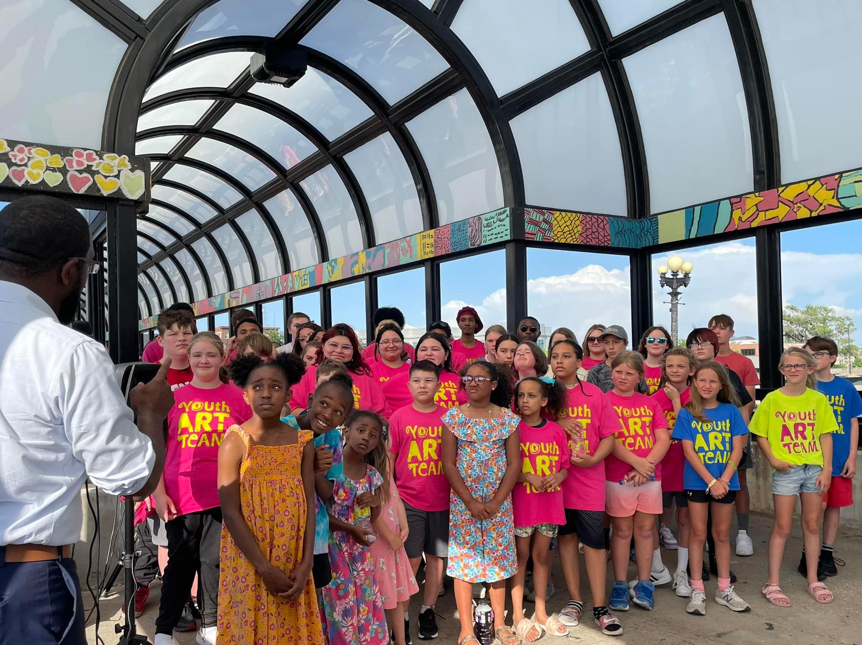

Slide 36
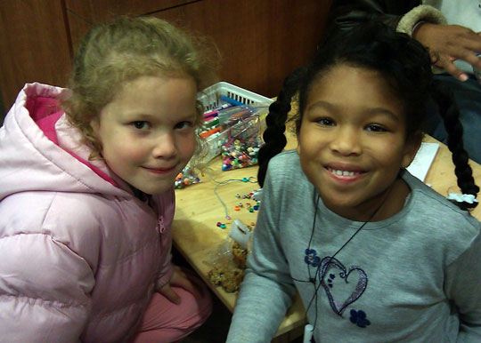

Slide 37
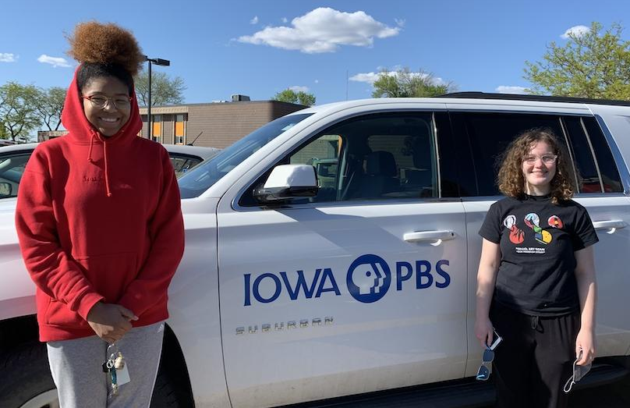

Slide 38
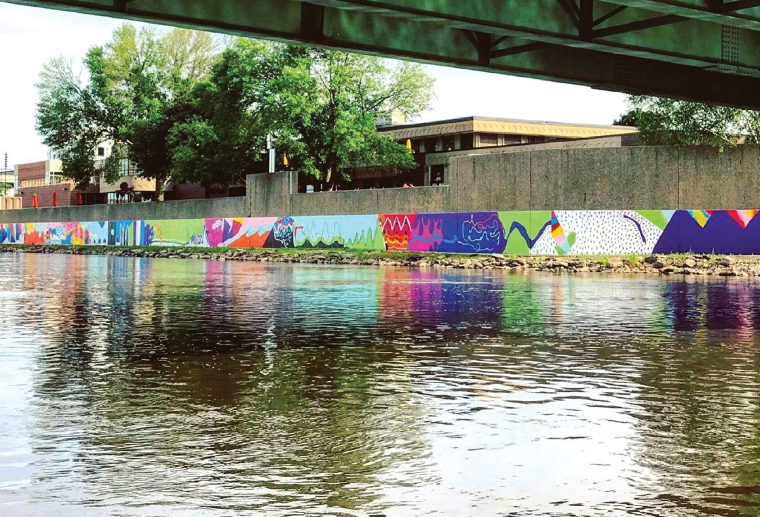
OUR FREEDOM STORY

Slide 39
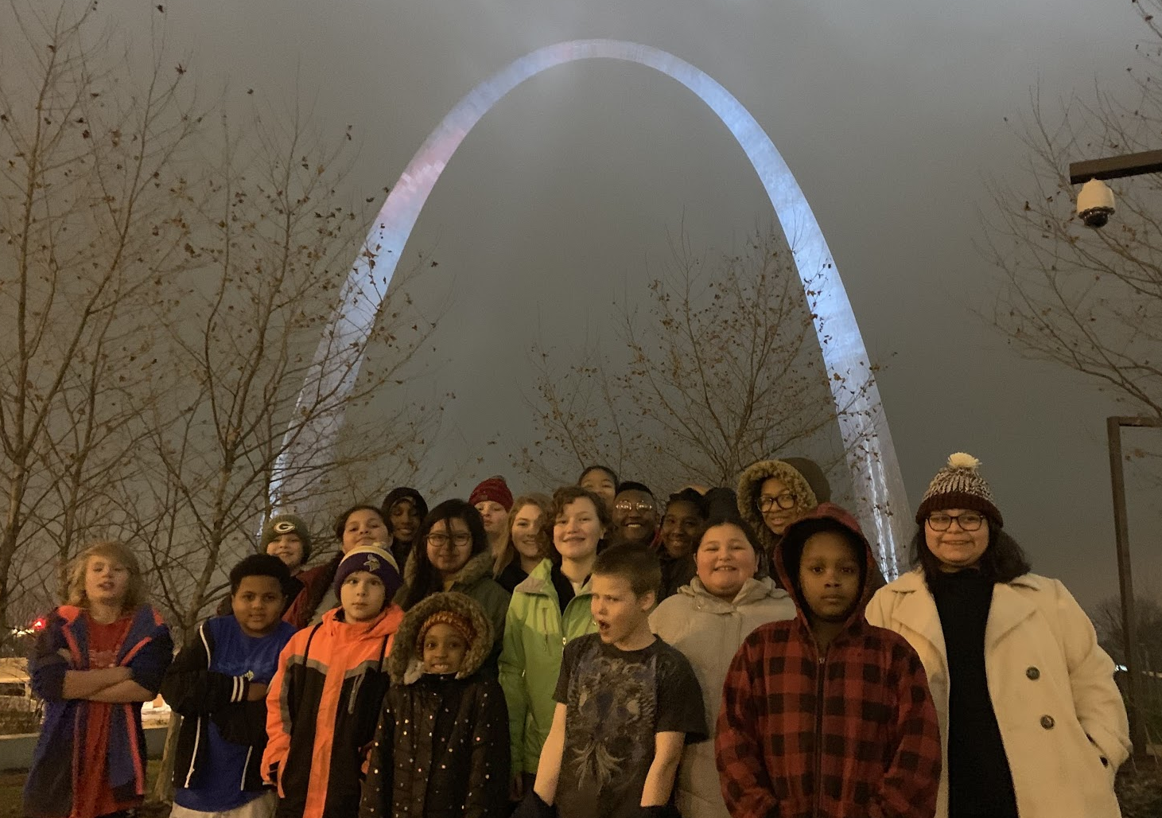

Slide 40
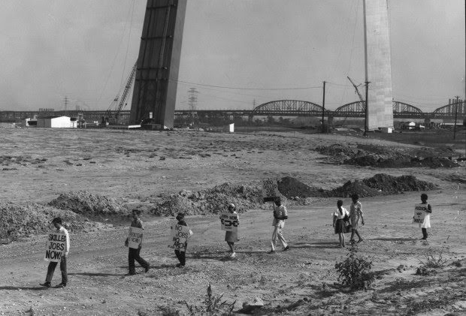
St. Louis Post-Dispatch file photo

Slide 41
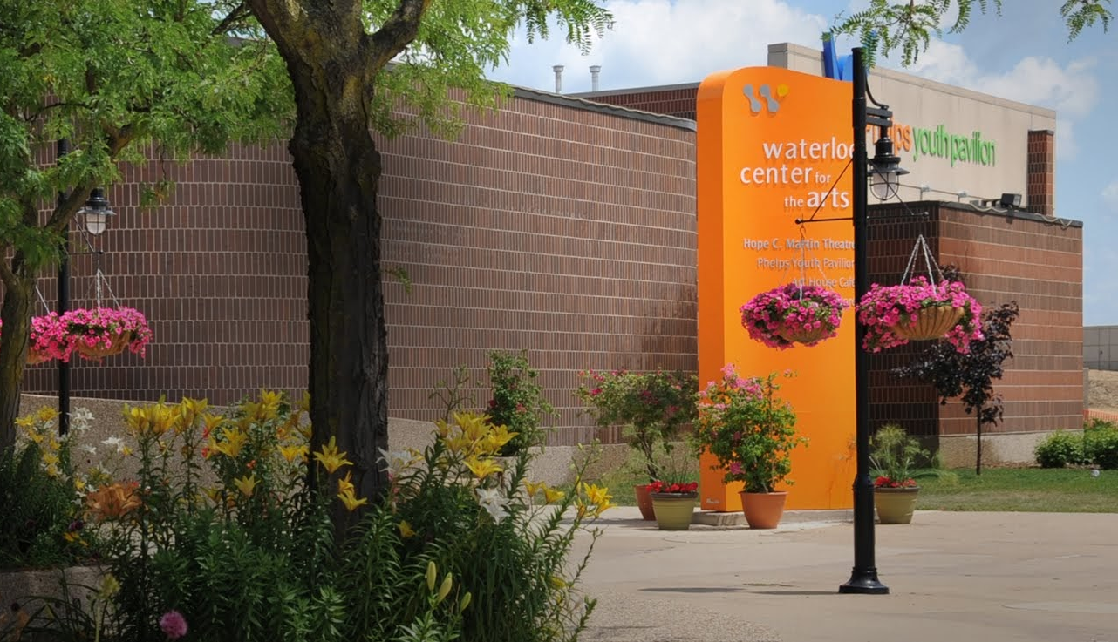
Waterloo Center for the Arts photo

Slide 42
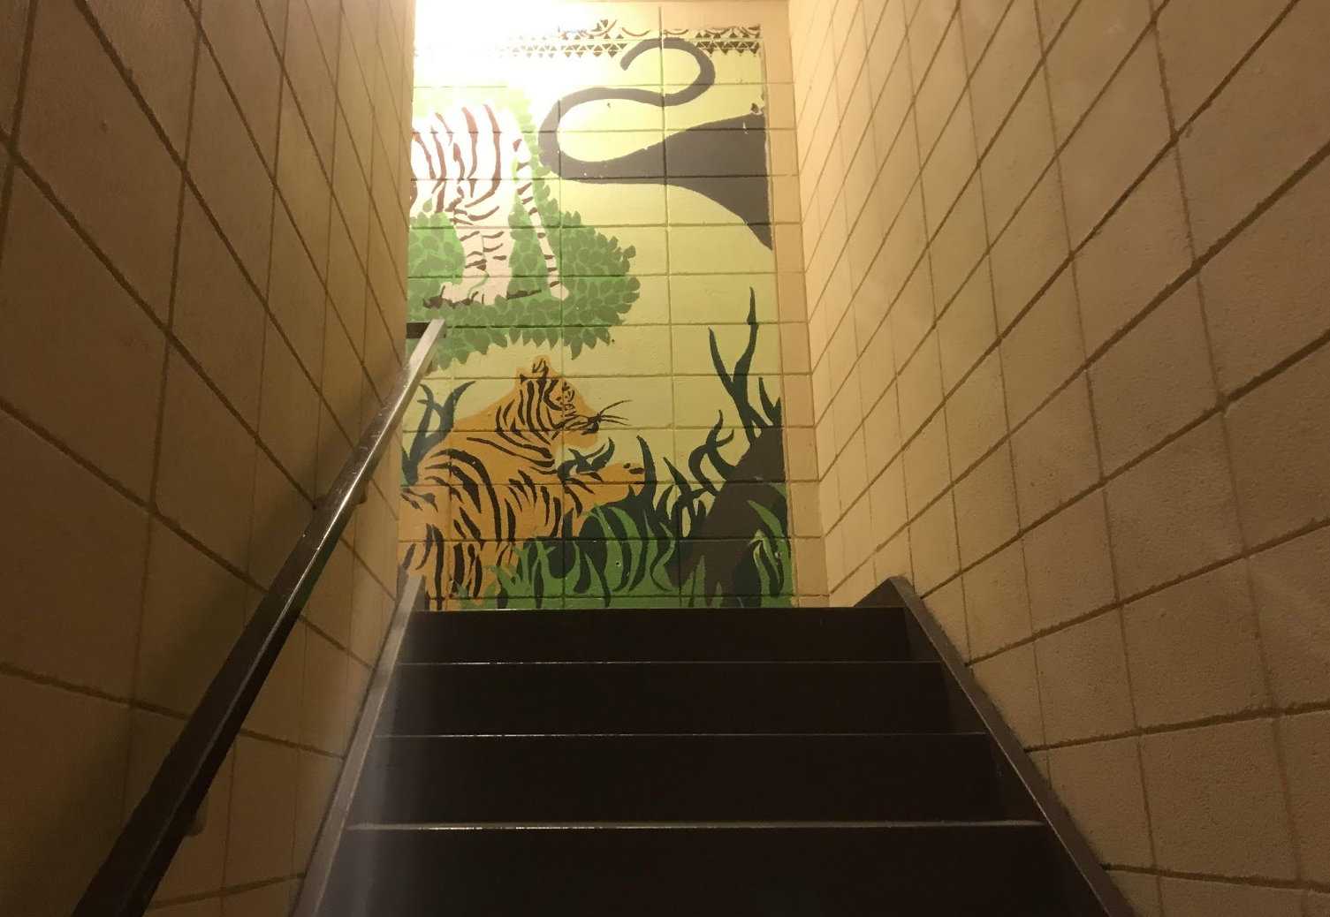

Slide 43
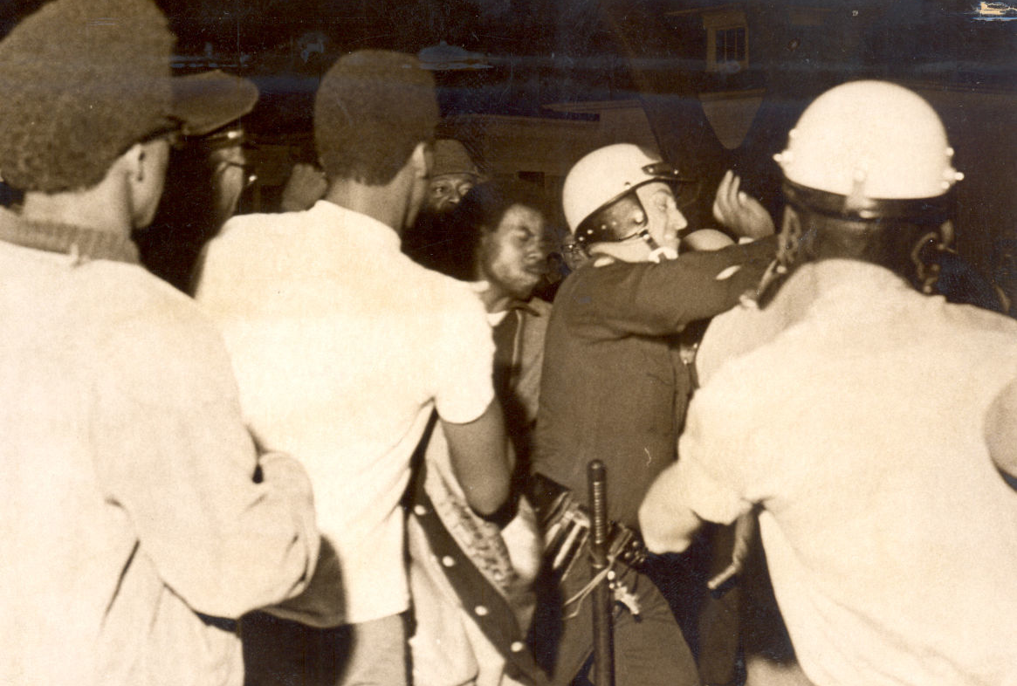
Waterloo-Cedar Falls Courier file photo

Slide 44
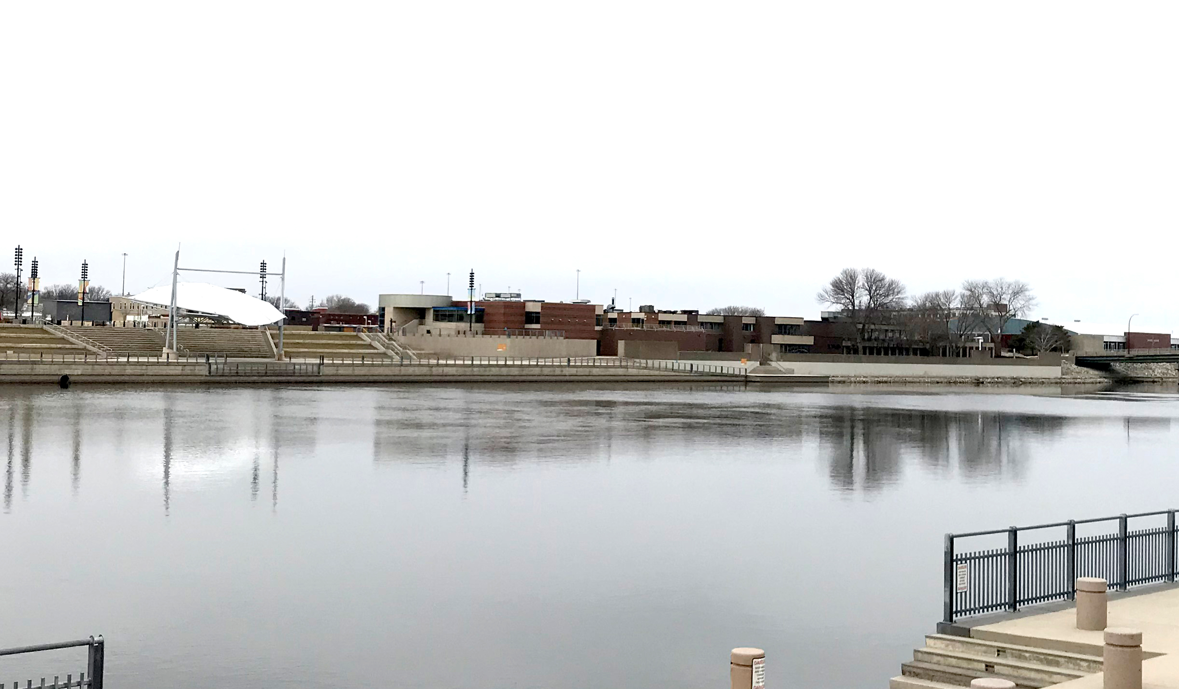

Slide 45
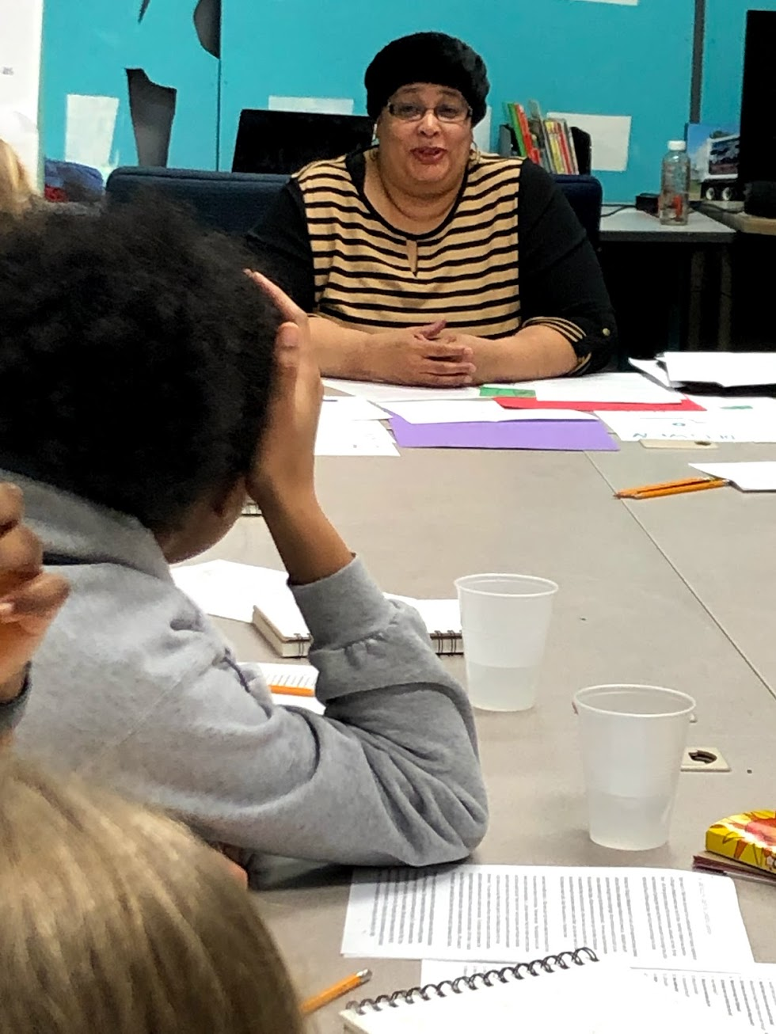

Slide 46
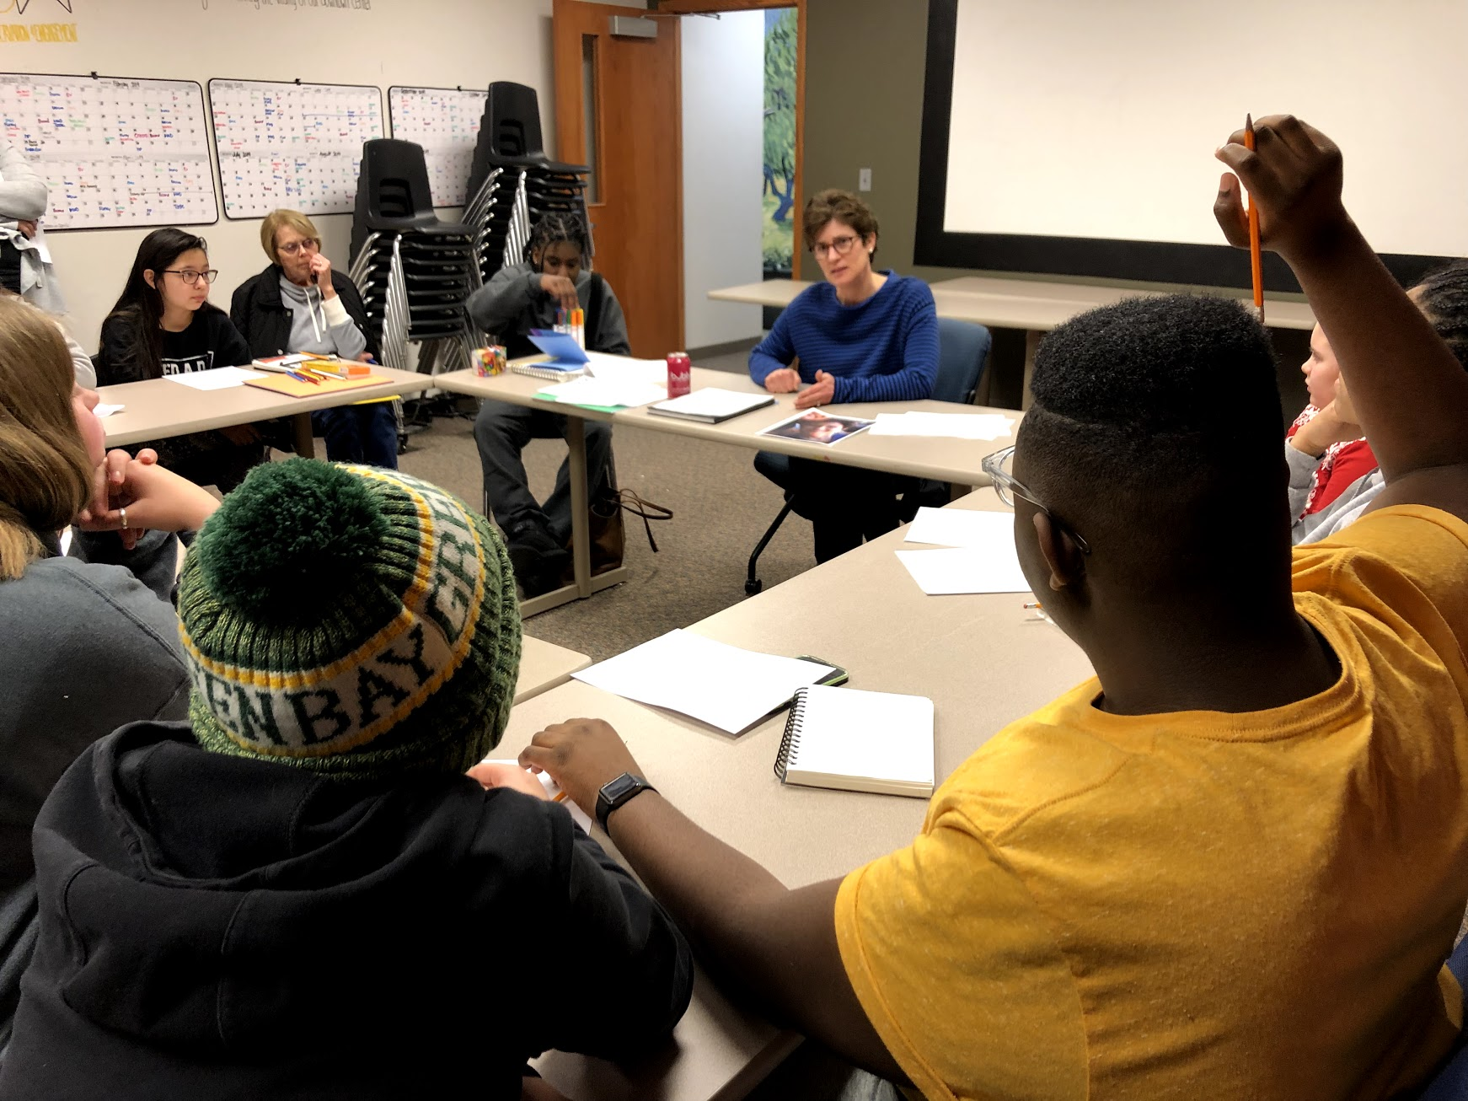

Slide 47
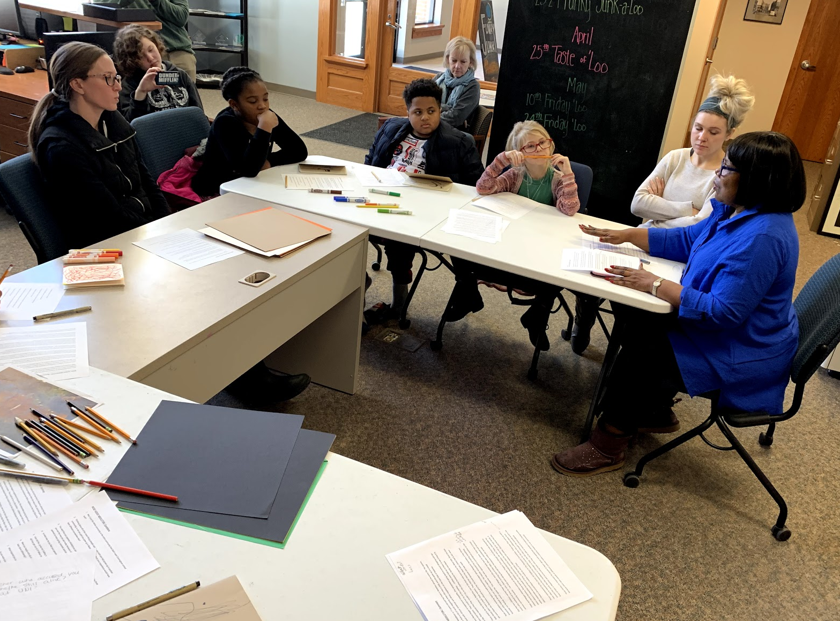

Slide 48
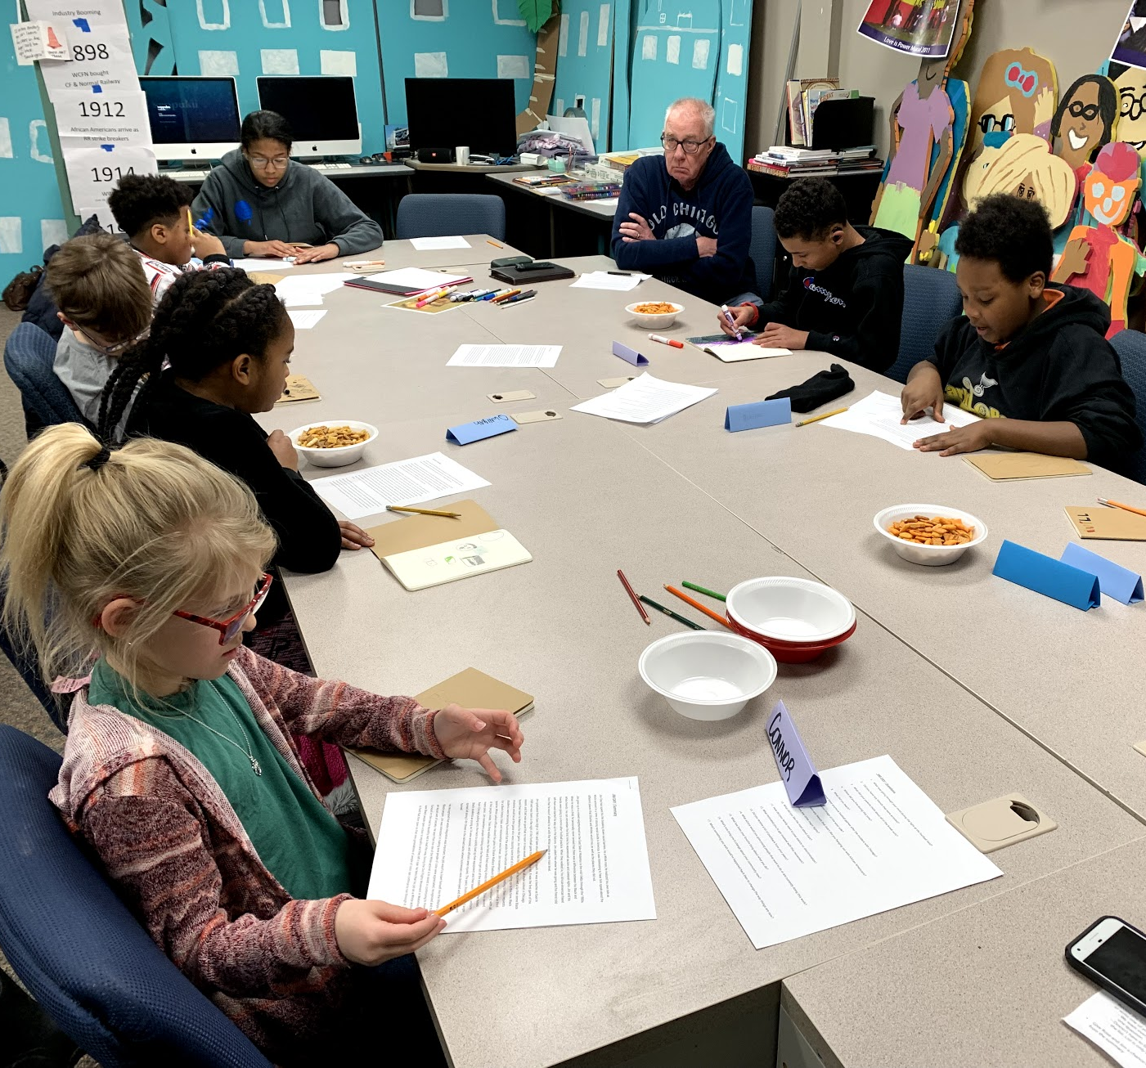
“Were you scared?”
“What was
school like?”
“What did it
feel like during
the fire?”

Slide 49
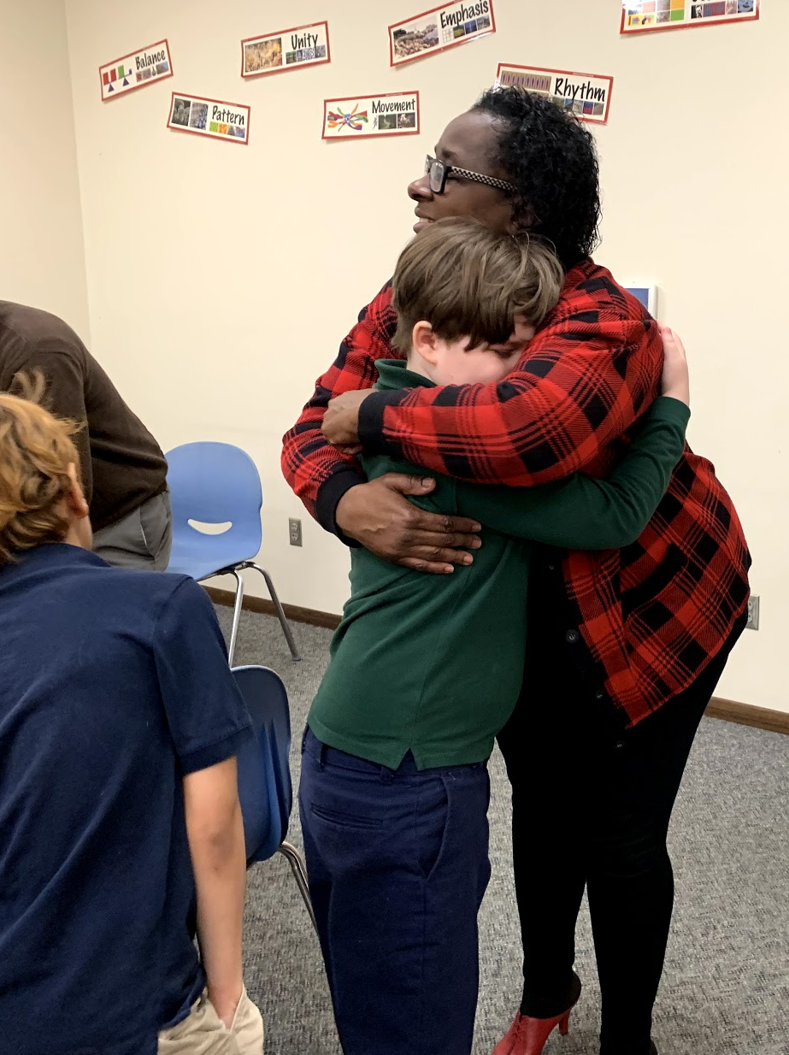
“Why did your dad go
to the sit-in?”
“How did you cope with
these tough times?”
“Did you ever feel like you didn’t want to do it anymore?”

Slide 50
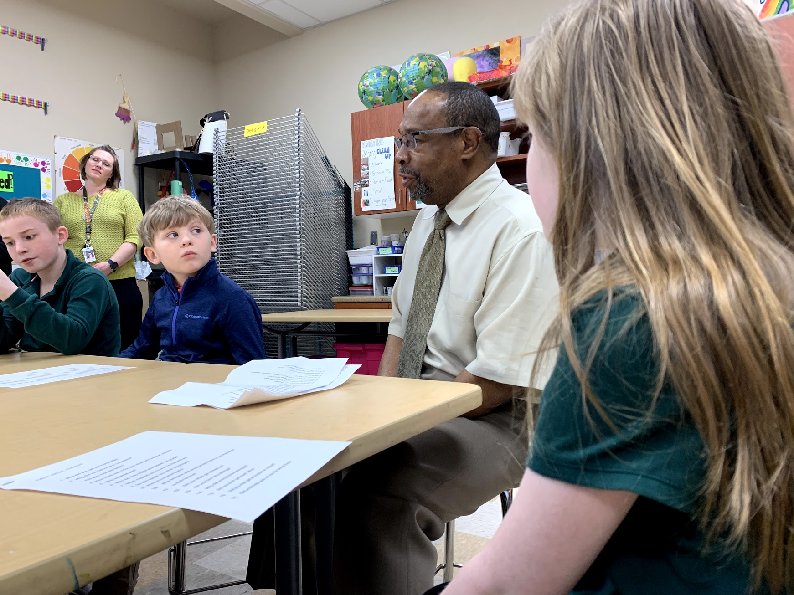

Slide 51
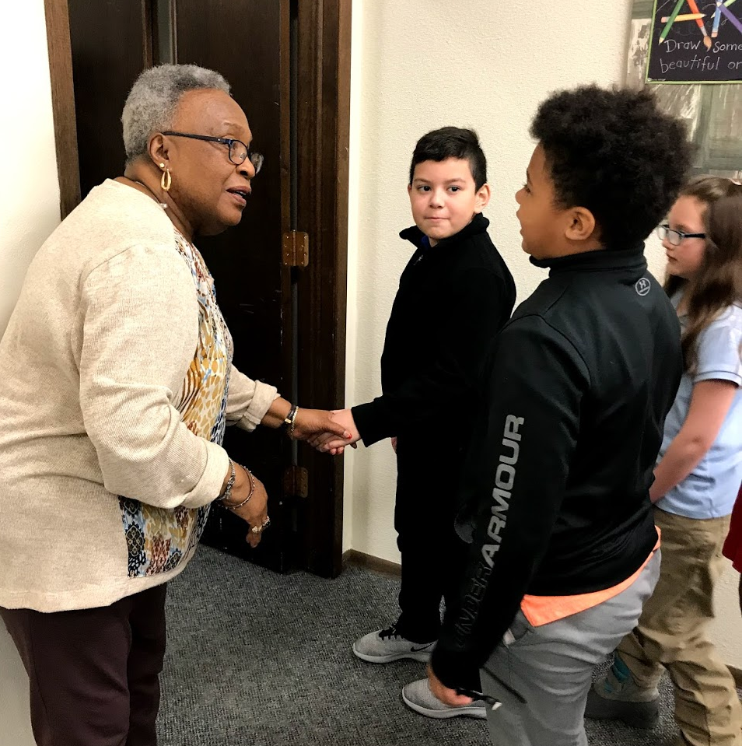

Slide 52
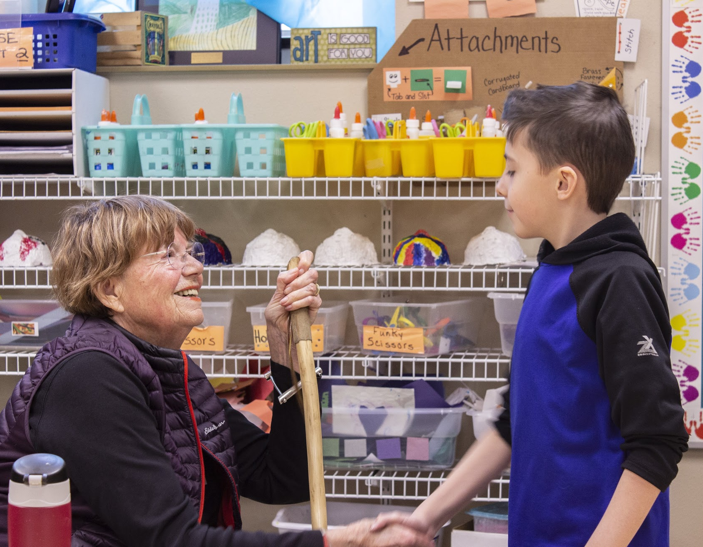

Slide 53
Then the 150 young artists who conducted the interviews tried to put themselves in the stories
they heard.

Slide 54
What words represent those feelings and traits?

Slide 55
What colors represent those words?
What kinds of lines can we draw
to show how a person feels?
What kind of shapes can we use?

Slide 56
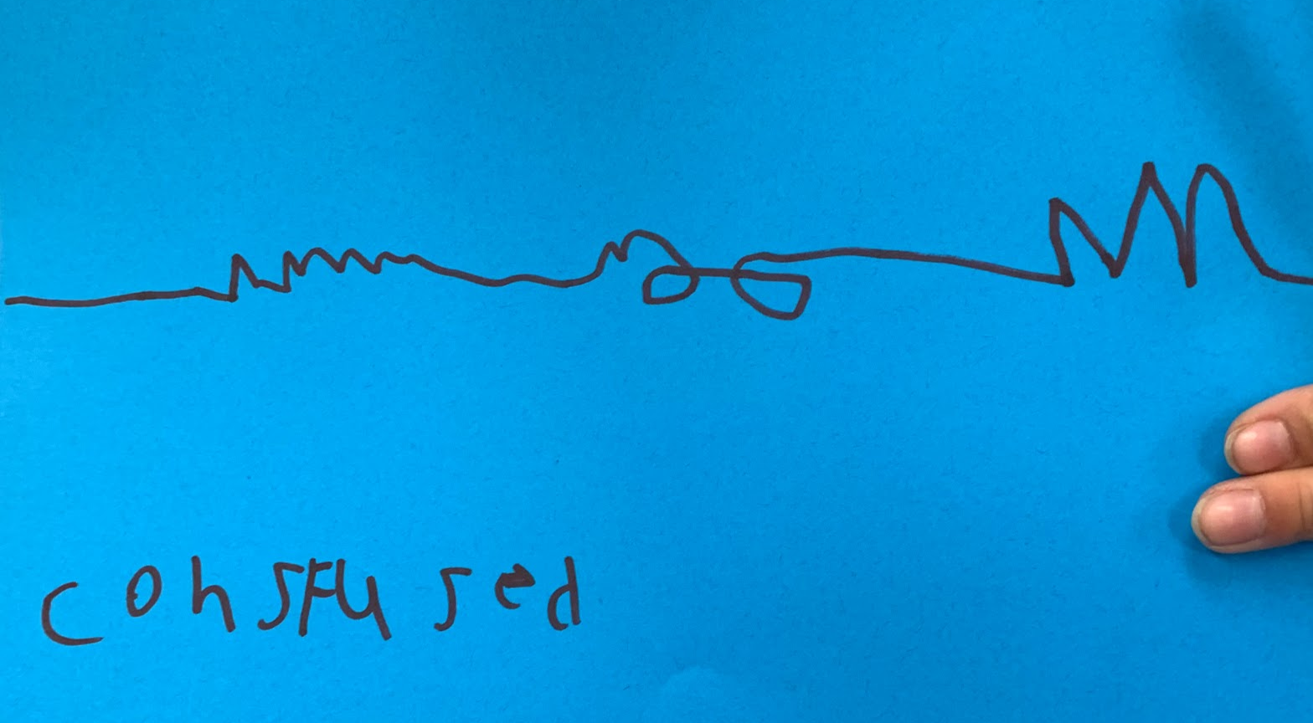

Slide 57
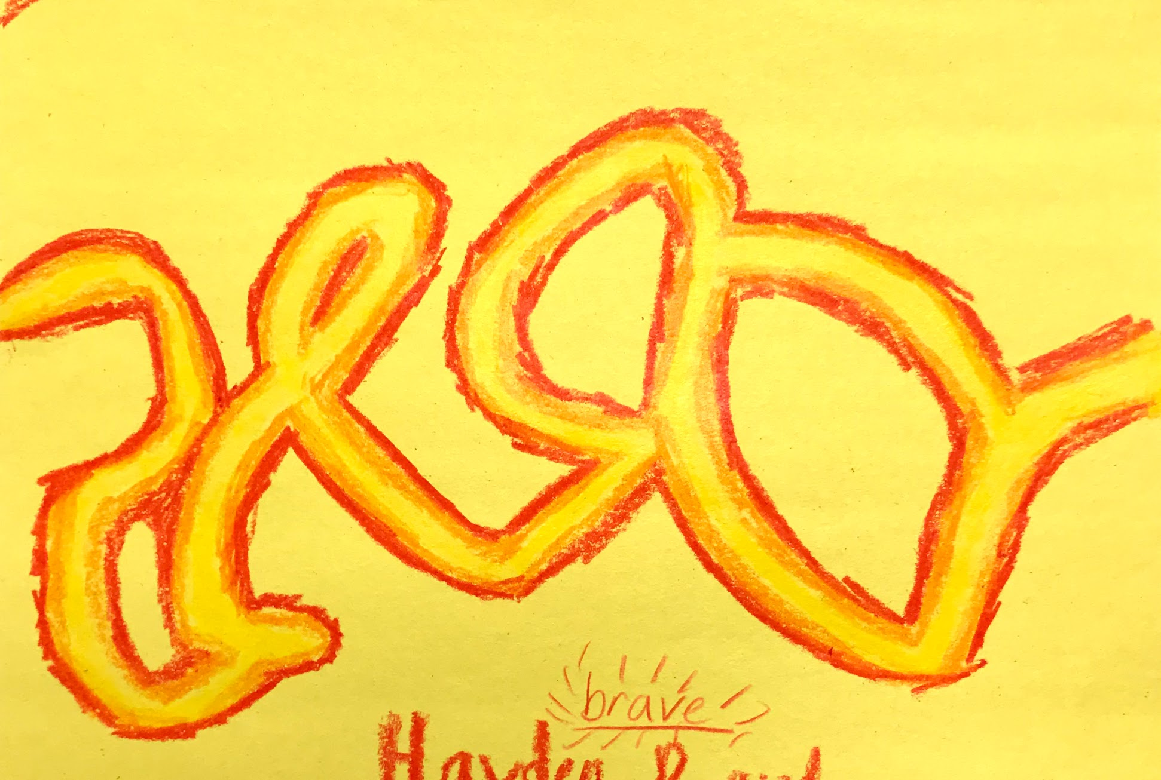

Slide 58


Slide 59


Slide 60


Slide 61


Slide 62


Slide 63


Slide 64


Slide 65

2019

Slide 66

2010

Slide 67


Slide 68

Lets make a 20’ post-it sculpture thats solar powered?

Slide 69
Creative place-making in urban centers
and rural communities

Slide 70

Can we connect the dots?

Slide 71
CHAWNE PAIGE
waterloocenterforthearts.org
HEIDI FUCHTMAN
youthartteam.com
JON BERG
iowaculture.gov/arts.com

